Slide 1
Laboratories & Educators Alliance Program
Henry Maynard

Slide 3
Questions
How can we foster the development of collaborative relationships between forensic science labs and academia?
How can academia help forensic science labs?
How can students learn about internship opportunities?
Is there one place to learn about the lab’s research interests, academic researchers’ forensic projects, and internship opportunities?

Slide 5
Where can I find out more?
ASCLD’s Forensic Research Committee Page
https://www.ascld.org/forensic-research-committee/
Additional Information available on that page:
ASCLD’s Research Needs List – which helps identify the research areas that are most impactful for Laboratory Directors
Research Resources List – which helps identify topic areas of interest related to forensic science research

Slide 6
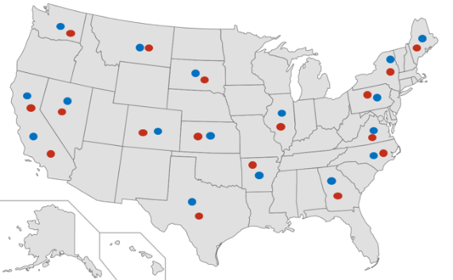
ASCLD FRC Research Needs
1.
2.
3.
4.
5.
6.
7.
8.
9.
10.
Webinars
Last Quarter’s Recorded Webinar
Title, Presenter
Next Quarter’s Webinar
Title, Presenter, Date and Time
Research in the Lab
List of active evaluation efforts.
List of research projects within ASCLD labs.
Interested in a research partnership with a University? Want to host an intern?

Slide 7
Lab Interested in Signing Up?
University Interested in Signing Up?

Slide 8
LEAP is new and has only launched recently…
72 LEAP Participating Labs and Universities (as of January 2019)
21 Forensic Science Labs
51 Universities
Outreach efforts will now be taking place to socialize LEAP which will greatly increase the number of participating labs and universities.
We expect that this program will grow fast!

Slide 9
70 US LEAP Participating Labs and Universities – January 2019

Slide 10
72 World LEAP Participating Labs and Universities – January 2019

Slide 11
Future
With more participating labs and universities:
We can begin to coordinate large, comprehensive evaluation efforts and inter-laboratory studies
As well as establish meaningful collaborations to support forensic science research projects
Please sign up today!

Slide 12
Thank you!
Questions: FRC@ascld.org

