Slide 1
Forensic Science as Technical intelligence
Michael P. Garvey, Jr, PhD
Director, Office of Forensic Science
Philadelphia Police Department

Slide 2
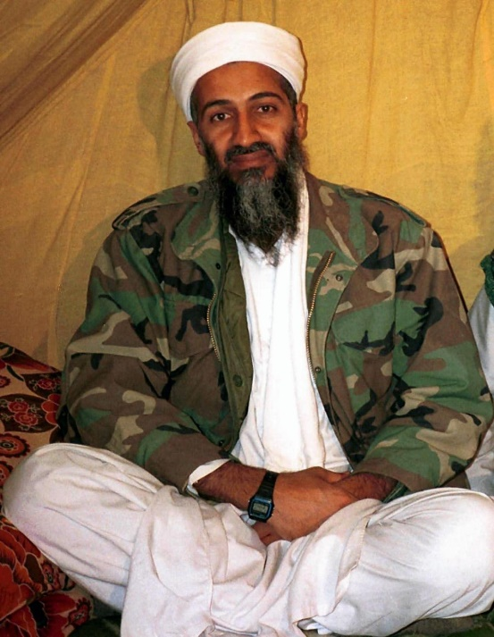
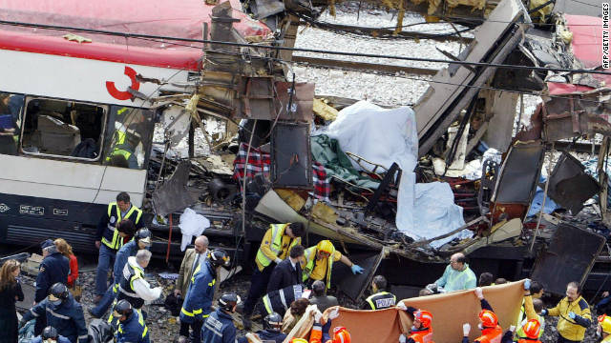
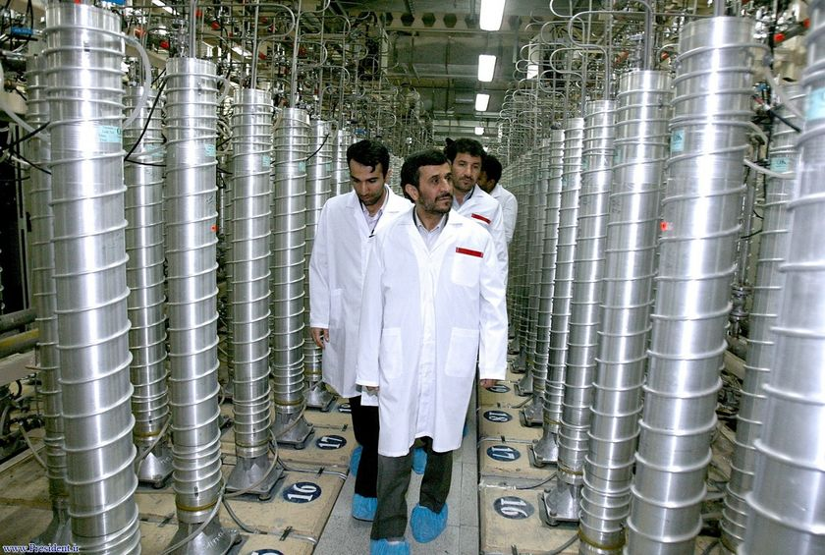


Intelligence = Operations = Intelligence
Counterterrorism
Counterproliferation
Counterintelligence & Cyber
Counternarcotics
Notes:
Slide 2: Intelligence and operations drive each other. Only when we have this connection between the two do we see the amazing outcomes such as the targeting of HVT1 (UBL). The concept of linking intelligence and operations has further applications than just Counterterrorism. While not all inclusive, it can also be applied to Counterproliferation, Counternarcotics, Counterintelligence/Cyber.
CT: targeting UBL, CT attacks
CN: A poppy field in Afghanistan which can lead to drug trafficking in other countries such as Mexico, Columbia. Drug Trafficking results in socio-economic problems and also may destabilize a nation or result in huge political consequences.
CI/Cyber: Attacks can range from those targeted at gathering counterintelligence against a gov’t to economic espionage such as stealing technology to cyber crime for greed.
THIS IS THE WORLD OF MODERN FOREIGN INTELLIGENCE.

Slide 3
Intelligence Cycle
Human
Intelligence
(HUMINT)
Technical
Intelligence
(TECHINT)
Signals
Intelligence
(SIGINT)
Materials and
Signatures
Intelligence
(MASINT)
Imagery
Intelligence
(IMINT)
Open Source
Intelligence
(OSINT)
Notes:
Slide 10: Intelligence Cycle
Set requirements, gather info/intel, analyze the information, disseminate intel to support of operations.

Slide 4
Law Enforcement: TechINT
Forensic Science is still, too often, viewed as a trial tool that isn’t nimble enough for real actionable intelligence…
Too Slow
Too Expensive
Too Restricted

Slide 5

Start somewhere and grow…

Slide 6
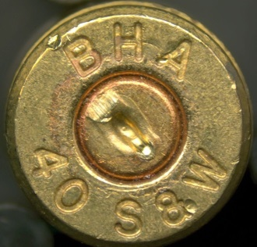
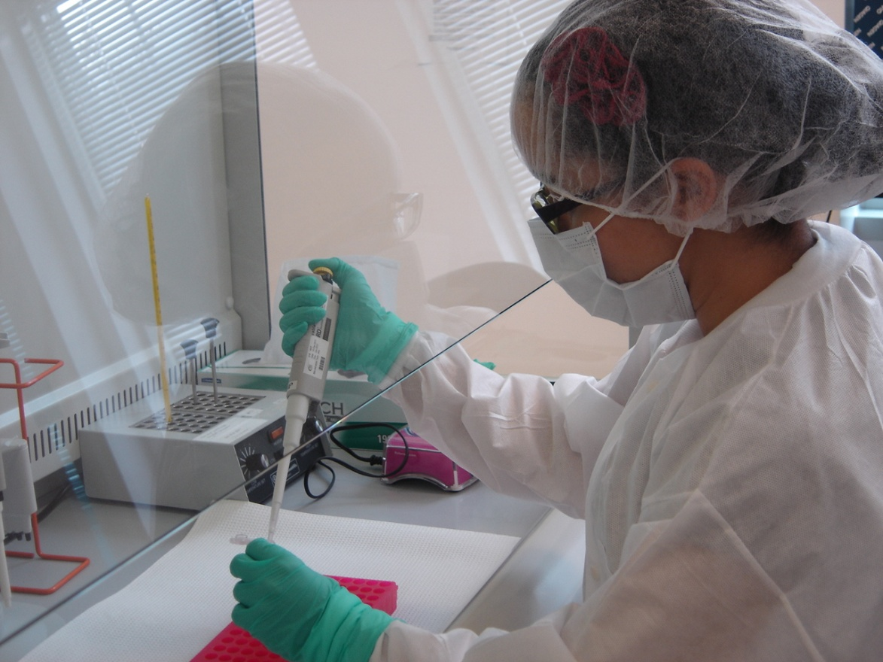
Forensic Data
DNA
  Convicted Offenders
  Arrestees
  Evidence
  Rapid DNA – future?
Firearms
  NIBN
    Uploaded quickly
    Results reported
    Detectives taught on what to do
  Serial #s, all searched
  Recovered serial numbers
    Search partials

Slide 7
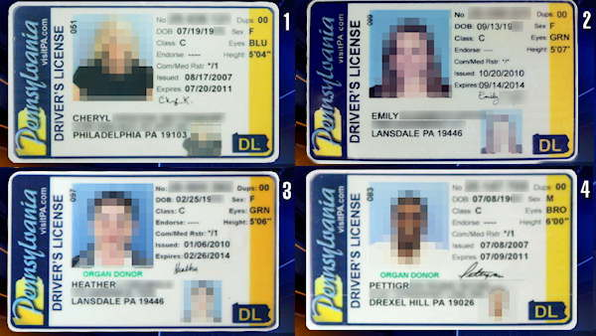
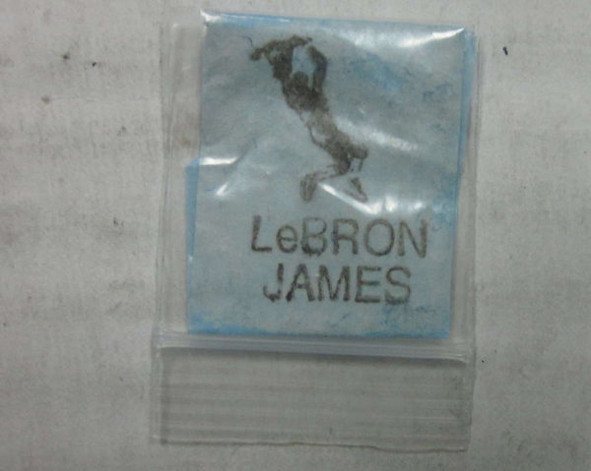
Forensic Data
Documents
  Serial bank robberies
    Inter-compare notes
Counterfeit IDs, etc
    Share with partner agencies
Drug Chemistry
  Trends: distribution, synthetic compounds, additives, LOGOS, etc.
  Share info with partner agencies

Slide 8
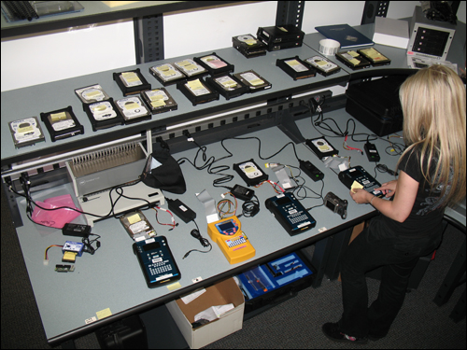
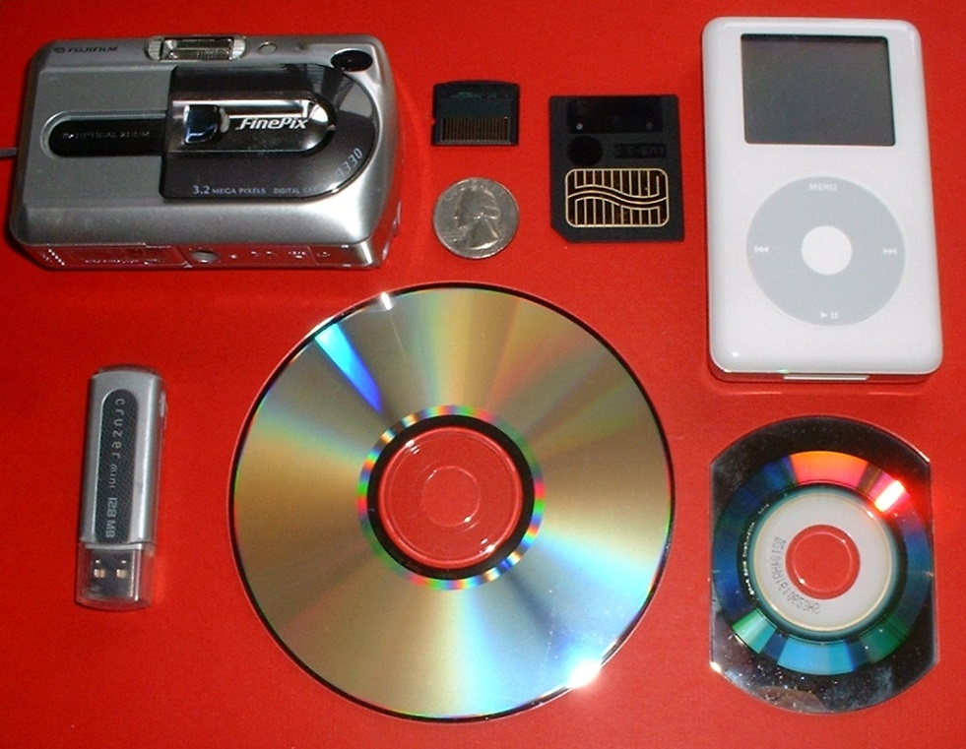
Forensic Data: Computer/Digital
It’s everywhere…

Slide 9

Putting it all together…

Slide 10

Is this the job of a forensic scientist?
We’re already too busy.
We’re scientists not investigators.
What about independence?
What about bias?
It’s not my job…

Slide 11
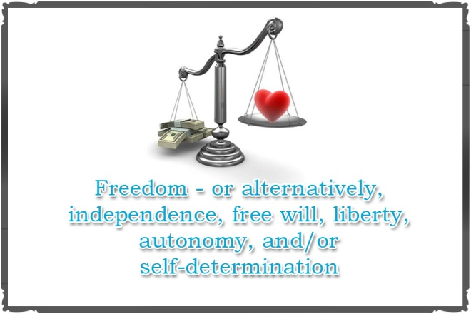
Forensic Scientists
Science applied to criminal investigations/law
Can maintain independence and be associated with good criminal investigations
Must remain objective and avoid potential bias
But, how?

Slide 12
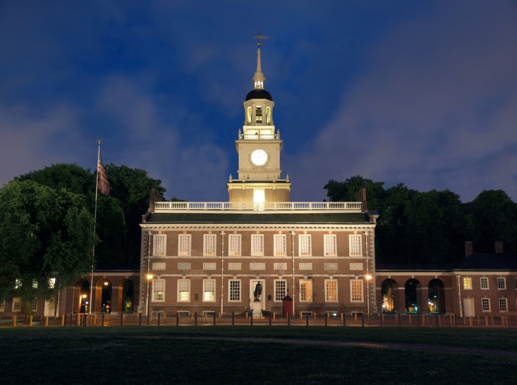

Slide 13
Intelligence Cycle
Human
Intelligence
(HUMINT)
Technical
Intelligence
(TECHINT)
Signals
Intelligence
(SIGINT)
Materials and
Signatures
Intelligence
(MASINT)
Imagery
Intelligence
(IMINT)
Open Source
Intelligence
(OSINT)
Notes:
Slide 10: Intelligence Cycle
Set requirements, gather info/intel, analyze the information, disseminate intel to support of operations.

Slide 14

Operations at the Delaware Valley Intelligence Center
Counter-
terrorism
Human Intelligence
JTTF
Fusion Liaison Officers
Crime
SAR
Federal Partners
State Partners
Technical Intelligence
Criminal
Intelligence
Local Partners
CIKR
Office of Forensic Science
Law Enforcement
DVIC Analytic Unit
Private Sector
Human
Trafficking
Maritime
Fire/EMS
OEM
Geospatial Intelligence
Public Health
ArcGIS
Cyber
Transit
Transit Partners
District Analysis
SEPTA
PATCO
DRPA
Amtrak
Notes:
Slide 11: Operations at the DVIC
In the center, demonstrates the different sections currently of in the future for the DVIC. You can see out this structure mirrors our information requirements. Describe each of the sections.
On the left, this demonstrates the different type of intelligence that we would use. Just as the IC uses HUMINT, MASINT, SIGINT and GEOINT, we can utilize various forms of intelligence. Our human intelligence is gained through our FLO program which encompasses not only LE, but also Fire/EMS, private sector and public health to provide us information from the community.
Our technical intelligence is provided by our Office of Forensic Science. The provide support of any forensic capability to identify links between people, places or things such as computer forensics, DNA testing like what was used in the UBL case or drug testing.
Further, we utilize geospatial information systems to support analytics through mapping crime data, critical infrastructure, etc.
District analysis is the PPD’s intel-led policing program.
On the right, this demonstrates the broad mission of fusion centers. These represent all our partners. Federal, state and local partners such as the FBI, ATF, CBP, PSA, HIS, FPS, PA Attorney General’s Office, SEPTA, DRPA, PATCO, Amtrak. In addition, integration of all the sectors such as LE, OEM, FIRE/EMS, Public Health and private sector.
OEM: The DVIC, Phila. OEM and DHS (IO and PSA) formed a CIKR steering committee to work on vulnerability assessments for the private sector and other agencies.
Public Health: Support the sector on issues such as supporting a bioterrorism event, human trafficking, and drug monitoring initiative with the ROIC and HIDTA
Fire/EMS: DVIC has a FIRE/EMS committee that meets monthly. They have access to the community to provide any SAR information to the DVIC.
Private Sector: Outreach to the private sector. They provide us a lot of our SAR information. We support them with information on any vulnerabilities/SAR seen throughout the country related to their sector.

Slide 15
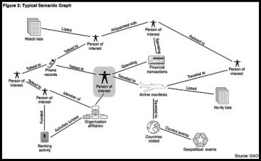
Products and Services
Forensic Investigative Reports
Forensic data and reports delivered to DVIC
  Data mined
  Data mapped
  Link analysis

Slide 16
1
2
3
4
5
DC11-17-
SDD#11-
Firearm: Bryco Jennings (9mm)
DC11-17-
HOM#11-
Recovered FCCs (9mm)
DC10-01-
SDD#10-
Recovered FCC (9mm)
DC10-03-
SDD#10-
Recovered FCCs
DC10-03-
SDD#10-
Recovered FCCs (9mm)
DC11-17-
SDD#11-
Firearm: S&W Model 19 (.357 caliber)
DC11-17-
HOM#11-
Recovered Body Bullets
DC10-01-
SDD#10-
Recovered FCCs (9mm)
DC10-03-
SDD#10-
Recovered FCCs
(.45 auto)
6
DC10-01-
SDD#10-
Recovered FCC (9mm)
7
12
DC05-01-
HOM#05-
Recovered FCCs (9mm)
DC10-22-
CDD#10-
Firearm: Sig Sauer P245 (.45 auto)
Forensic Evidence – Linking cases, aiding investigation
8
DC10-03-
SDD#10-
Recovered FCC (9mm)
Each color represents
evidence linked to a specific firearm
9
DC10-17-
SDD#10-
Firearm: Keltec P-11 (9mm)
6 YEARS : 12 CASES : 5 GUNS
10
DC06-01-
SDD#06-
Recovered FCCs (9mm)
11
DC06-01-
SDD#06-
Recovered FCCs
(.40 S&W)
DC06-01-
SDD#06-
Recovered FCCs
(.40 S&W)

Slide 17
DVIC: TECHINT PRODUCTS awkward transition to pdf files…

Slide 18
Challenges
Resources
  Forensic science has to turn items around faster
    Technology
    Automation
    Six Sigma
    Proper staffing
  Need analysts
    Intel centers
Acceptance
  Need buy in from investigator and scientists

Slide 19
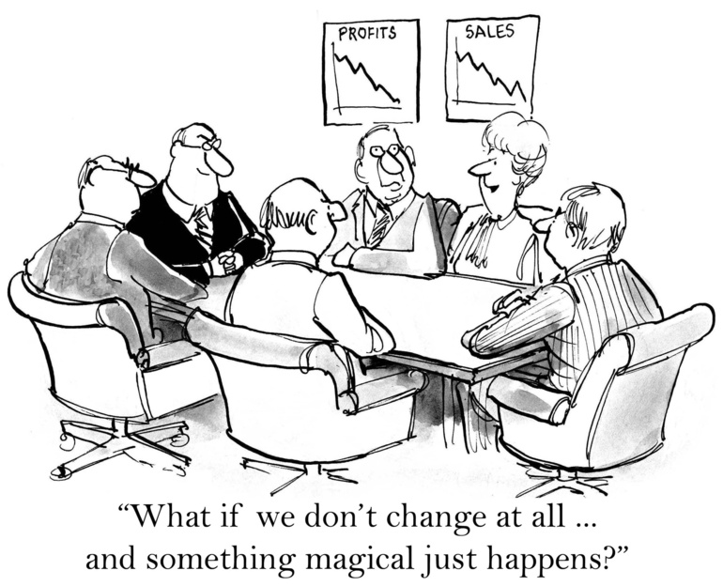
Good news
This is a scalable effort

