Slide 1
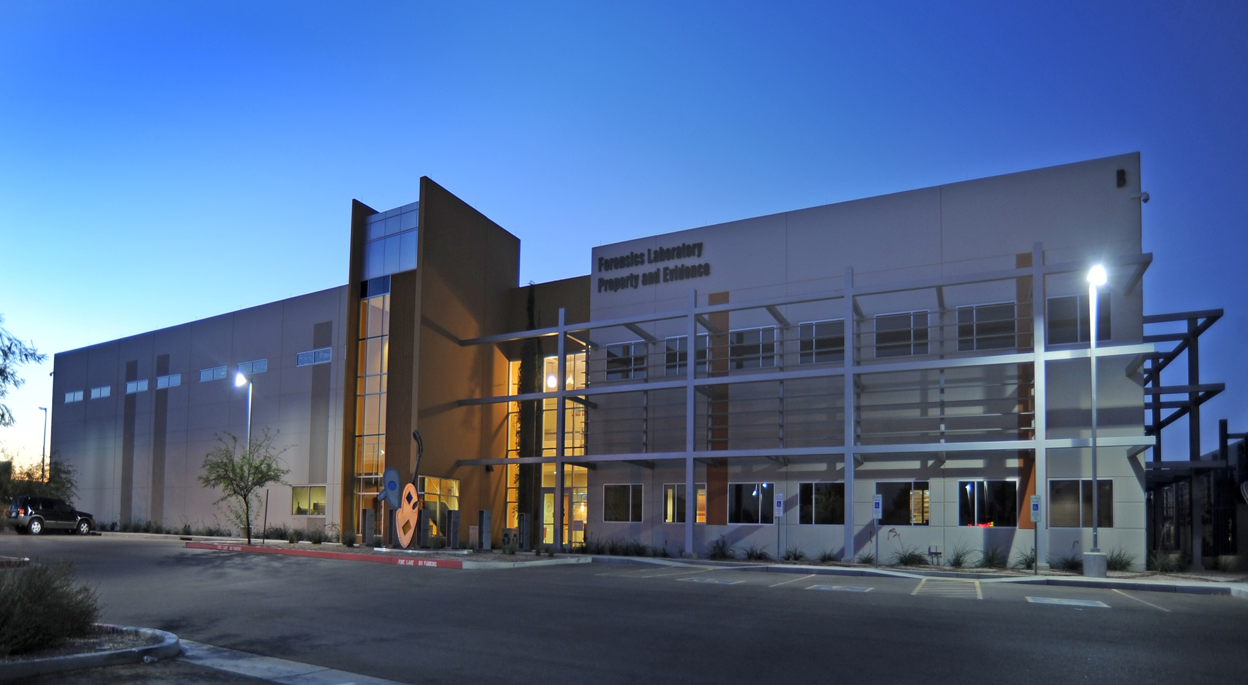

Report Standardization in the State of Arizona
Kris Cano
Forensic Laboratory Manager
Scottsdale Police Department Crime Laboratory

Slide 2



NAS “Strengthening Forensic Science” Report released February 18th, 2009
Reports generated from scientific analysis should be complete and thorough. The use of terms can have a profound effect on how the evidence is perceived and evaluated
Should scientific reports be the same?
Now they bring you…
FIVE RULES FOR CREATING GREAT PRESENTATIONS
Notes:
To view this presentation, first, turn up your volume and second, launch the self-running slide show.

Slide 3








Notes:
Presentations are a powerful communication medium.

Slide 4
Can this be accomplished with no funding?
What discipline has the most inconsistencies?
How do we get buy in?
Where should we start?
Now they bring you…
FIVE RULES FOR CREATING GREAT PRESENTATIONS
Notes:
To view this presentation, first, turn up your volume and second, launch the self-running slide show.

Slide 5
Arizona Forensic Science Advisory Committee
In 2007, the Arizona Attorney General’s Office created a statewide Forensic Science Advisory Committee to coordinate and improve forensic science services provided by laboratories that are funded and operated by different governmental agencies throughout the state. The Advisory Committee provides a forum for various members of the criminal justice system, including lab directors, forensic scientists, law enforcement officers, prosecutors, defense attorneys, and members of the public, to address and collaborate on issues and concerns relating to forensic science services in Arizona.
The committee is chaired by retired Judge Ron Reinstein and meets quarterly to address National and local issues that effect forensic science in the State. All laboratory directors and their Chief’s sit on this committee.

Slide 6


Forensic Biology
Five DNA Labs in the State
AZDPS Scottsdale PD Tucson PD
Mesa PD Phoenix PD
First meeting was in the summer of 2011
Started with a basic report and the meetings would consist of the
DNA Technical Leaders.
Notes:
To view this presentation, first, turn up your volume and second, launch the self-running slide show.

Slide 7
Notes:
…increase company value,

Slide 8







5
RULES
Notes:
Along the way we’ve discovered…

Slide 9

How are we going to accomplish this daunting task, by the way we are the DNA people…..
Determine what you can live with, be open and be able to compromise.
Determine what you can not change due to agency policies.
Circle of safety…..no idea is a bad idea.
Dedicated to reach a common goal to make testimony more consistent and meaningful.

Slide 10
Are the Reports that different?
Yes
No
Tables vs. No Tables
Use of the word match, inconclusive, and consistent
Statistical calculations
Loci
Order of results and conclusions
Inclusion of a CODIS statement
Chain of custody
No results were reported as such
Numbers were defined in the report
Consistent with the word exclusion

Slide 11


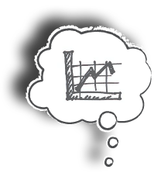













Notes:
Your audience deserves to be treated like royalty. Design a presentation that meets their needs, not just yours.

Slide 12






Notes:
…and you will undoubtedly find favor with the king.

Slide 13
BLAH
BLAH
BLAH
BLAH
BLAH
BLAH
BLAH
Notes:
Your audience didn’t show up to read your 60 page on screen dissertation.

Slide 14
AN
OTHER
ME
ET
ING
Notes:
You are not giving your presentation to have another meeting. You are there to covey meaning.

Slide 15



Notes:
So, consider including imagery that powerfully illustrates your point.

Slide 16





Notes:
Sometimes moving images can inspire in a way that static slides cannot. A slow moving animation creates a sense of nostalgia.

Slide 17

Systematic Approach
Standard definitions
Single source cases
Sexual assaults
YSTRs
Complex mixtures
Partial profiles
Body Fluid Identification

Slide 18
Conclusions
We were able to come up with consistent reports for DNA analysis in terms of content, and terms were consistently utilized.
Inconclusive results were clearly identified and described in the report.
For YSTR analysis we were all consistent and reduced the wording in the reports.
We were not able to conform to the same approach when reporting statistical calculations; however, labs that utilized the same methods reached consistency.
The order of the report varied and one lab continued to include tables in the reports.
Body fluid identification is still pending.
Like anything in DNA, by the time we agreed, technology changed….

Slide 19
Who’s Next?
Blood Alcohol
Controlled Substances

Slide 20
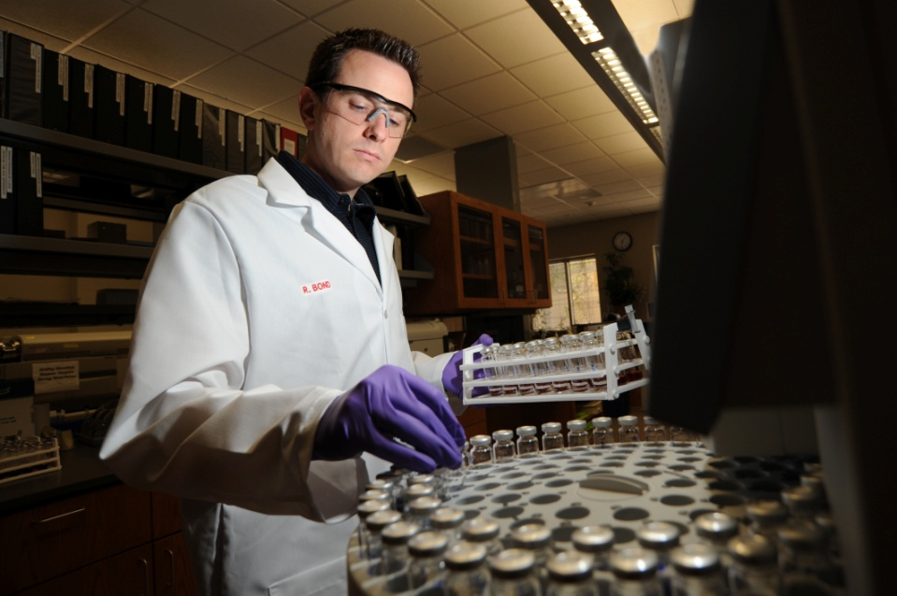
Uncertainty of Measurement
Driving force behind standardization of blood alcohol reports.
Not only did they agree on report wording and definitions, they agreed on how to calculate the U of M for the State.

Slide 21
Controlled Substances
Currently meeting on the standardization of their reports.
With new drugs and legislation this is one group that will constantly be evolving.
The use of field testing varies from agencies and how drugs are confirmed.

Slide 22
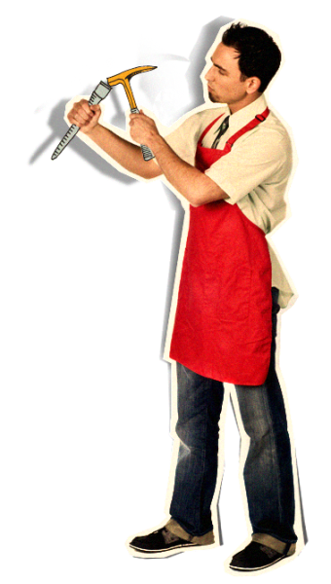

Notes:
Any writer or designer will tell you that 90% of the creative process…

Slide 23






















































Notes:
…is destructive.

Slide 24
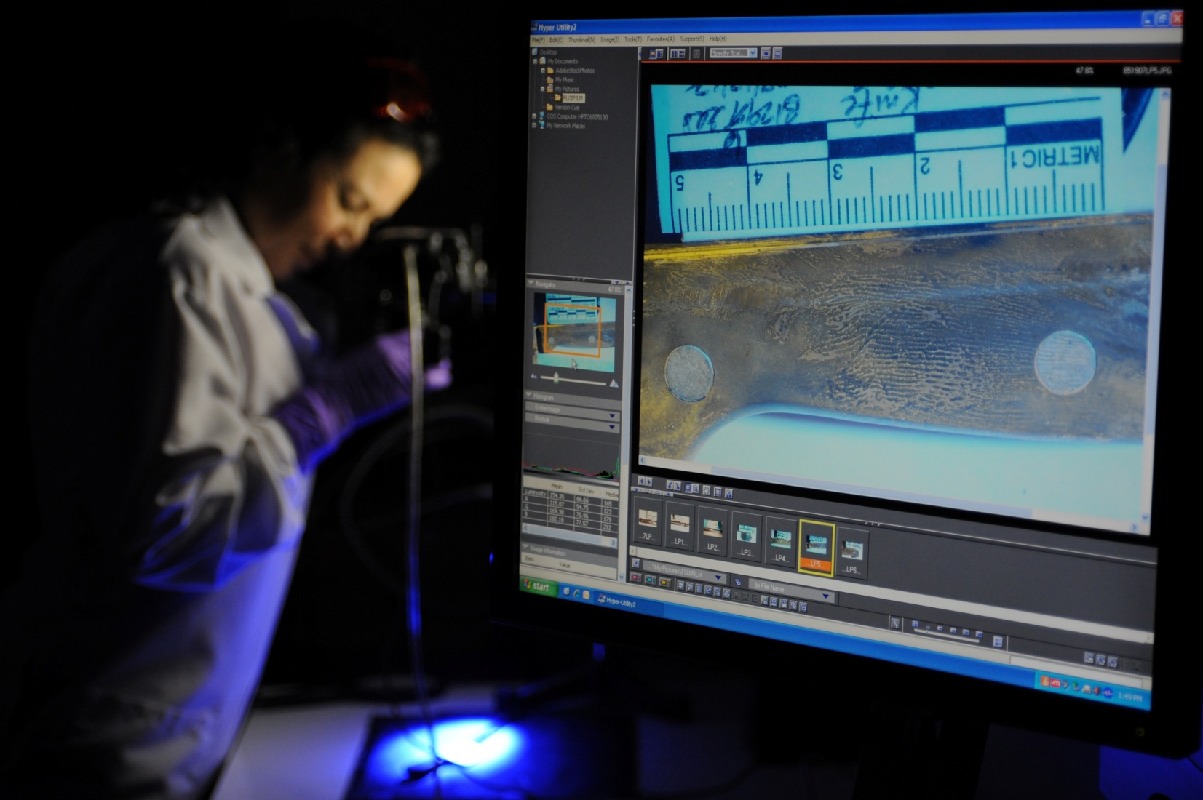
The Comparison Sciences……
Firearms/Toolmarks, Latent Print (processing and comparisons), Trace Evidence

Slide 25
Yes it can…..with no funding, a little cooperation, and time.
Results = better work product for our customers.
Can it be done?
Now they bring you…
FIVE RULES FOR CREATING GREAT PRESENTATIONS
Notes:
To view this presentation, first, turn up your volume and second, launch the self-running slide show.

Slide 26
Thank You for your attention!
Acknowledgements
  Members of the AZ Forensic Science Committee
  Technical Leaders
  ASCLD
  Questions?
  Kris Cano
  kcano@scottsdaleaz.gov
  (480) 312-5107

