Slide 1
Rapid DNA Costs and Benefits: Status of Examining the Current Uses Within the law Enforcement Community.
Garry Bombard, Ph.D.
Loyola University Chicago
Vince Figarelli
Arizona DPS

Slide 2
Background
ASCLD Board’s Position Statement (2014)
ASCLD FRC Subcommittee (2014-2015)
Discussions/Education in Public Policy Cost-Benefit Analyses

Slide 3
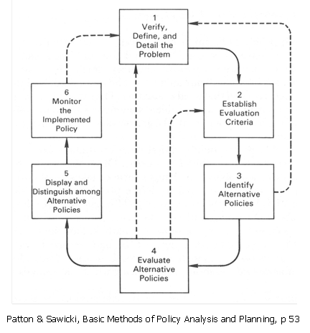
Public Policy: Rational Planning Model

Slide 4
Public Policy Overview
Four Criteria/Streams
Technical Feasibility
Economic and Financial Possibility
Political Viability
Administrative Operability

Slide 5
Public Policy Overview
Economic and Financial Possibility
Heavily based upon economic theory
Produces data that is easy to wrap your arms around
Favored by politicians
Based on the Free Market Model
Two Economic Terms
Costs
Benefits
Two Concepts of Measurement
Economic Effectiveness
Economic Efficiency

Slide 6
Public Policy Overview
Economic Effectiveness
All Stakeholders input included
Costs are computed
Benefits are listed: Local and/or Societal Note: depends on level of analysis

Slide 7
Public Policy Overview
Economic Efficiency
Very complex and time consuming
Examines the most promising cost effective programs
Status Quo is included and compared
Monetizes benefits (includes societal values)
Cost-Benefit is computed at three, five, or seven years.

Slide 8
Types of Costs
Infrastructure (One-Time)
Buildings
Instrumentation
Other costs
Annual Costs
Reagents
Software

Slide 9
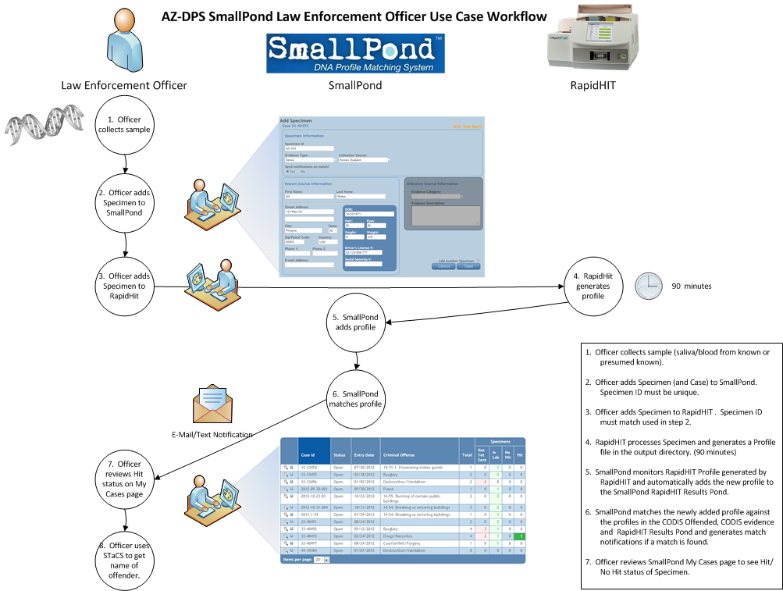
Arizona Model

Slide 10
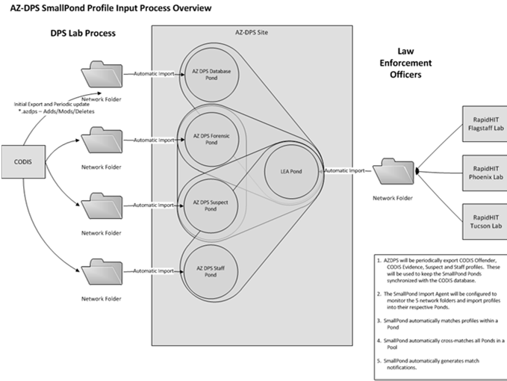
Arizona Model

Slide 11
Arizona Model
External
Officer Training and Certification
Officer Analysis for Search in AZ DNA Database
Internal
Database Unit Hit Confirmations
Database analysis of Arrestee and Convicted Offender Samples
Forensic Casework Knows

Slide 12
Arizona Model
External Costs:
DPS Training Program and Certification
AZ Database Network Set-up
Instrumentation Validation
Commodities
Software
Personnel

Slide 13
Arizona Model
Internal Costs:
DPS QA with Agencies
Normal Operations Comparable to Internal Case
Instrumentation
Commodities
DB and Software
Personnel costs
Other costs

Slide 14
Arizona Model
Benefits:
Investigative Leads to Law Enforcement
Identification of Victims
Cold Case Hits (apprehended to forensic unknowns)
Casework Reduction

Slide 15
Next Steps for Analyses
Include Other Demonstration Projects
Colorado
Miami-Dade Sherriff's Office
Philadelphia Police Department
Wisconsin Proposed Legislation: Booking Stations
Collect Data from Projects and Other Sources
Palm Beach property crimes program: 11 years
Doleac’s public policy analysis on DNA Database

Slide 16
Next Steps for CL Community
Understand and Use the Findings Nationally and Locally
Integrate This with Other Information and Data to Our Advantage
Recommend National Model(s) as an Organizational Voice

