Slide 1
OSAC Outcomes and Action Items
ASCLD 42nd Annual Symposium
Washington, DC
April 28, 2015
Richard Vorder Bruegge, Digital/Multimedia SAC Chair
Greg Davis, Crime Scene/Death Investigation SAC Chair
Scott Oulton, Chemistry/Instrumental Analysis SAC Chair
George Herrin, Biology/DNA SAC Chair
Austin Hicklin, Physics/Pattern SAC Chair

Slide 2
OSAC STRUCTURE

Slide 3
Digital / Multimedia
Richard Vorder Bruegge, Ph.D.
Digital/Multimedia SAC Chair
Federal Bureau of Investigation

Slide 4
Digital / Multimedia SAC
Subcommittees
Digital Evidence
Facial Identification
Speaker Recognition
Video/Imaging Technology & Analysis
Solid foundation of documents for all derived from Scientific Working Groups and others
QIC identified over 80 relevant documents
Some have been through an SDO (e.g., ASTM, ISO…)

Slide 5
Digital / Multimedia SAC: Foundational Concepts
Define the Discipline
Terminology
Professional Qualifications
Gap Analysis/Research Agenda
Sample Identification and Collection
Validation
Methods, tools, people
Documentation
Conclusion Scales
Interpretation of Results
Human Factors
Automated Systems

Slide 6
Digital / Multimedia: Digital Evidence Subcommittee
Priority Topics
Minimum standards in computer and mobile devices forensics
Quality Assurance
Training / Certification
Education
Audio Forensics (minimum standards)
Working Documents
25 existing documents
SWGDE, FSR, SWGIT, NIST, NIJ, AIC, ASTM, SWGDR
Process
TBD

Slide 7
Digital / Multimedia: Facial Identification Subcommittee
Priority Topics
Terminology
Training
One-to-one comparison
Systems & Capture
Public Communication
Working Documents
15 existing documents
FISWG
Process
SDO

Slide 8
Digital / Multimedia: Speaker Recognition Subcommittee
Priority Topics
Speech collection guidelines
Research
General principles
Structured listening by phonetic approach
Type 11 voice records
Scientific evidence manual
Annotated list of SR cases
Working Documents
3 existing documents
DMMSAC, SWG-Speaker, ANSI/NIST
Process
TBD, Registry

Slide 9
Digital / Multimedia: Video/Imaging Technology and Analysis Subcommittee
Priority Topics
Subcommittee cross-cutting coordination
Recognize existing standards
Training
Review/Update standards
Photogrammetry
Working Documents
39 existing documents
ASTM, SWGIT, LEVA, ISO, UK Government, SWGDE
Process
TBD, Registry

Slide 10
Digital / Multimedia SAC
Some Key DMSAC & OSAC Challenges:
Facial Identification & Speaker Recognition vs. Eyewitness & ”Ear”witness
Scientific Paradigm for Digital/Multimedia Forensics
Error Rates through Testing Examiners
Experts and “Experience”
Not a 1-, 2-, or 5-year project…nor is it without cost.

Slide 11
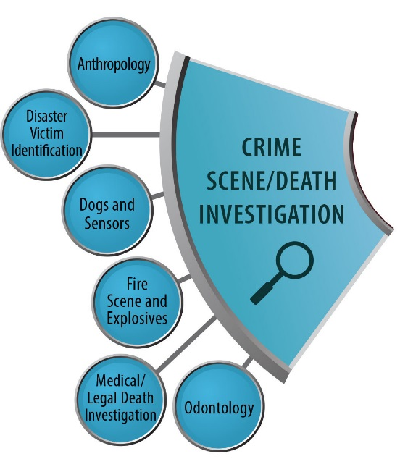
Crime Scene / Death Investigation
Greg Davis, M.D.
Crime Scene / Death Investigation SAC Chair
University of Alabama-Birmingham

Slide 12
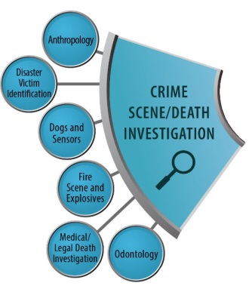
Crime Scene / Death Investigation SAC
Purposes
Support development and promulgation of forensic science consensus documentary standards and guidelines.
Ensure a sufficient scientific basis exists for each discipline.
Subcommittees
Anthropology
Disaster Victim Identification
Dogs and Sensors
Fire and Explosion Investigation
Medicolegal Death Investigation
Odontology

Slide 13
Crime Scene/Death Investigation: Anthropology Subcommittee
Priority Topics
Recognize existing standards
Training/Competency
Method Development / Validation
Revise existing standards
Working Documents
23 existing documents
SWGANTH, ISO/IEC, ASTM
Process
Registry, SDO

Slide 14
Crime Scene/Death Investigation: Disaster Victim Identification Subcommittee
Priority Topics
Mass fatality scene processing
Molecular biology
Friction ridge
Forensic pathology
Data Management
Ethics
DVI management
Quality Assurance
Family Assistance/Victim ID Center
Forensic Anthropology
Forensic Odontology
Terminology
Working Documents
1 existing document
SWGDVI
Process
CANVASS

Slide 15
Crime Scene/Death Investigation: Dogs and Sensors Subcommittee
Priority Topics
Review current documents
Training/Competency
Cross-disciplinary standards
Outreach / Education
Integration of Dogs and Sensors
Working Documents
6+ existing documents
SWGDOG
Process
TBD

Slide 16
Crime Scene/Death Investigation: Fire and Explosion Investigation Subcommittee
Priority Topics
Recognize existing standards
Competency
Documentation / Report Writing
Analysis of relevant standards
Research
Working Documents
14 existing documents
NFPA, ASTM, Standards Australia
Process
Registry, SDO

Slide 17
Crime Scene/Death Investigation: Medicolegal Death Investigation Subcommittee
Priority Topics
Peer review, QA, Cognitive Factors
Autopsy standards
Medicolegal Death Investigation
Working Documents
4 existing documents
NAME, NIJ, CDC
Process
TBD

Slide 18
Crime Scene/Death Investigation: Odontology Subcommittee
Priority Topics
Dental Identification
Bitemarks
Dental Age Estimation
Oral/Peri-oral issues
Working Documents
3 existing documents
ABFO
Process
SDO, TBD

Slide 19
Crime Scene / Death Investigation SAC
Summary
Different subcommittees at different points
Subcommittees realize that some aspects of each practice more controversial than others
Concentrate on topics ripe for consensus first
Wrestle with more contentious areas later
Process will take time, but careful, deliberate, steady progress needed.

Slide 20
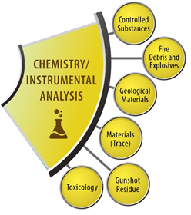
Chemistry/Instrumental Analysis
Scott Oulton
Chemistry/Instrumental Analysis SAC Chair
Drug Enforcement Administration

Slide 21
Chemistry / Instrumental Analysis SAC
SAC is made up of a very diverse group – all with a basic foundation in chemistry
We have started to recognize our common interests
Began discussing the need to work on foundational and interdisciplinary documents (e.g., education, training, validation)
Fortunate that majority of subcommittees had strong foundational documents that were already developed from Scientific Working Groups
Many have already been through SDO process
SAC is focusing on what already exists and is relevant for placement on the registry
Prepared to recommend 8 existing standards (Fire, Trace, Drugs)
Other existing standards are being updated through the SDO process

Slide 22
Chemistry / Instrumental Analysis: Fire Debris and Explosives Subcommittee
Priority Topics
Evaluate ASTM Standards
Guide for Fire Debris and Explosives analysis
Terminology
Report wording
QA/QC Guidelines
Research / Training
Working Documents
13 existing documents
ASTM, SWFEX
Process
SDO, TBD

Slide 23
Chemistry / Instrumental Analysis: Geological Materials Subcommittee
Priority Topics
Research
Sample collection
Terminology
Validation of collection document
Resources and references
Working Documents
1 existing document
SWGGEO
Process
SDO

Slide 24
Chemistry / Instrumental Analysis: Gunshot Residue
Priority Topics
Report writing, qualifying statements, disclaimers, interpretation
Proficiency, Analysis, Competency, Training
Testimony, Ethics
Methodology, Research, Literature review
Validation, Performance Checks, Instrument Performance, general troubleshooting
Working Documents
4 existing documents
SWGGSR, ASTM, ENSFI
Process
SDO, TBD

Slide 25
Chemistry / Instrumental Analysis: Materials (Trace) Subcommittee
Priority Topics
Evidence interpretation
Outreach
Existing documents
Fibers, Tape and Paint, Hair, Glass
Working Documents
25 existing documents
ASTM, SWGMAT
Process
TBD, SDO

Slide 26
Chemistry / Instrumental Analysis: Seized Drugs Subcommittee
Priority Topics
Recognize existing standards
Education/Training/Competency
Method Development
Reporting & Terminology
Analogs & Structural Class Determinations
Ongoing OSAC Catalog review
Working Documents
14 existing documents
ASTM, SWGDRUG, ENSFI, UNODC
Process
SDO

Slide 27
Chemistry / Instrumental Analysis: Toxicology Subcommittee
Priority Topics
Document evaluation
Method Validation
Quality Control
Breath Alcohol calibration
Terminology
Reporting / Testimony
Measurement traceability
Working Documents
31 existing documents
SWGTOX, UNODC, CLSI, Eurachem, HAS, ASFSTP, FDA, ABFT, SOFT, AAFS, GTFCh, OIML, ASCLD/LAB, ISO/IEC
Process
CANVASS

Slide 28
Chemistry / Instrumental Analysis SAC
OSAC is providing consistent funding, formalized process, cross communication and balance of interests
(transparency, private, federal, state, researchers, statisticians, LRC, HFC, QIC, etc.)
With this structure, we have begun to recognize how much we are the same and not to “re-invent the wheel” for those topics that cross all disciplines
Enforcement of standards is becoming a real possibility

Slide 29
Chemistry / Instrumental Analysis SAC
Spring 2015: Several subcommittees submit existing SDO documents for SAC review/approval and forward to the FSSB for consideration of placement on the registry
Fall 2015: Complete review of existing SDO documents
Late 2015: Propose revisions to existing SDO documents that need updating and begin submitting relevant documents to an SDO or Canvass process
2016: Begin authoring new relevant standards

Slide 30
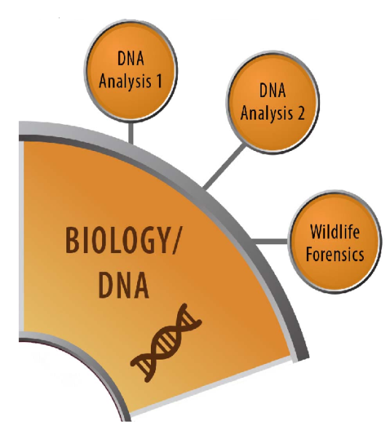
DNA / Biology
George Herrin, Ph.D.
DNA / Biology SAC Chair
Georgia Bureau of Investigation

Slide 31
DNA / Biology: Biological Methods Subcommittee
Priority Topics
Terminology
Validation / Method Development
Education, Training, Competency, Certification
Sample identification and collection
Working Documents
21 existing documents
SWGDAM, FBI, ENSFI, ISO/IEC
Process
TBD

Slide 32
DNA / Biology: Biological Interpretation and Reporting Subcommittee
Priority Topics
Software Validation Standards
Mixture interpretation verification
Working Documents
15 existing documents
FBI, SWGDAM, ASTM, ANSI
Process
TBD

Slide 33
DNA / Biology: Wildlife Forensics Subcommittee
Priority Topics
Genetics and Morphology
Terminology
Report writing
Validation
Working Documents
15 existing documents
SWGWILD, ASTM, FBI, IFSG
Process
TBD

Slide 34
DNA/Biology SAC
Tentative Timeline Goals
Fall 2015: Complete drafting and/or review of documents in subcommittees by fall 2015
Late 2015: Subcommittee approves documents for SAC review
2016: SAC completes document reviews, approves guidelines for registry, moves potential standards to FSSB for review

Slide 35
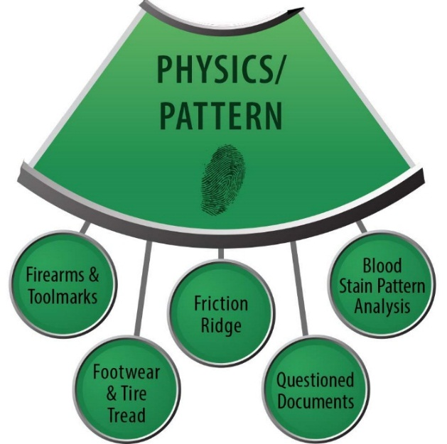
Physics / Pattern
Austin Hicklin
Physics/Pattern SAC Chair
Noblis

Slide 36
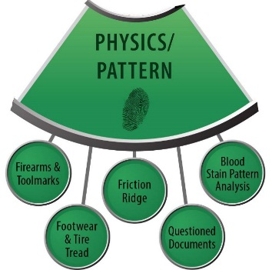
Physics / Pattern SAC: Priorities
To foster the development of rigorous standards and guidelines within and across the pattern disciplines
To assist in the adoption of these standards and guidelines
To encourage enforcement of these standards and guidelines through accreditation, certification, and training
To encourage evaluation to test and validate procedures
To encourage research to improve the disciplines
To enhance the rigor of these disciplines through transparent, accurate, and reliable processes

Slide 37
Physics / Pattern SAC: Priorities
Develop standards and guidelines that are as rigorous as practical given current capabilities
Recommend research to continually improve the disciplines
Encouraging studies of accuracy, repeatability, and reproducibility in each discipline
Outreach to others in the community not in OSAC
Build on the work of the SWGs

Slide 38
Physics / Pattern SAC: Priorities
Coordination across disciplines in defining standards and guidelines in these areas:
Terminology
Reporting
Conclusions
Training/competency/certification/proficiency
Accreditation
Testimony
Imaging
Documentation
Collection/Crime scene investigation
Research/General discipline needs
Validation

Slide 39
Physics / Pattern: Bloodstain Pattern Analysis Subcommittee
Priority Topics
Terminology
Reports and Validation
Training and Education
QA and SOPs
Research
Place existing standards in OSAC Registry
Working Documents
9 existing SWGStain documents
Process
Canvass, Registry

Slide 40
Physics / Pattern: Firearms and Toolmarks Subcommittee
Priority Topics
Technology development, validation, implementation
Standards for examination
Uncertainty of Measurement
Training
Criteria for identification, documentation, reporting
Terminology
Report writing
Working Documents
28 existing documents
SWGGUN, AFTE, ISO/IEC, SWGDAM, ASCLD/LAB, NFSTC
Process
Canvass, TBD

Slide 41
Physics / Pattern: Footwear and Tire Subcommittee
Priority Topics
Terminology
Method Development
Training / Competency
Research / Technology
Working Documents
16 existing documents
SWGTREAD, IAI
Process
Canvass

Slide 42
Physics / Pattern: Forensic Document Examination Subcommittee
Priority Topics
Place existing ASTM standards in OSAC Registry
Review and revise existing SWGDOC guidelines
Working Documents
15 existing ASTM and SWGDOC documents
Process
Registry, Canvass

Slide 43
Physics / Pattern: Friction Ridge Subcommittee
Priority Topics
Method Development / Validation
Examinations & Conclusions
Documentation
Articulation
Research
Training
Terminology
Working Documents
26 existing documents
SWGFAST, NIJ, NIST, Noblis, Interpol, IAI, FSR, ANSI, ISO/IEC
Process
Canvass

Slide 44
Questions?
www.nist.gov/forensics/osac.cfm
workspace.forensicosac.org

