Slide 1
Preserving and Expanding a High-Performing Laboratory Team in a Challenging Leadership Environment
Ryan Larrison
Michigan State Police
Bridgeport Laboratory

Slide 2
MSP Bridgeport Forensic Science Laboratory
Total Staff in 1990: 30
Total Staff in 2011: 18

Slide 3
Year-End 2011 Lab Status
16 Scientists across 5 disciplines
8 Scientists also process homicide scenes.
Flint and Saginaw typically share positions in the top 3 most violent cities in the country.
Lab system is still strained by the 2008 closure of the Detroit Police Department Laboratory.
Laboratory completes ISO 17025 Accreditation in December, 2011.
Large backlogs exist in Firearms, Trace, and Biology

Slide 4
Local Relationships in 2011
Very strong ties and impactful working relationships with RURAL partners
Strong ties and impactful working relationships in SAGINAW
Weak ties, weak working relationships in FLINT
MSP……Strong tie, “challenging” working relationship**

Slide 5
Reality
Flint: 11.7 per 10k residents
Camden: 34.5 per 10k residents
Washington DC: 61.2
Chicago: 47.4
Detroit: 36.3

Slide 6
Reality
MSP: 2-4 Detectives
3-4 person scene crew
5 hours per scene
15-24 man-hours
Each scientist has a specific role
Flint PD: 2 detectives
One evidence tech
One hour per scene
One man-hour
Two detectives search the scene and then call ET to photograph scene and collect evidence

Slide 7
The Big Problem

Slide 8
Opportunity?

Slide 9
Transformational Leadership?
You Have Identified Your Problem
You Have Identified Your Opportunities
You Have Come Up With Your “Vision”
How Are You Going To Get There as a Leader?

Slide 10
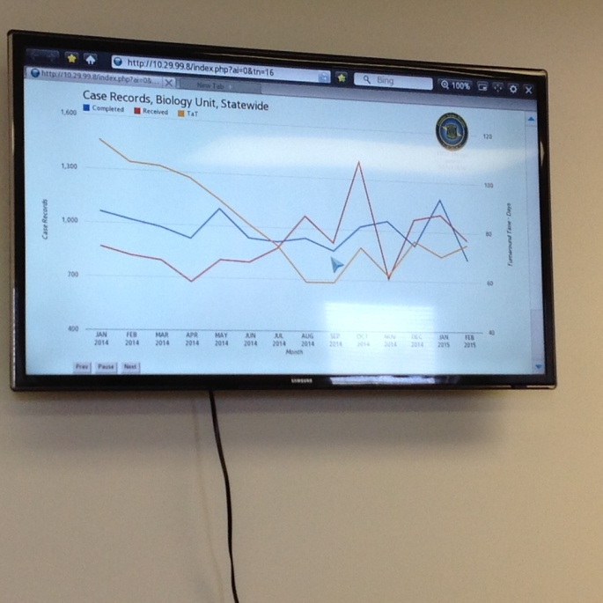
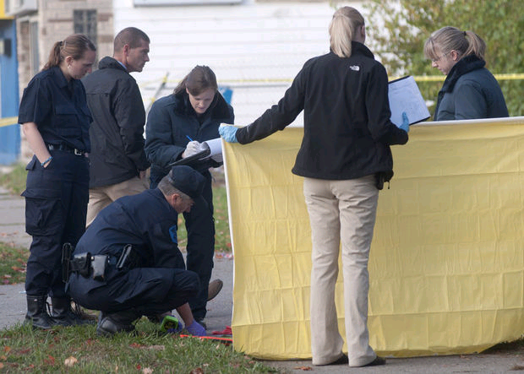
Planning Stage
Scene Work (Local)
YOU Can Fight for a Say in Local Policy—Failure To Do So Affects Your Followers!
Backlog Reduction (System-Wide)
Massive Project, Huge Organizational Change

Slide 11
Motivating Followers
You have to believe in what you are selling.
Seek the commitment of your staff. Communicate the vision and goals.
Share the potential opportunities.
Listen to and address their individual concerns.
Always come back to the vision.
Your followers will seek promises. Be careful.

Slide 12
Kickoff

Slide 13
Us and Them
If you and your worksite have a challenge that has to be met outside the walls of your laboratory, and YOU lack positive working relationships with key partners, you will find yourself in the back of the room at the first meeting.

Slide 14
32 Homicides Processed by Bridgeport in 2011

Slide 15
Excerpt: Flint Journal, July 3, 2012
Flint had more violent crimes per capita reported in 2011 than any other U.S. city with over 100,000 residents, according to the latest FBI crime data.
In the first six months of this year, 32 people have been killed in the city.
Larrison said his staff is eager to help.
"I think everybody wants to make a difference," he said. "There's going to be a little bit of hesitation, like 'How many more 1 a.m. scenes are we going to go to?' But people want to do it.
"Things are only going to get better as a result of this collaboration."
Staff cuts and retirements have taken their toll on the Flint Police Department and it's 12-person detective bureau. In one violent stretch of more than two months, no suspects were charged in a string of 14 homicides from the end of March to the beginning of June.

Slide 16
65 Homicides Processed by Bridgeport in 2012

Slide 17
Forensic Training Center

Slide 18
Excerpt: Saginaw News, August 16, 2013
First Lt. Ryan Larrison and the personnel in his lab on Dixie in Bridgeport Township are leading a four-month evidence technician training program for police officers. Larrison said more evidence gathering should result in more arrests.
“It's going to be like shooting fish in a barrel,” he said. “There's low-hanging fruit here, forensically. We're going to have a lot of results with getting some of these criminals."
Sgt. Reggie Williams (Saginaw PD) agrees, noting that obtaining fingerprints from broken glass and around forced-open doors “would be easy.” “From what I see, the way houses are broken into, there's not a lot of care going into it,” he says. “We're not talking about 'Ocean's 11'-type criminals.”
Obtaining fingerprints or DNA from such scenes could allow investigators to connect less serious crimes to more serious ones, such as shootings, he adds.
“You can't just treat (the crime problem) by investigating murders,” Larrison says. “You have to be proactive.”

Slide 19
Evidence Tech Program
Train Detectives and Officers Attached to Major Case Units to Effectively Process Simple Scenes
Increase Understanding of Forensic Science Capabilities, Processes, and Standards

Slide 20
Managing Burnout
I handled the scene callouts for the first 18 months.
I sought assistance from other labs where necessary.
I stopped at some scenes with cold drinks and pizza or hot drinks and breakfast.
We celebrated participation with challenge coins.
Individuals with training duties were exempted from scene work.**

Slide 21
Failures and Mistakes
I had angered some MSP Uniform partners prior to the project taking shape.
I lacked strong relationships with field commanders at the beginning of the project.
I made a LOT of promises to employees.
A stressful incident nearly caused a loss of trust for some of my staff.
I failed to alter the Evidence Tech Programs in the district with our own department and with Flint PD.

Slide 22
Victories
Employee engagement with the project was very high throughout.
Lab was allowed to spend money to create, renovate, and equip a Forensic Training Center.
We were allotted a great deal of funding.
I sought and gained access to local press, and had some success in sharing our story.
The team became even more cohesive as more employees were added.
The project changed the worksite physically and it also emotionally re-connected long-term employees to the importance of their work. WE FORGET.

Slide 23
Victories, Continued
The violent crime rates dropped very slowly in the first 12 months--but then dropped quickly thereafter as the project gained traction.

Slide 24
52 Homicides Processed by Bridgeport in 2013

Slide 25
41 Homicides Processed by Bridgeport in 2014

Slide 26
Flint Homicide Clearance Rate by Arrest:
2011: Less Than 10% of 57 Homicides
2014: Nearly 100% out of 29 Homicides

Slide 27
Excerpt, Saginaw News February 2015
BRIDGEPORT, MI -- The Michigan State Police Crime Lab solves cases with science, and the laboratory operating in Bridgeport has additional staff and new methods to help fight crime.
It's helped the laboratory turn a 12-month backlog for lab work in the biology department one year ago into a two-week backlog today. The lab located at 6296 Dixie also is expediting cases in a matter of days, if needed.
One reason for the improvement is the addition of six new technicians and scientists to the facility compared to 2012. It brings total manpower there to 24, according to Bridgeport lab director 1st Lt. Ryan Larrison.
Funding for the positions comes through the state's secure cities partnership, which added the troopers to Saginaw's streets and to the Bridgeport lab.

Slide 28
Celebrating Success
We have always avoided “awards” in our lab system to prevent perceptions of bias; however, these system recognitions went a long way with the employees.

Slide 29
Excerpt, Flint Journal, January 2015
FLINT, MI -- A forensic scientist with the Michigan State Police crime lab in Bridgeport Township was recently recognized for his work in helping bring down Flint's Howard Boys gang, and was given the Meritorious Service Award.
Special Lt. Ronald Crichton, who enlisted with the department in 1989, was recently given the award at a bi-annual MSP recognition ceremony in Lansing by MSP Director Col. Kriste Kibbey Etue. Crichton was the only person given the award at the ceremony, said Detective 1st Lt. Ryan Larrison, who is the commander of the Bridgeport Forensic Science Lab.
Crichton is also possibly the only forensic scientist to ever receive the award, Larrison said.
"I've been with the department for 16 years, and it's the first time I've ever seen a forensic scientist get a meritorious award," Larrison said, saying it is unusual for someone working in a lab to earn this particular award. "It's possible that, prior to my time, someone got one, but I can't recall ever hearing about it."
The Meritorious Service Award is usually given to someone in the department who goes "way above and beyond" their course of duty, Larrison said.
Getting the award is rare, and one of the highest honors in the department, Larrison said.

Slide 30
Homicide Rates
Saginaw
Flint
2012: 30
2013: 27
2014: 10
2015: 4
2012: 66
2013: 52
2014: 29
2015: 10

