Slide 1

Advanced Techniques for Identifying New Compounds in Toxicology Casework
Jeff Walterscheid, Ph.D., F-ABFT
Toxicology Manager

Slide 2

I have no commercial interests or financial relationships to disclose

Slide 3


Looking for drugs: Where’s Waldo?
In order to characterize the presence of drugs, we need to know their unique characteristics:
  Size
  Structure
  Mass
  Solubility
  Volatility

Slide 4
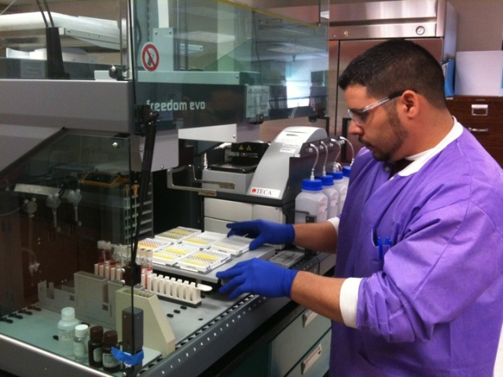
Immunoassay Screen
Pros
Quick and easy, no extraction needed
Requires a minimal volume
Flags cocaine, amphetamine (which cross reacts with many phenethylamines such as MDA, phentermine, and norephedrine), methamphetamine (also picks up MDMA, ephedrine/pseudoephedrine), PCP, opiates, benzodiazepines, barbiturates, methadone, and marijuana
Cons
Only flags on drugs that have an antibody probe
Gives false positives on amphetamine in decomposition or spoiled urine
PCP will trigger on dextromethorphan
Opiate typically does not detect oxycodone or oxymorphone
Benzodiapine assay reacts poorly with lorazepam

Slide 5

Immunoassay Screen
Y
Y
Y
Y
Y

Slide 6
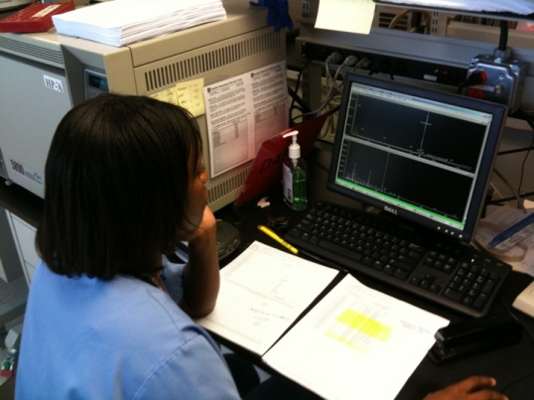
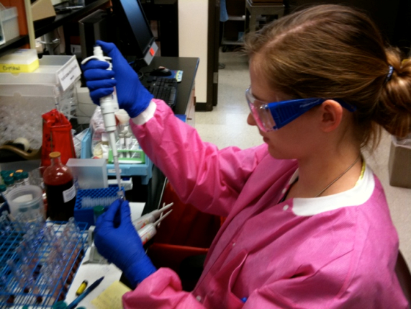
Acidic/Neutral vs. Alkaline Screen
Pros
Acidic screen reveals select anticonvulsants, phenytoin, barbiturates, ibuprofen, valproic acid
Alkaline screen will find most antidepressants, antihistamines, benzodiazepines, some opiates
Cons
Lengthy and complicated extraction
Consumes up to 10x more specimen
Machine run time is about 15 hours
Data processing takes several hours even days to complete

Slide 7
GC/MS Drug Screen
94%
53%
27%
36%
45%

Slide 8
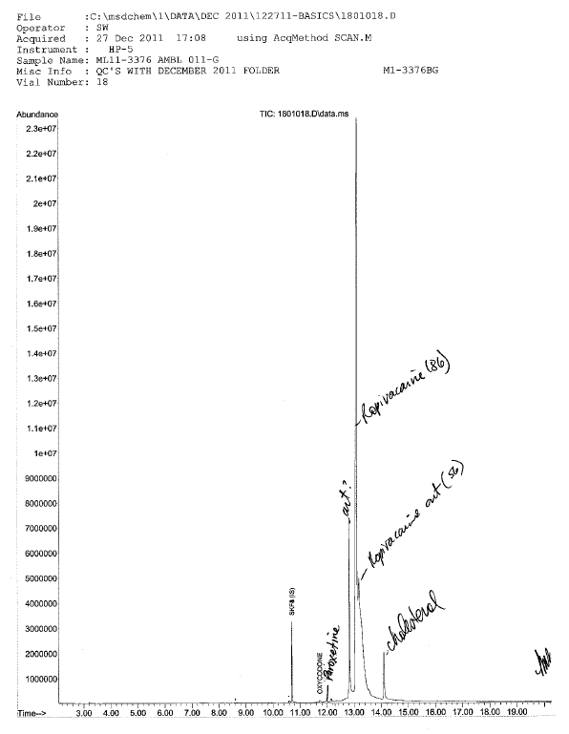
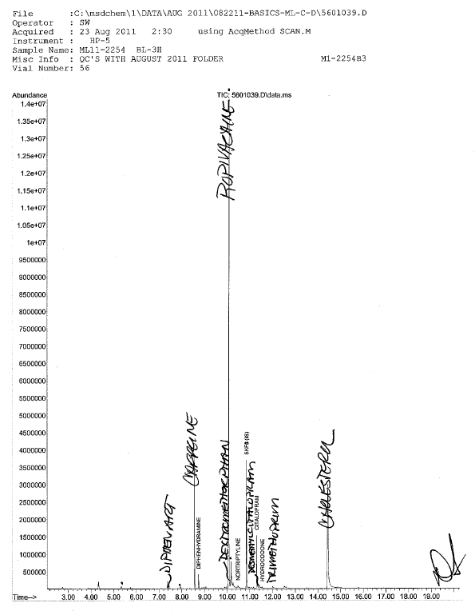
GC/MS Drug Screen: Ropivacaine or Bath Salt?

Slide 9
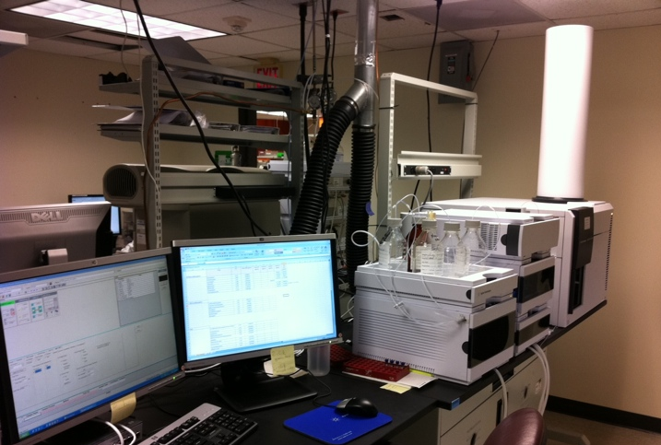
LC-TOF/MS Drug Screen
Finding Waldo’s cousins by LC-TOF Mass Spectrometry
Is something there we didn’t expect?
Do we even know what they look like?

Slide 10
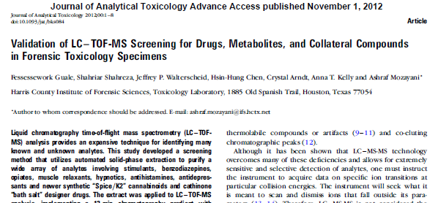
TOF Drug Screen

Slide 11
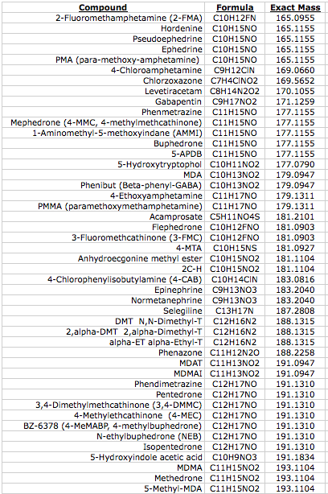
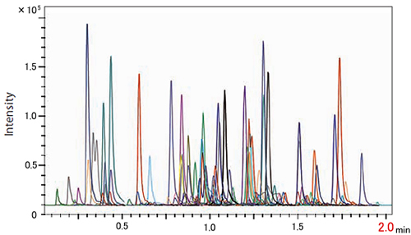
TOF Drug Screen
Pros
TOF catalogues most all compounds present in the sample
Easy to review the list without re-analyzing
Cons
Only reports drugs found that are specified in template
Often requires personal inspection of data
Sometimes drug peaks are not obvious

Slide 12
Case 1:
Scene investigation

Slide 13

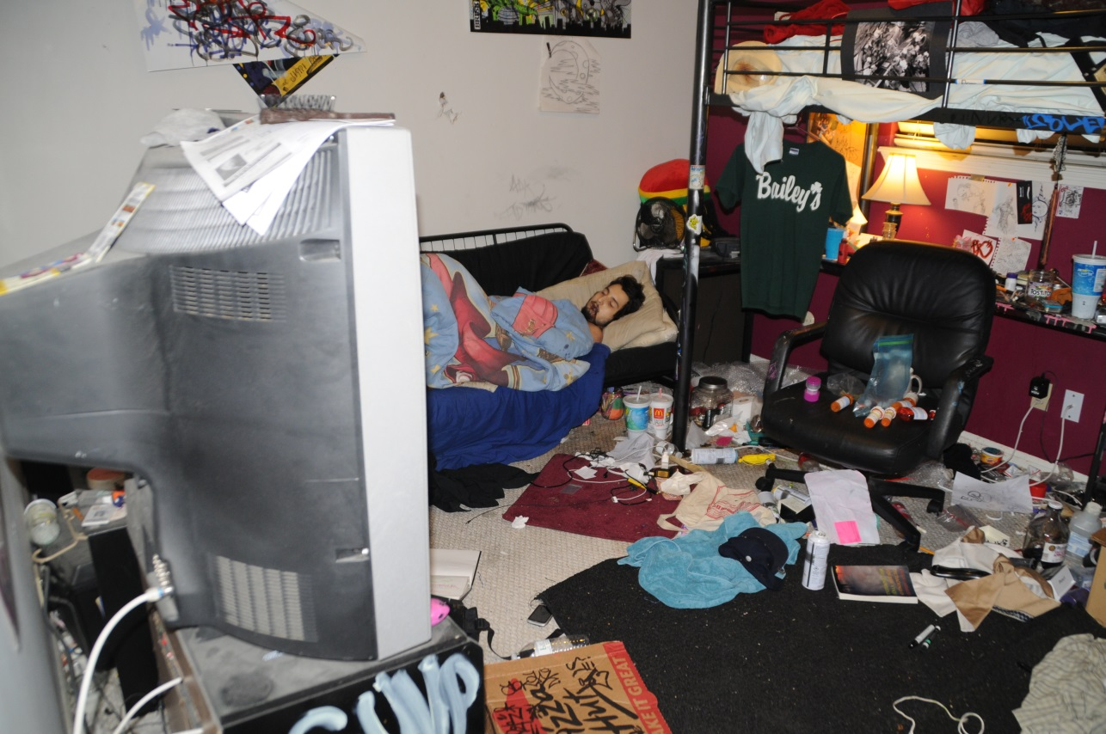
Case 1: Scene
19 year old male found dead at home after a party

Slide 14
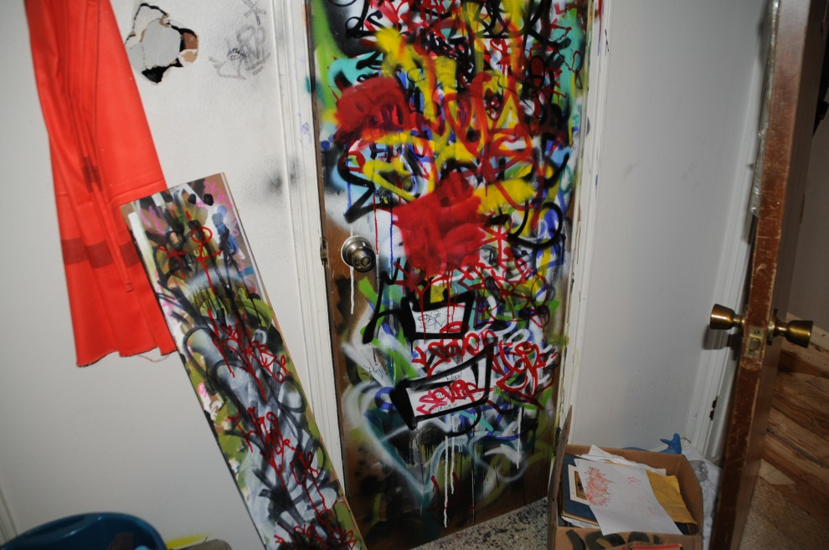
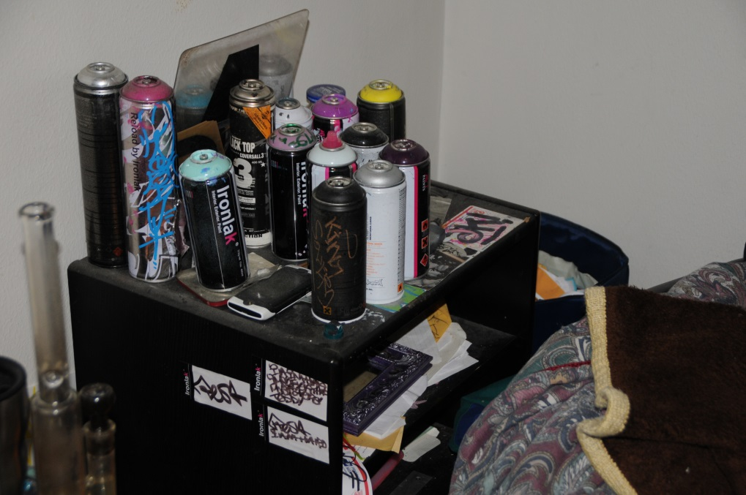
Case 1: Scene
Liked to spray paint graffiti
Could solvent inhalation be a factor?

Slide 15
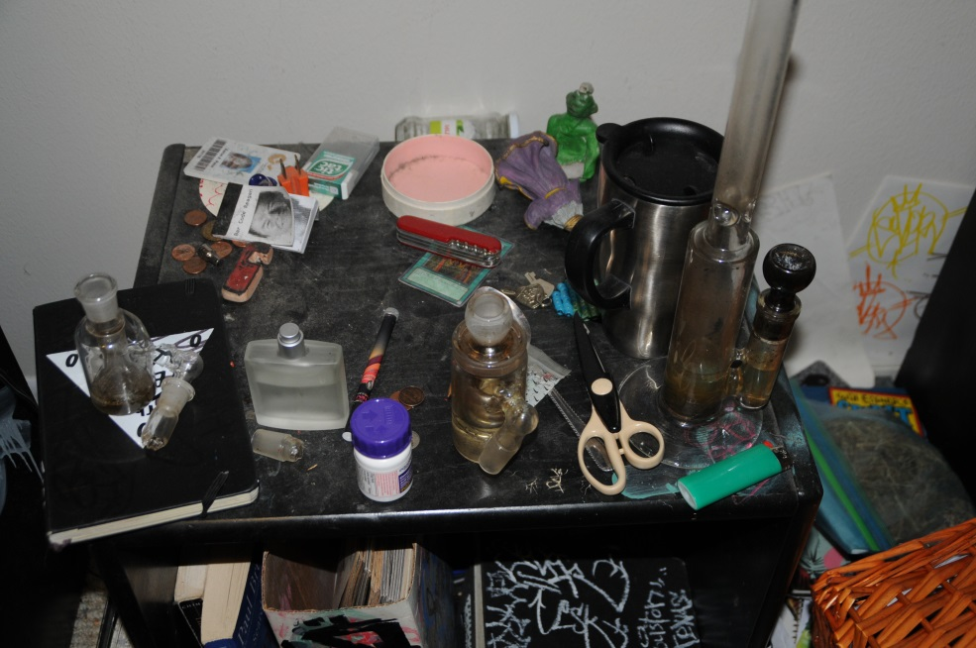
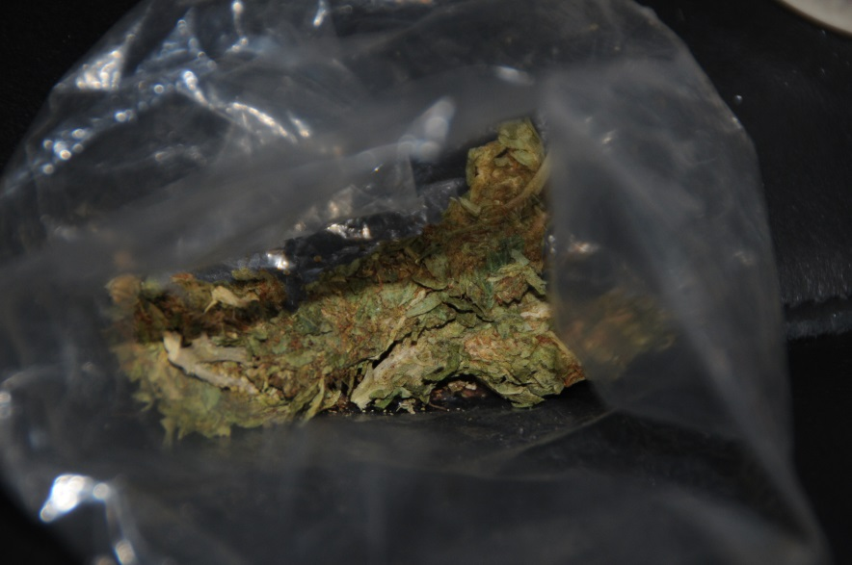
Case 1: Scene
Drug paraphernalia and marijuana found on site

Slide 16
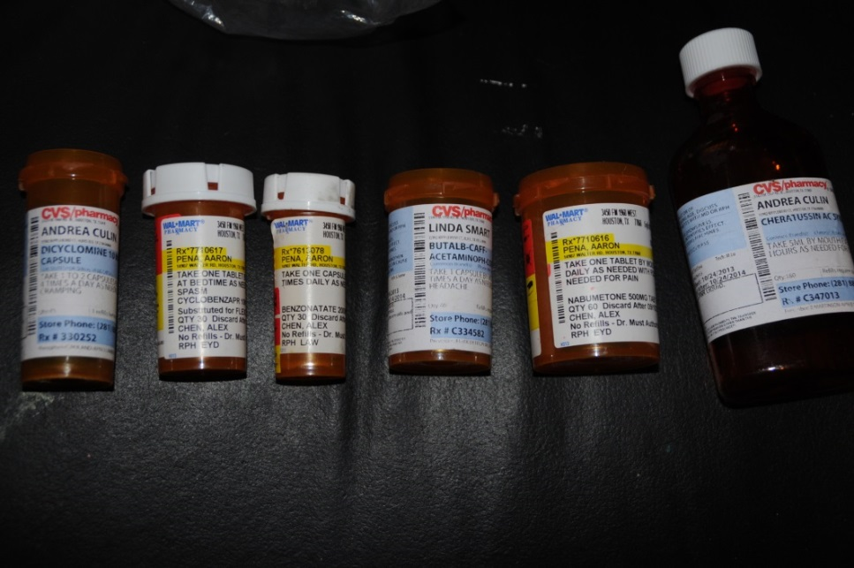
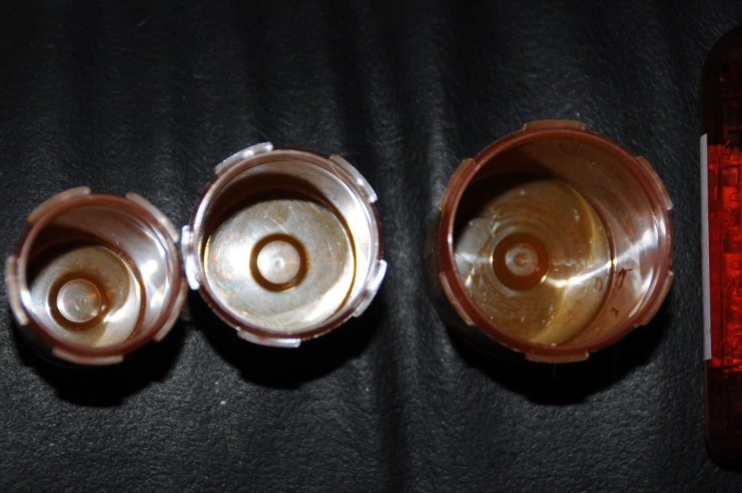
Case 1: Scene
Several prescription medication bottles found
Half of them assigned to other patients
All are empty

Slide 17
Case 1:
Autopsy

Slide 18
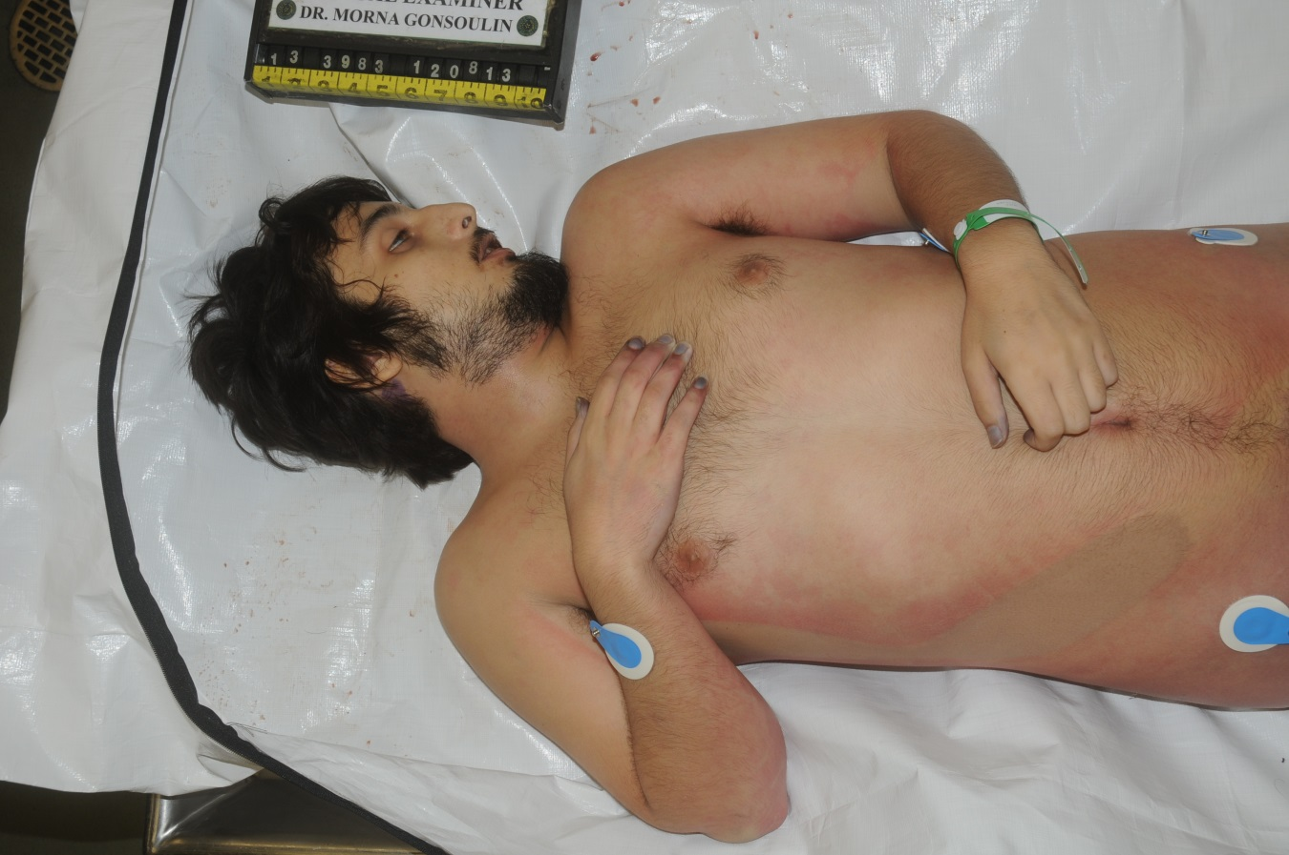
Case 1: Autopsy
Young, healthy, no injuries

Slide 19
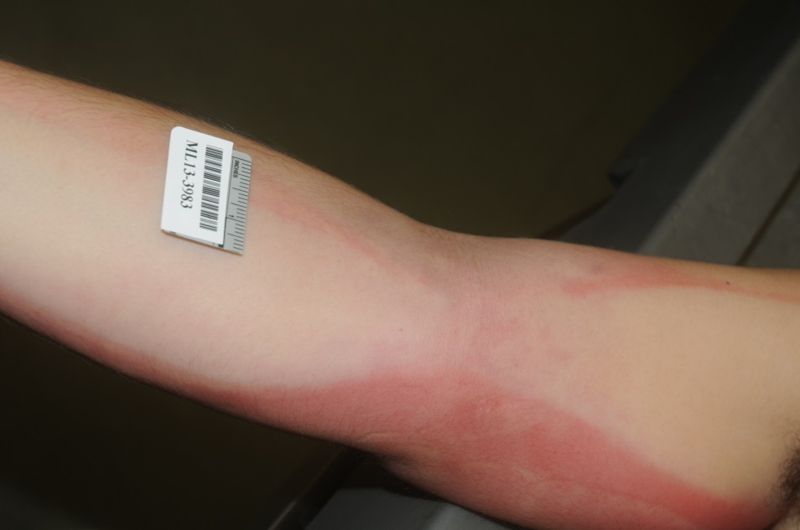
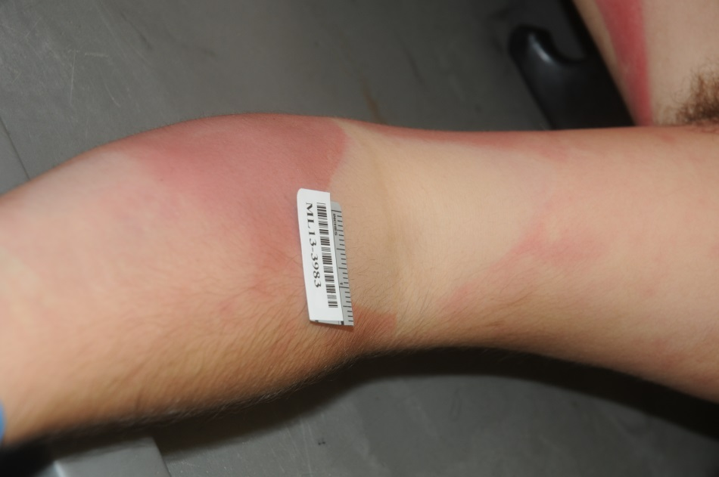
Case 1: Autopsy
No needle marks

Slide 20
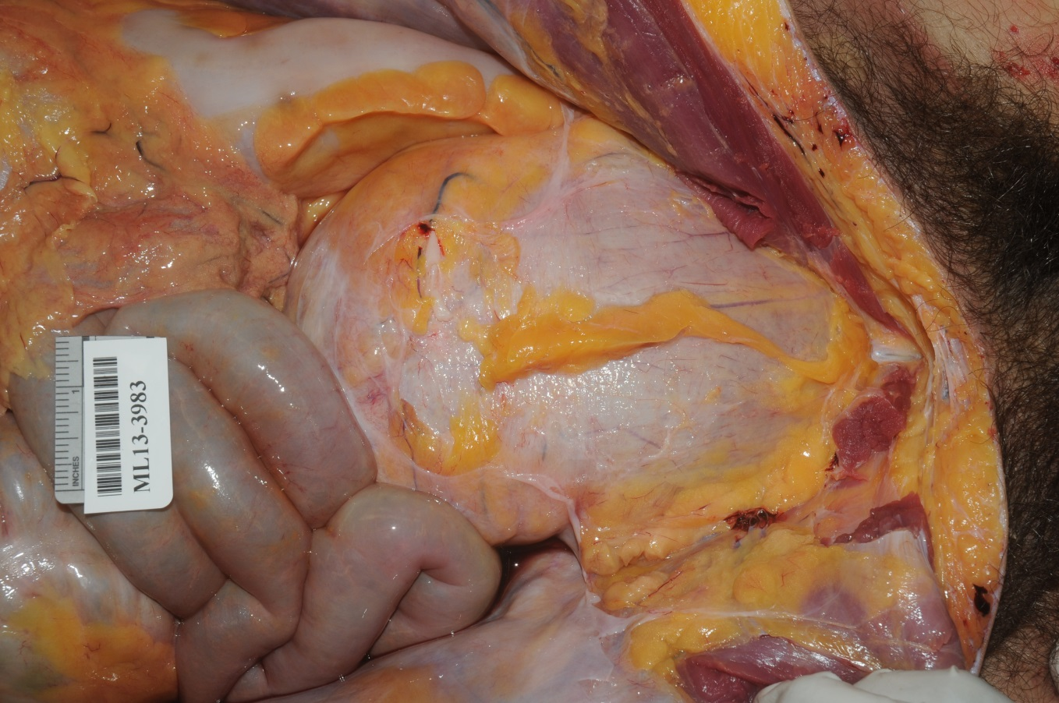
Case 1: Autopsy
Distended bladder, a sign of opioid toxicity

Slide 21
Case 1:
Toxicology

Slide 22
Case 1: Traditional toxicology
Blood
Analyte Result Method
Alprazolam 0.040 ± 0.009 mg/L LC/MS/MS
Fluoxetine 0.46 ± 0.17 mg/L LC/MS/MS
Marijuana Metabolite Presumptive positive Immunoassay - ELISA
Norfluoxetine 0.23 ± 0.09 mg/L LC/MS/MS
Vitreous Humor
Analyte Result Method
Chloride 100 ± 6 mEq/L Ion Selective Electrode
Creatinine 1.7 ± 0.3 mg/dL Spectrophotometric
Potassium 19.2 ± 1.2 mEq/L Ion Selective Electrode
Sodium 135 ± 4 mEq/L Ion Selective Electrode
Urea Nitrogen 18 ± 2 mg/dL Spectrophotometric
Toxicology shows a nominal profile that does not explain the reason for his death

Slide 23
Case 1: Further analysis
???
LC-TOF/MS profile showed:
  Caffeine
  Alprazolam
  Fluoxetine
  Norfluoxetine

Slide 24
Case 1: Further analysis
???

Slide 25
Case 1: Further analysis
Specimen: Blood
Analyte Result
Loperamide 0.063 mg/L
Therapeutic reference range: 0.001-0.003 mg/L
Cause of death:
Toxic effects of loperamide with fluoxetine and alprazolam
Manner:
Accident

Slide 26
Case 2:
Scene investigation

Slide 27
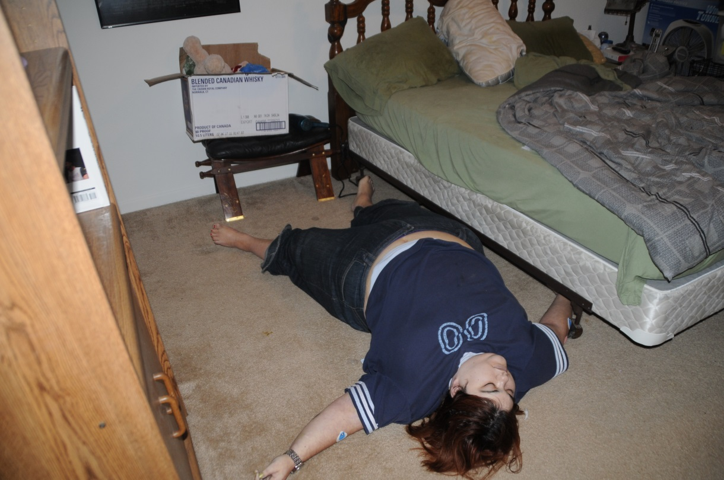
Case 2: Scene
Originally found sitting upright next to bed
Was repositioned on the floor for assessment
No attempts to resuscitate

Slide 28
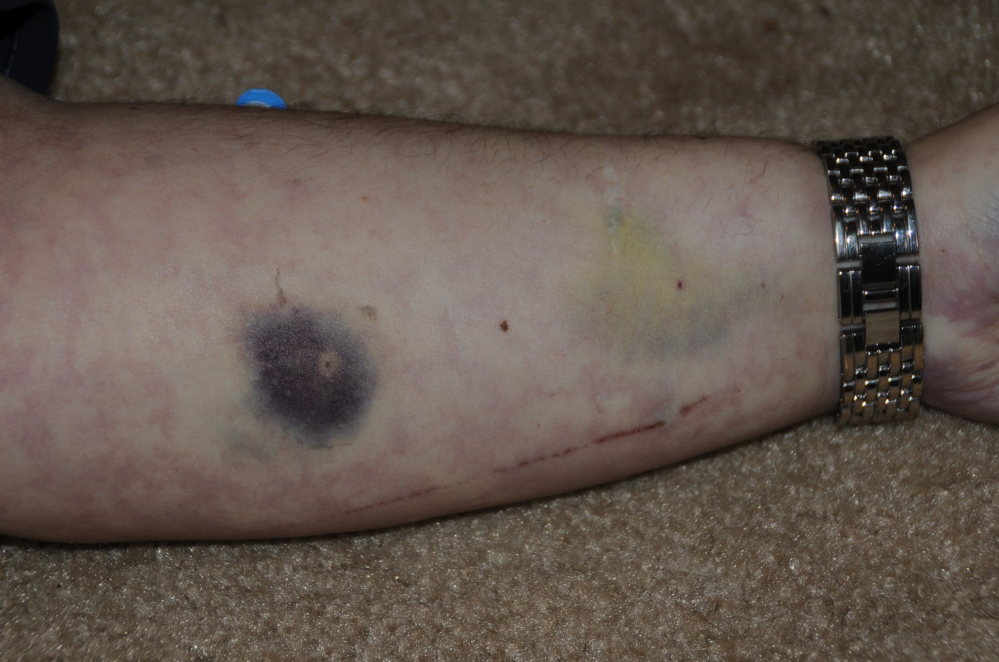
Case 2: Scene
Bruising was noted, but likely due to medical intervention when hospitalized five days ago

Slide 29
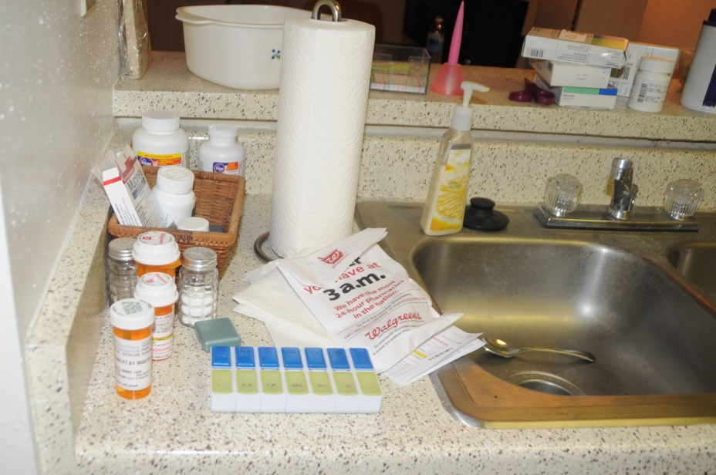
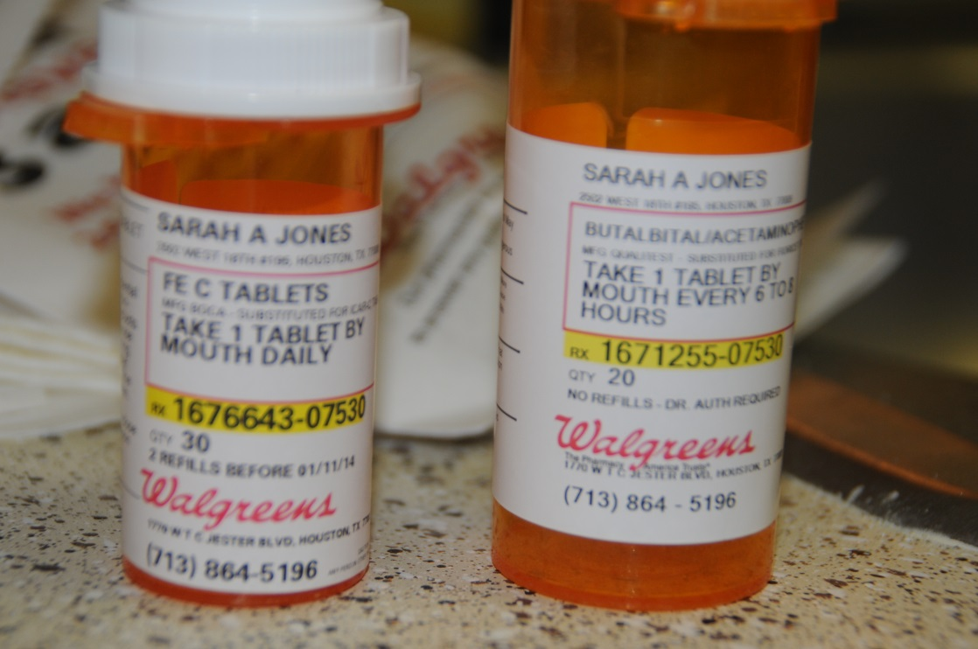
Case 2: Scene
Only a few prescriptions on scene:
  iron citrate and
  butalbital/APAP

Slide 30
Case 2:
Autopsy

Slide 31
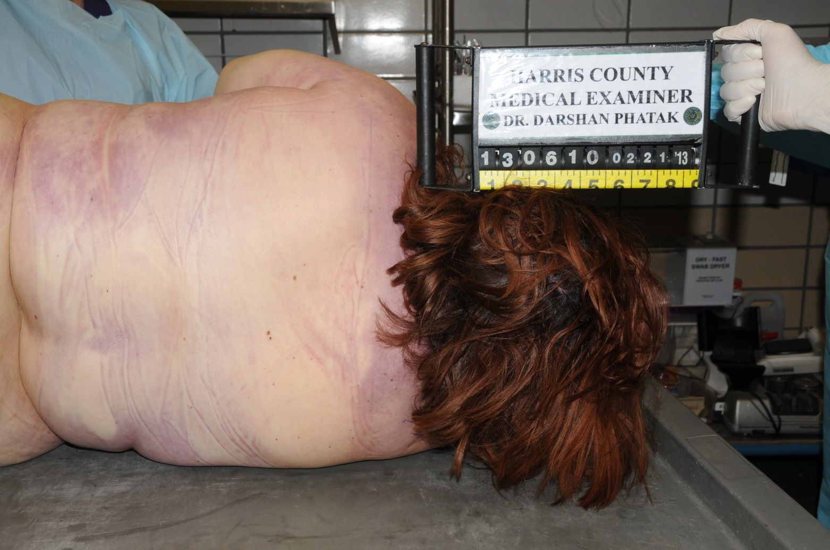
Case 2: Autopsy
Obesity noted at 332 lbs; lividity consistent with positioning

Slide 32
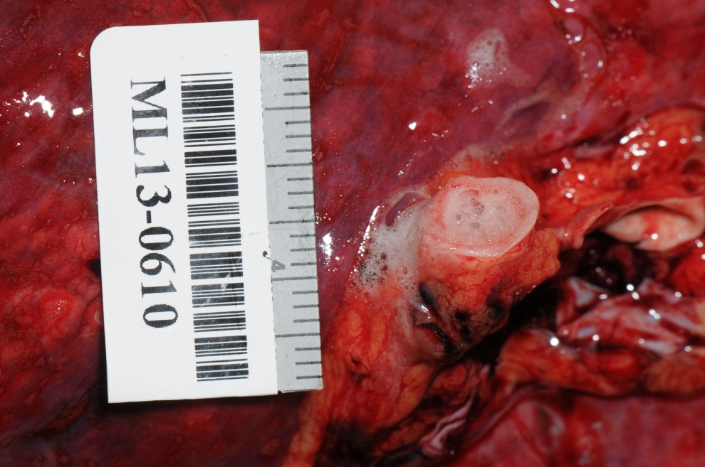
Case 2: Autopsy
Pulmonary edema; frothy material exuding from bronchi

Slide 33
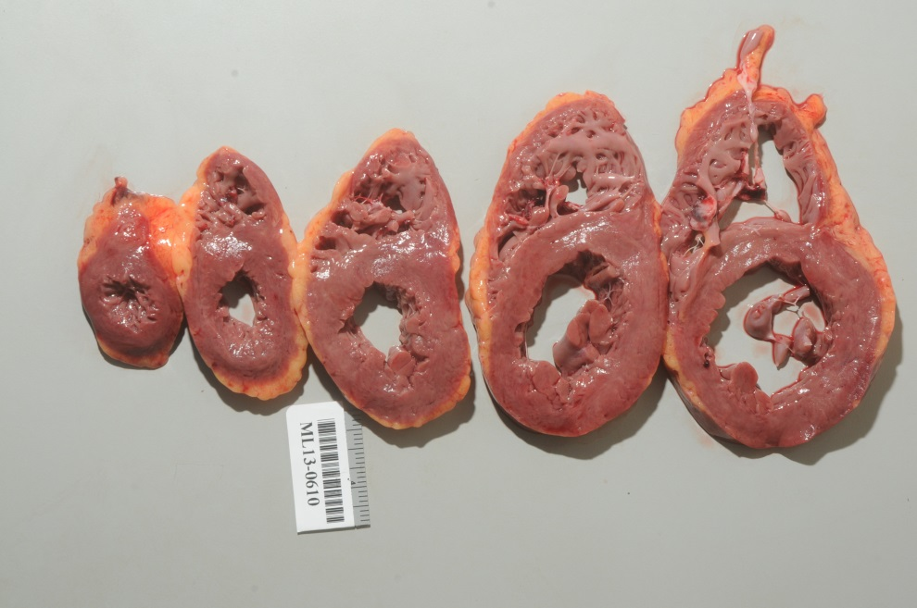
Case 2: Autopsy
Cardiomegaly noted (450 gram heart); minimal atherosclerosis

Slide 34
Case 2:
Toxicology

Slide 35
Case 2: Traditional toxicology
Blood
Ibuprofen Present
Metaxalone Present
Pregabalin 6.6 mg/L
Vitreous Humor
Chloride 110 mEq/L
Creatinine 0.7 mg/dL
Potassium 7.8 mEq/L
Sodium 149 mEq/L
Urea Nitrogen 34 mg/dL
Traditional methods revealed nominal concentrations of ibuprofen, metaxalone, and pregabalin
Vitreous chemistries are unremarkable
Without a pathological cause of death, the toxicology becomes a primary issue

Slide 36
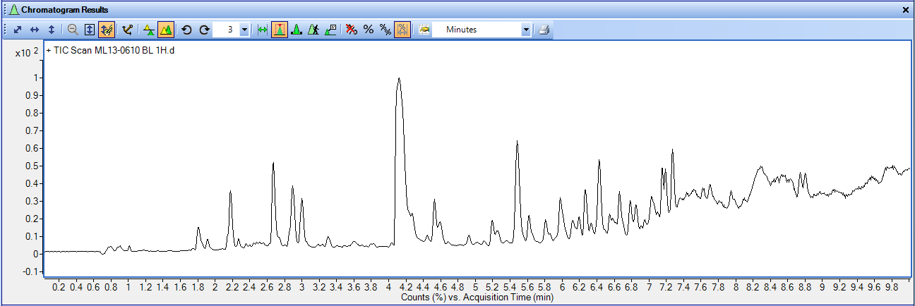
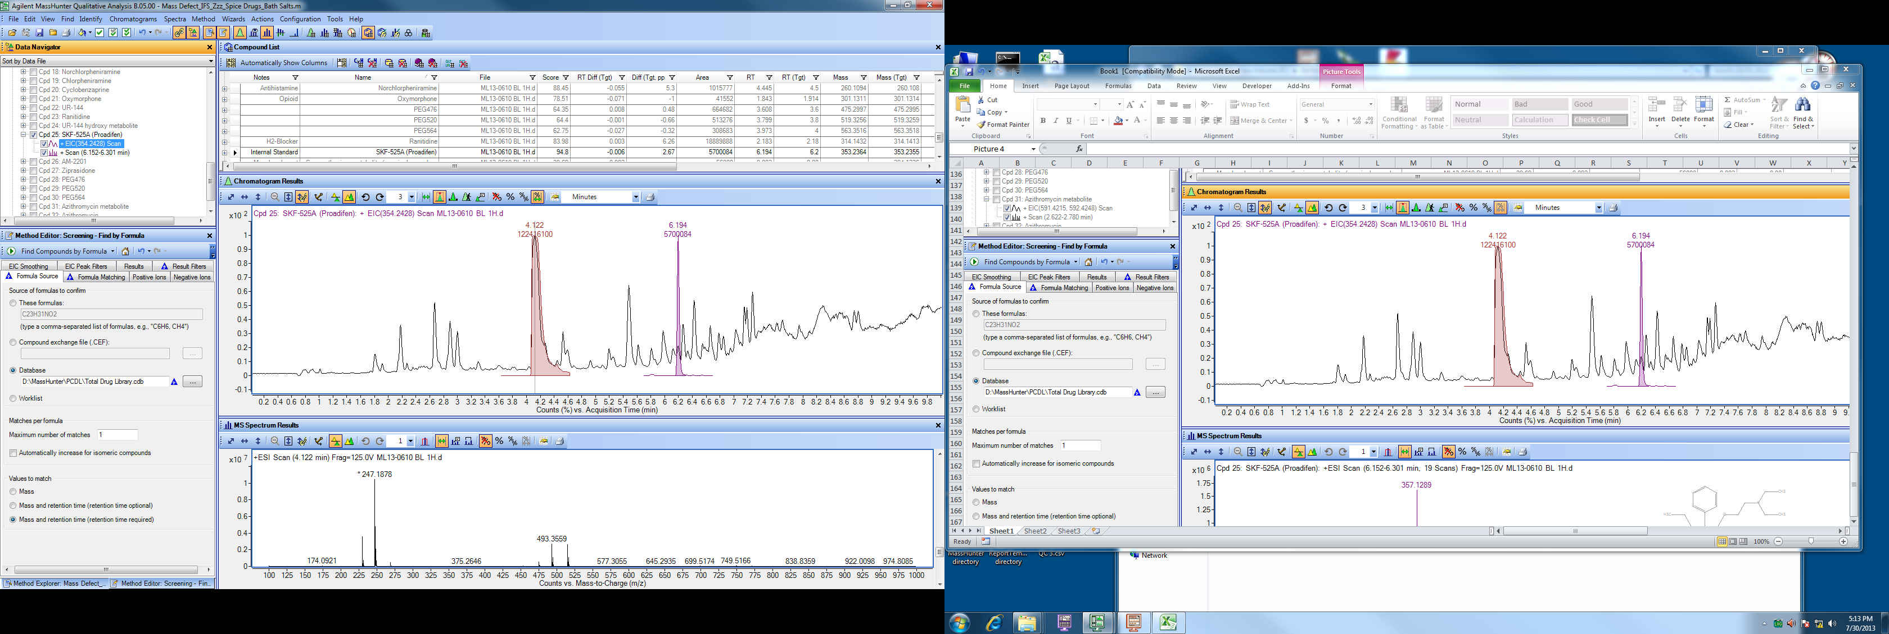
Case 2: Further analysis

Slide 37
Case 2: Further analysis
+

Slide 38
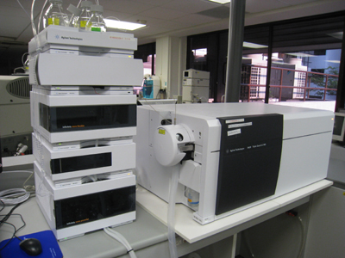
Case 2: Further analysis
Blood
Milnacipran 40 mg/L
Gastric contents
Milnacipran 379 mg/L
Cause: Acute milnacipran toxicity
Manner: Suicide

Slide 39
Case 3:
Scene investigation

Slide 40
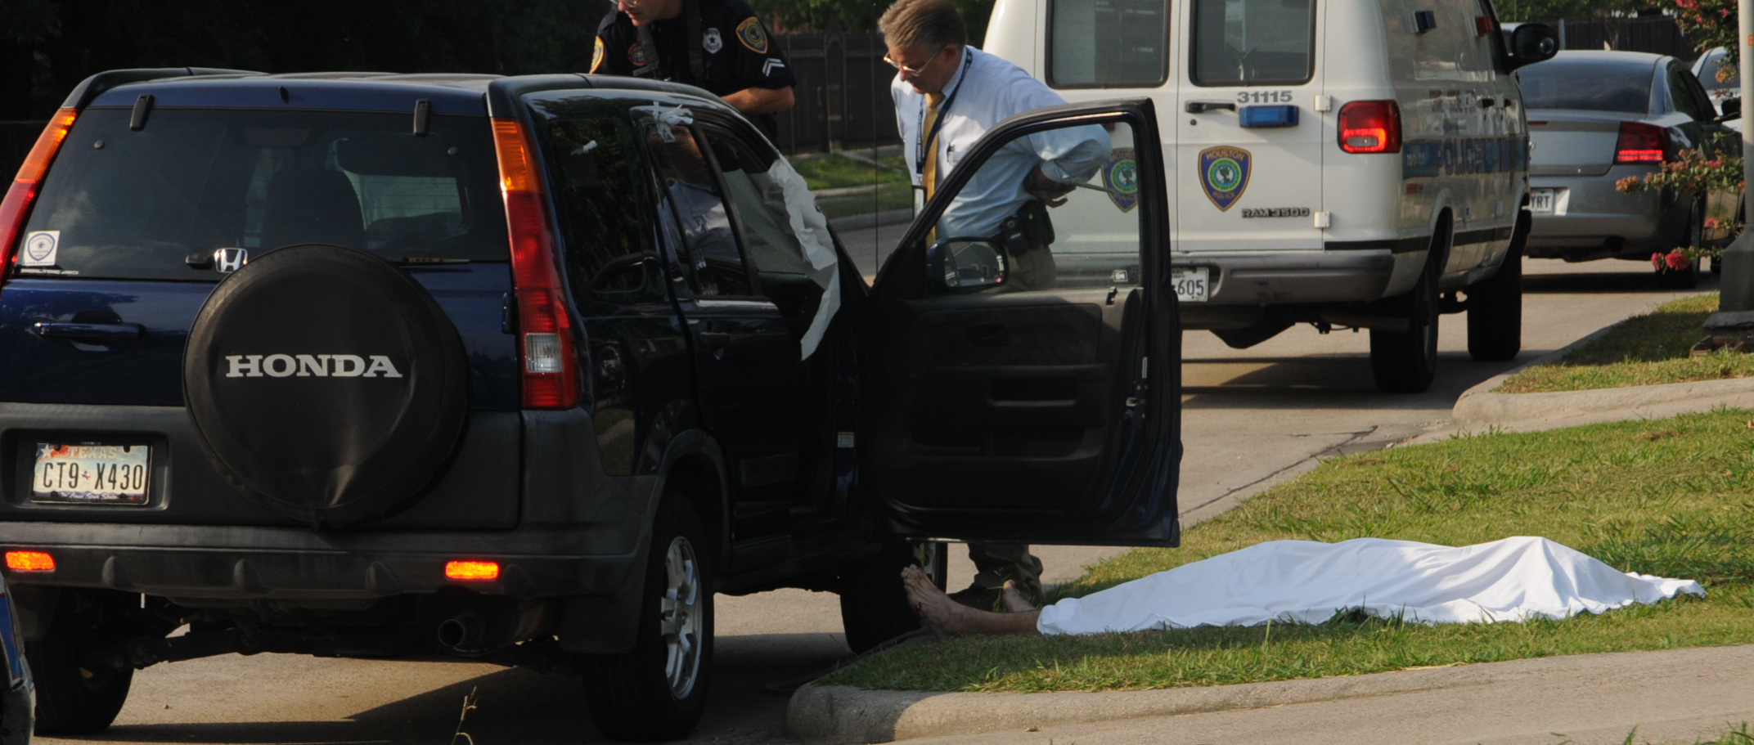
Case 3: Scene
A 21-year-old male went with his friend to a rave party
Admitted to his friend he had taken “new acid”
A sudden violent rage occurred, then he become unresponsive

Slide 41
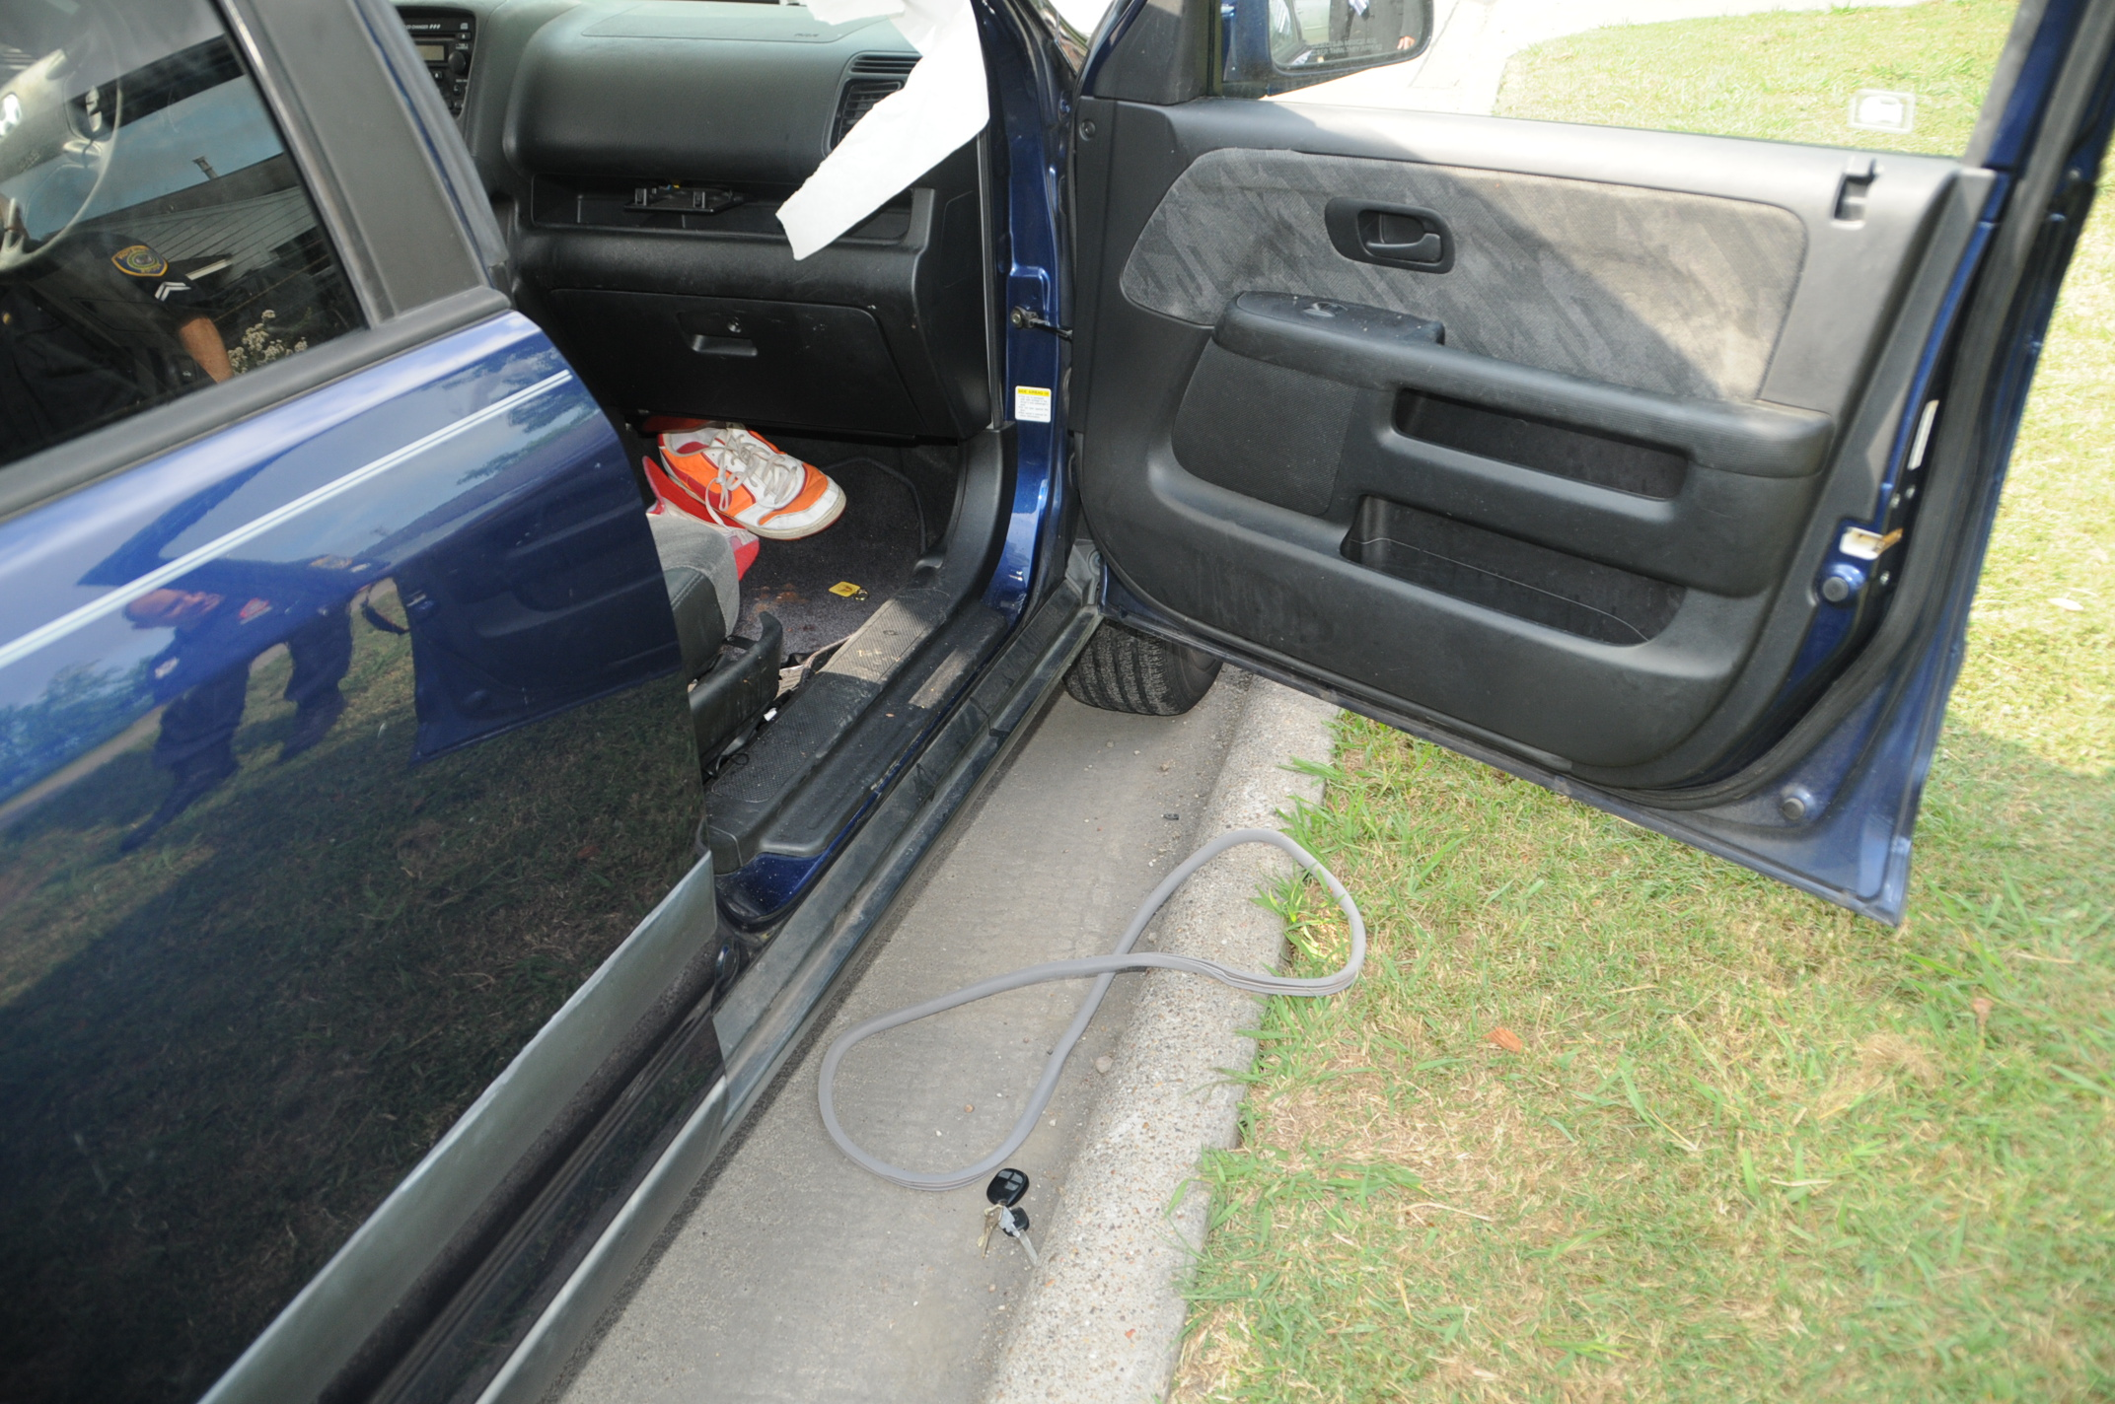
Case 3: Scene

Slide 42
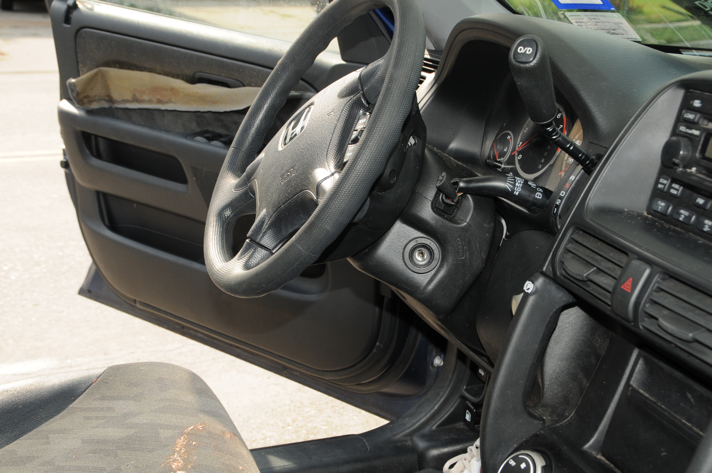
Case 3: Scene

Slide 43
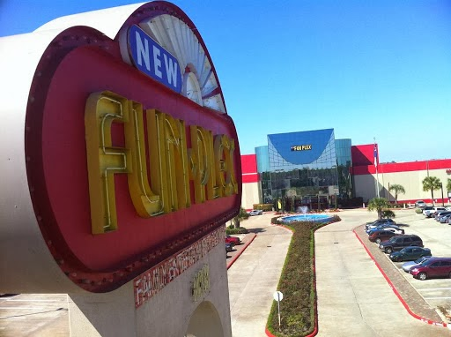
Case 3: Scene
A 15-year-old female was socializing outside a rave party; friend went inside
When friend returned, she became ill and rapidly deteriorated
She went unresponsive as her friend transported her to the hospital

Slide 44
Case 3:
Autopsy

Slide 45
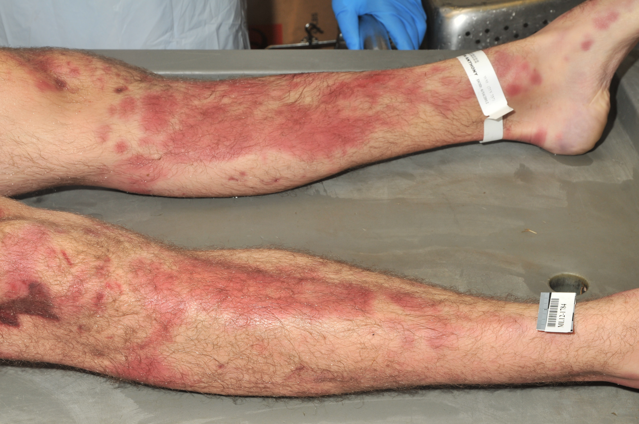
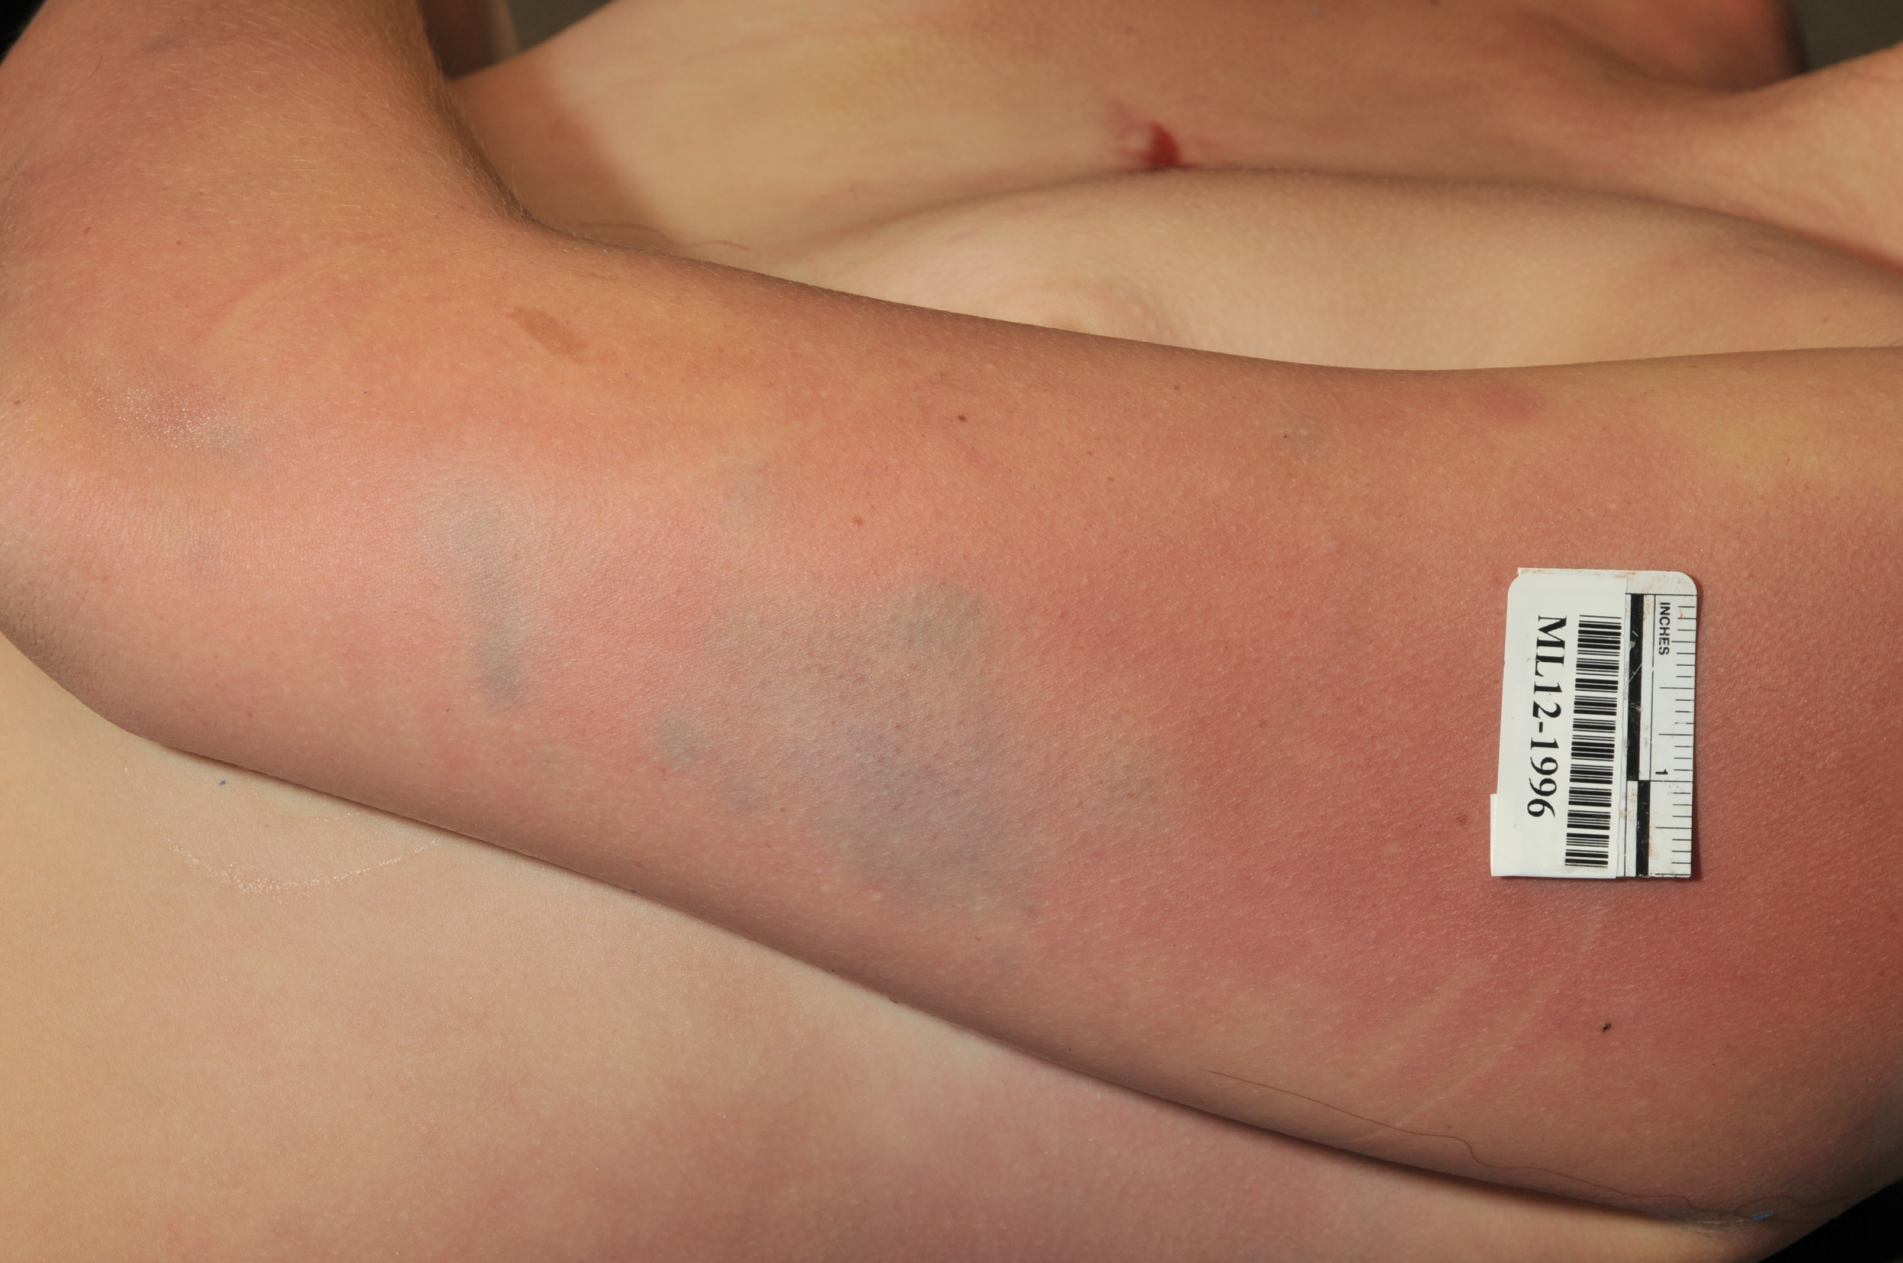
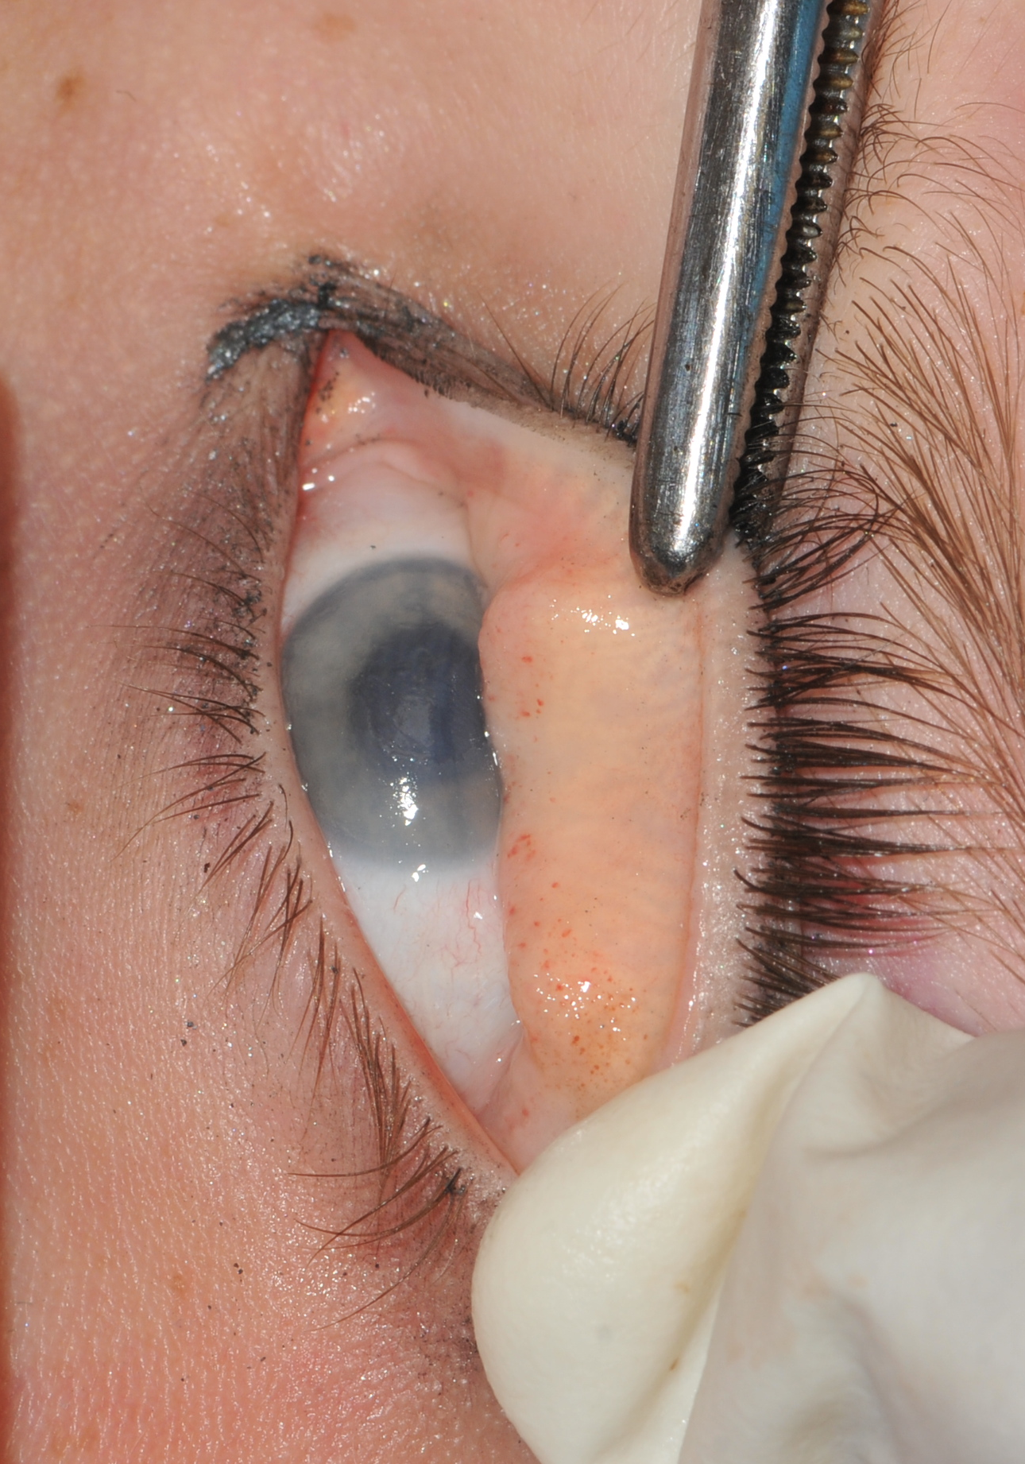
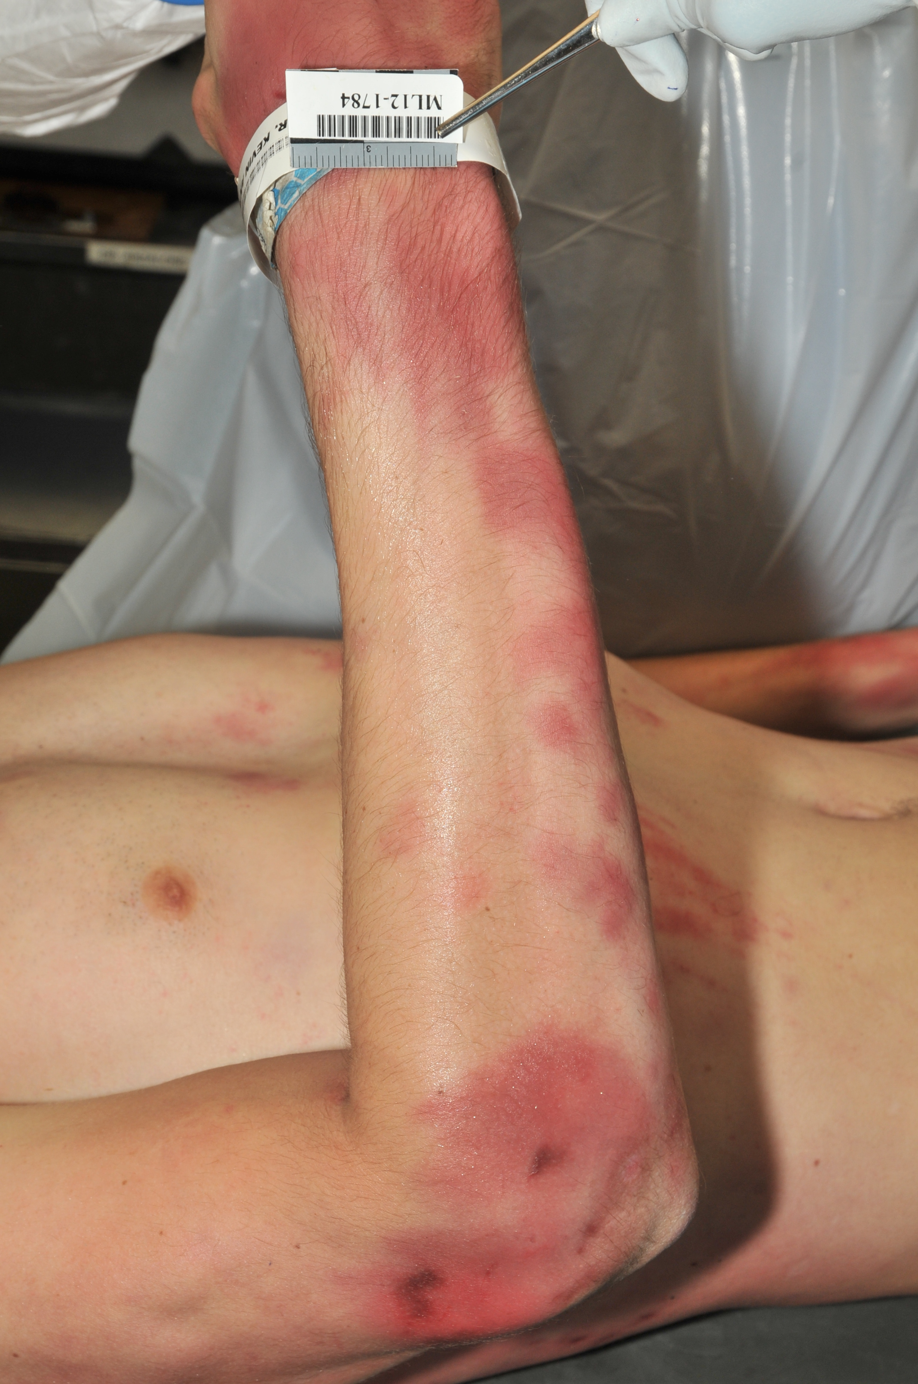
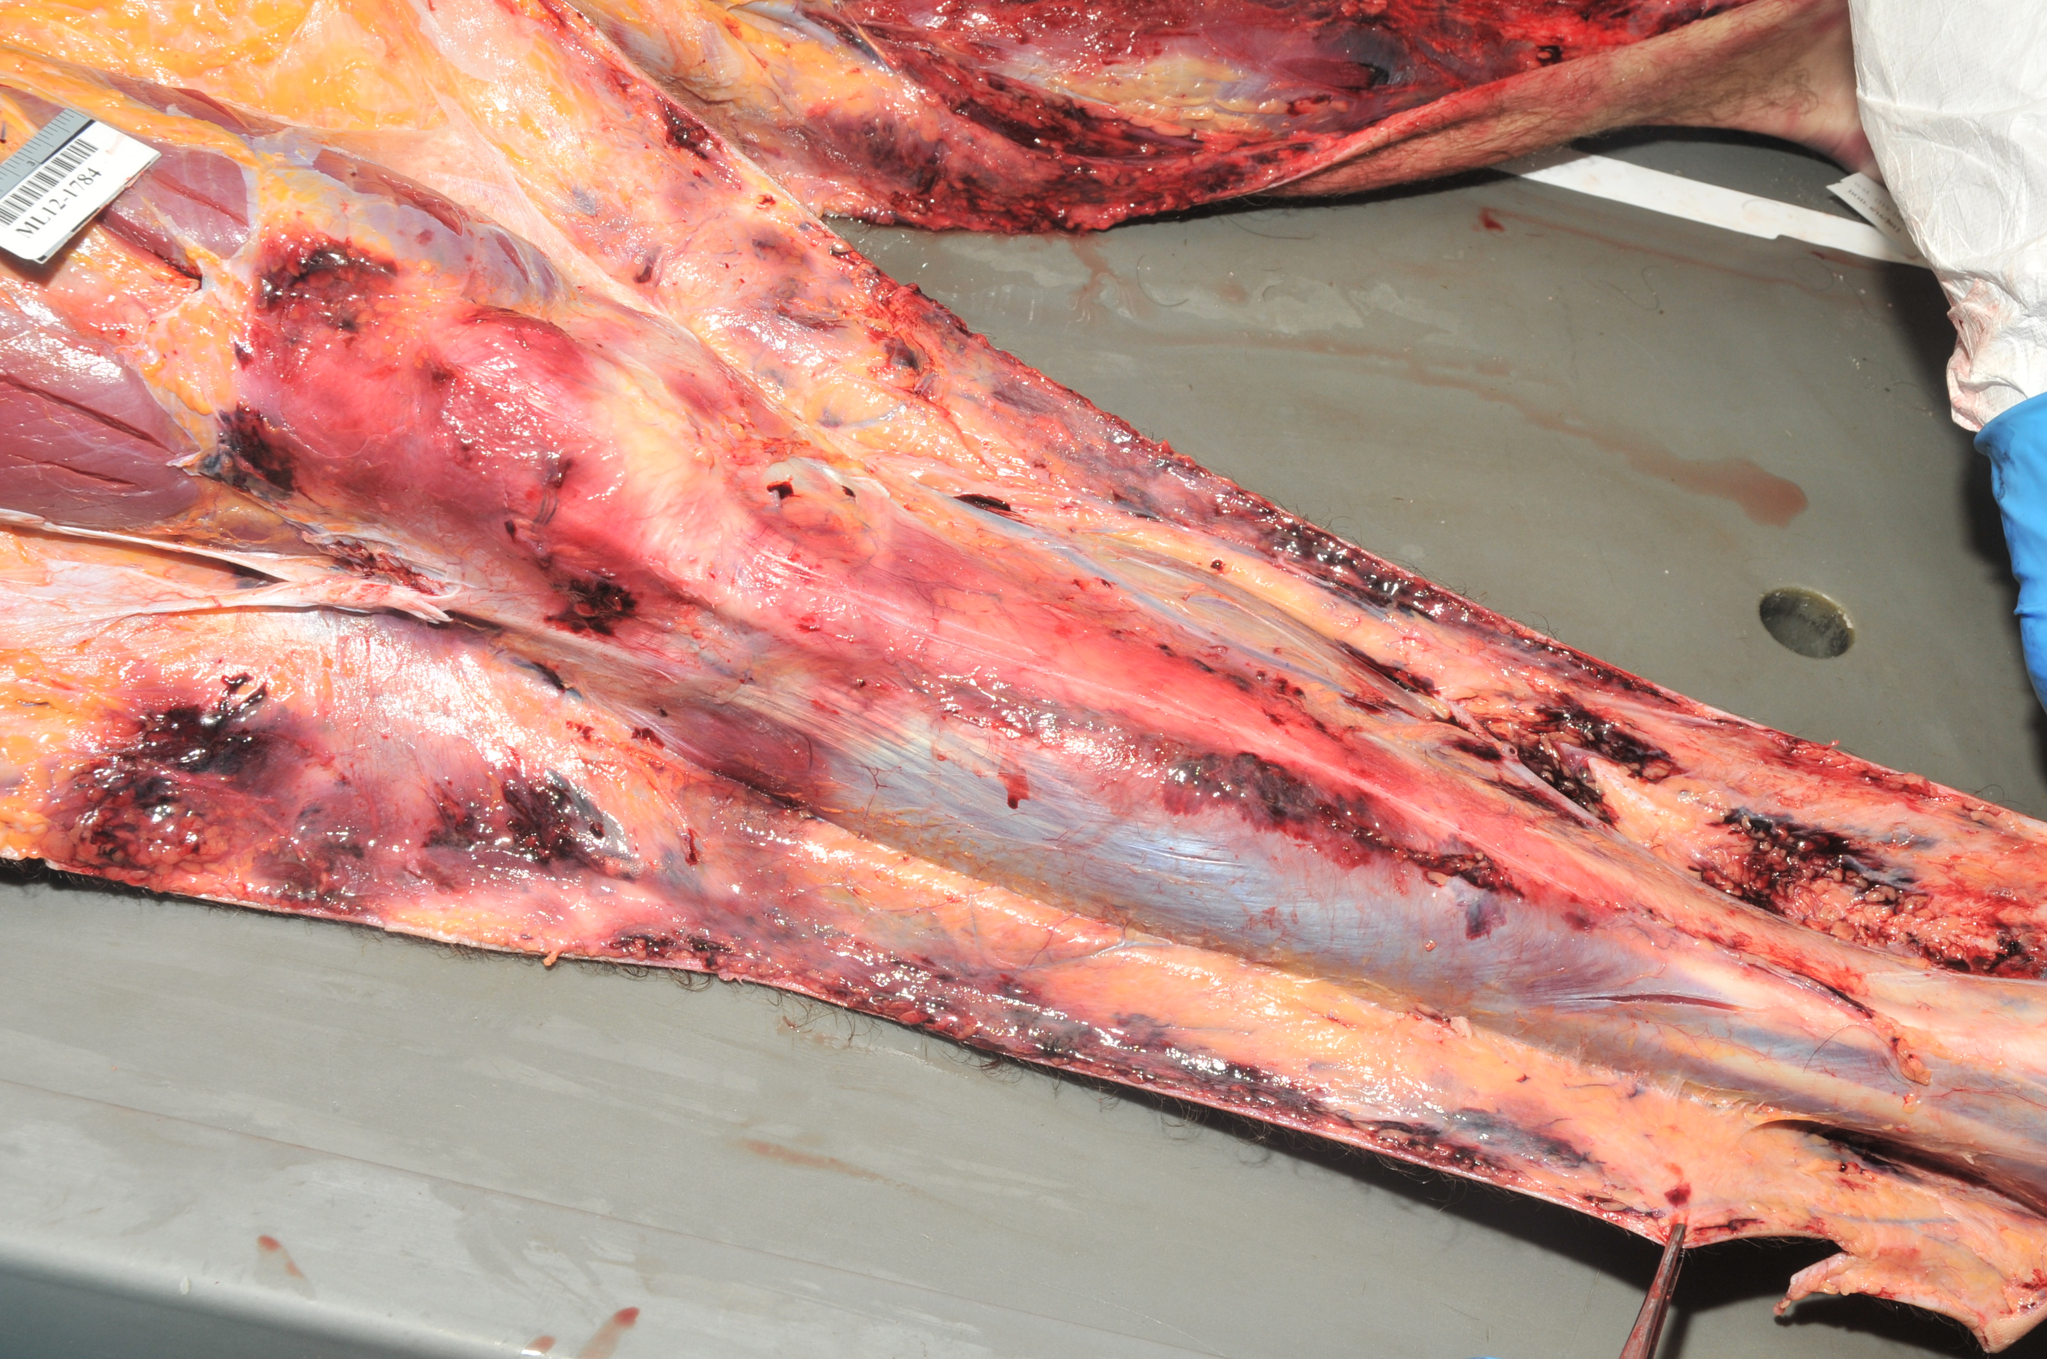
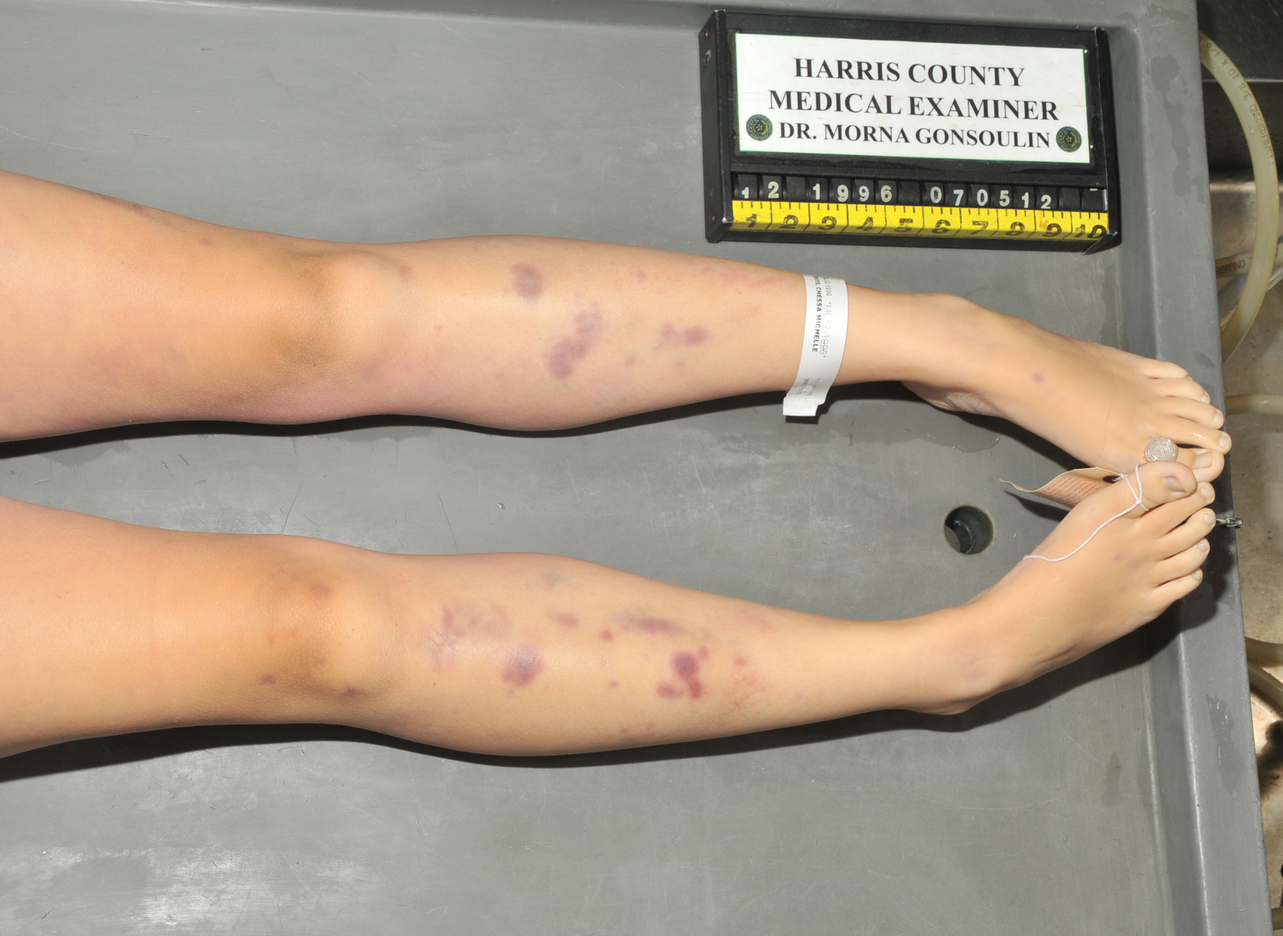
Case 3: Autopsy
Both decedents are young and healthy
Both have numerous external contusions
Both went to “rave” parties
Both died shortly after consuming an unknown substance

Slide 46
Case 3:
Toxicology

Slide 47
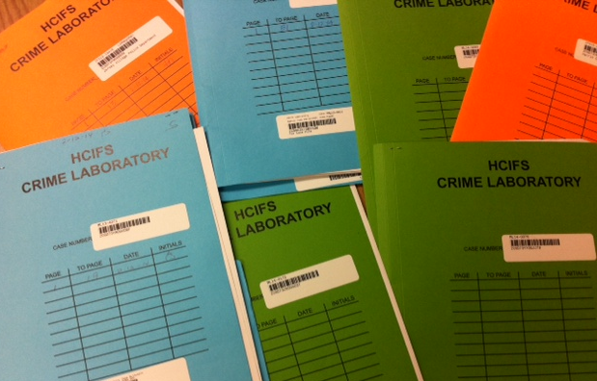
Case 3: Traditional toxicology
21 yo male:
THC metabolite
Normal chemistries
No ethanol
Negative alkaline drug screen
Negative TOF drug screen
15 yo female:
THC and metabolite
Normal chemistries
No ethanol
Negative alkaline drug screen
Negative TOF drug screen

Slide 48
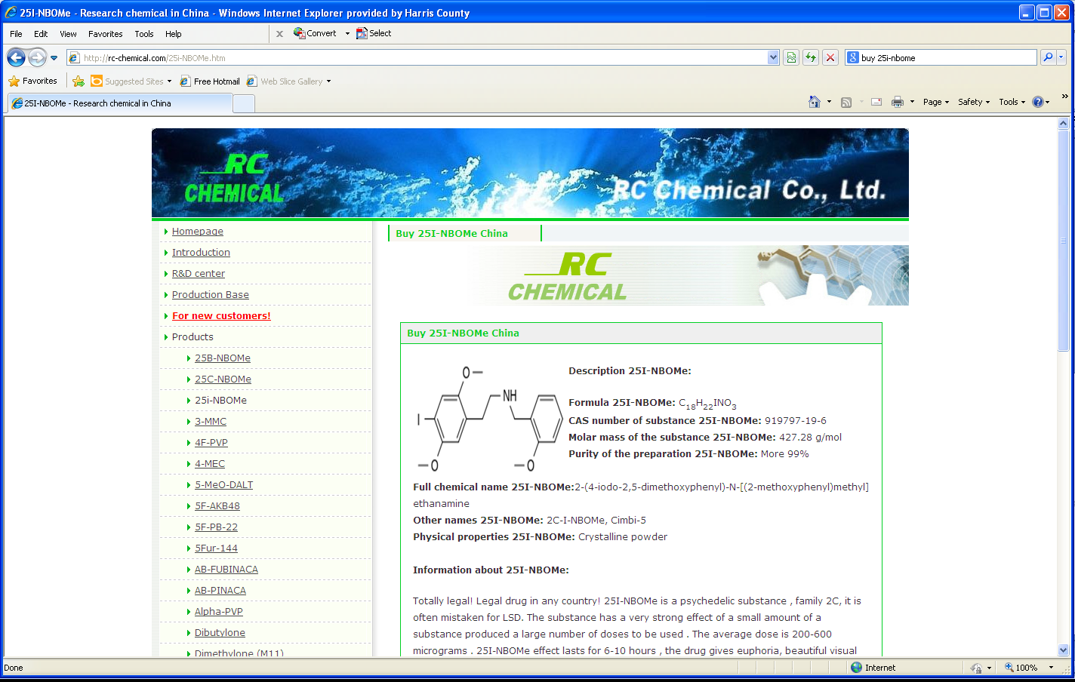
Case 3: Further analysis

Slide 49
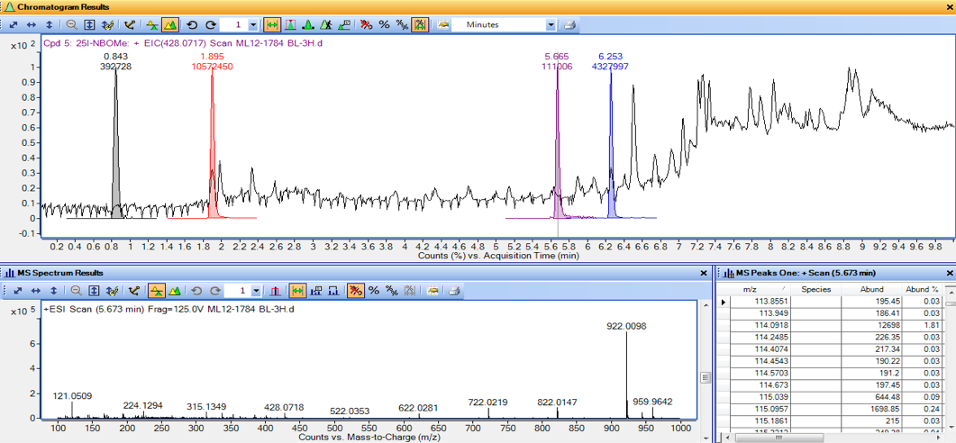
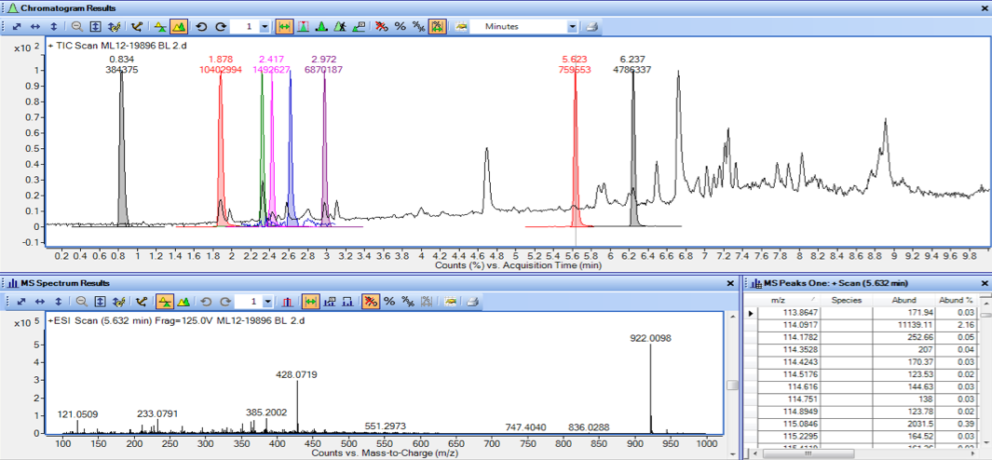
Case 3: Further analysis
21 yo
male
15 yo
female

Slide 50
Case 3: Further analysis
21 yo male
15 yo female

Slide 51
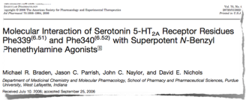
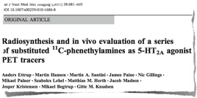
Case 3: Further analysis
A new serotonin receptor agonist with superpotent activity
25I-NBOMe

Slide 52
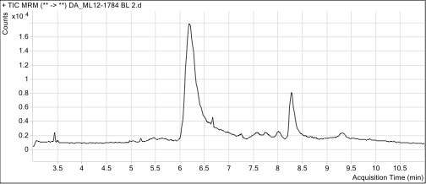
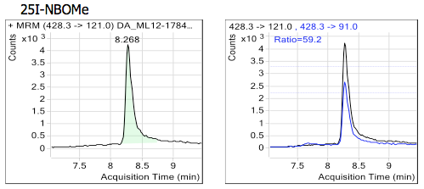
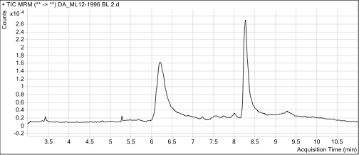
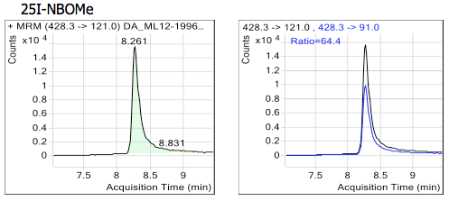
Case 3: Further analysis
CONFIRMED
Tandem mass analysis is needed to confirm the presence of 25I-NBOMe in blood and urine
CONFIRMED

Slide 53


Case 3: Further analysis

Slide 54
Case 3: Further analysis
25I-NBOMe
(ng/mL or ng/mg)
Specimen | Case 1 | Case 2
Whole blood | 4.7 | 16
Vitreous humor | 0.0 | 0.4
Stomach contents | 6.5 | 570
Urine | 6.7 | 19
Liver | 0.0 | 31
Brain | 22 | 241
Bile | 17 | 157
Cause: Toxic effects of 25I-NBOMe
Manner: Accident

Slide 55
DWI
Toxicology

Slide 56
DWI by synthetic cannabinoids
JWH-018
UR-144
AB-FUBINACA
2011
2012
2013
2014
Napthoylindoles
Tetramethylcyclopropylindoles
Indazolecarboxamides

Slide 57

DWI by synthetic cannabinoids 2012

Slide 58

DWI by synthetic cannabinoids 2013

Slide 59

DWI by synthetic cannabinoids 2014

Slide 60
Summary

Slide 61
Summary
Toxicology investigations require knowledge of the drugs involved in order to assign proper tests.
Accurate mass spectrometry such as LC-TOF/MS allows for monitoring a wide array of drugs, metabolites, and other exotic compounds in a single test.
This method can reveal evidence of drug use in postmortem or human performance casework when information is misleading or lacking.
If your lab does not have this technology, make sure the outsourced lab can provide this type of assay.

Slide 62
Thank you for attending!
jeffrey.walterscheid@ifs.hctx.net

