Slide 1
NIST/NIJ Technical Working Group on Biological Evidence Preservation
40th Annual ASCLD Symposium
The Business Behind the Science
Stephanie Stoiloff
Miami-Dade Police Department
May 8, 2013

Slide 2
The State of Biological Evidence Preservation
“ In order for qualified forensic science experts to testify competently about forensic evidence, they must first find the evidence in a usable state and properly preserve it.”
NAS Report

Slide 3
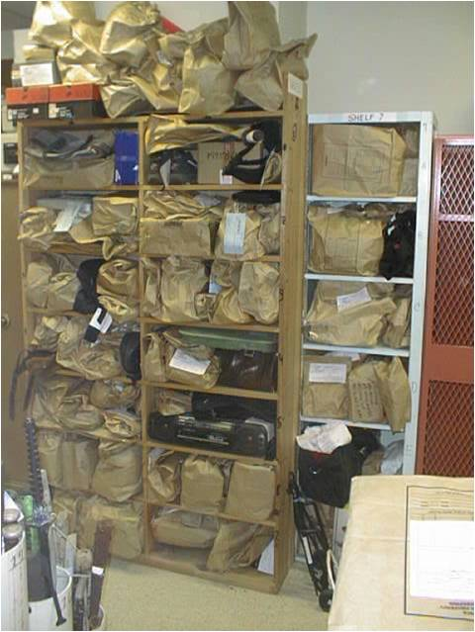
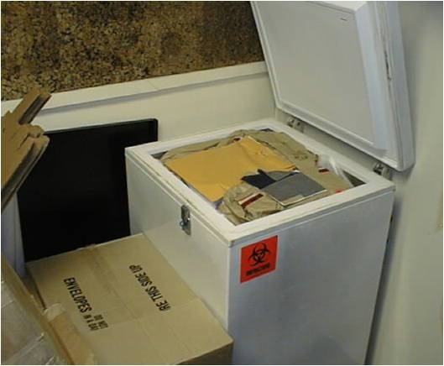
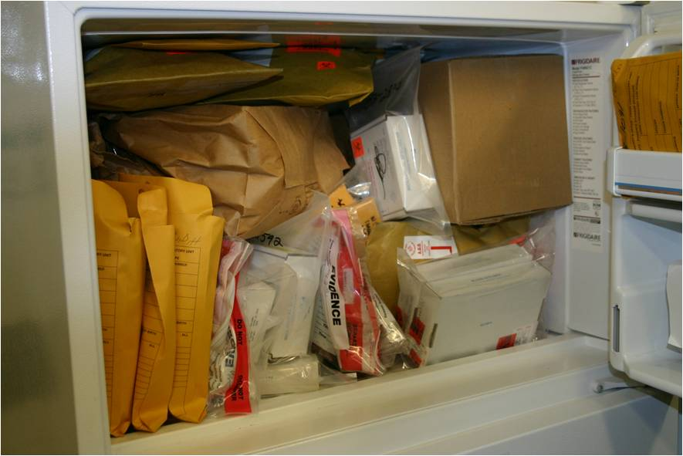
“Bad” Evidence Rooms

Slide 4
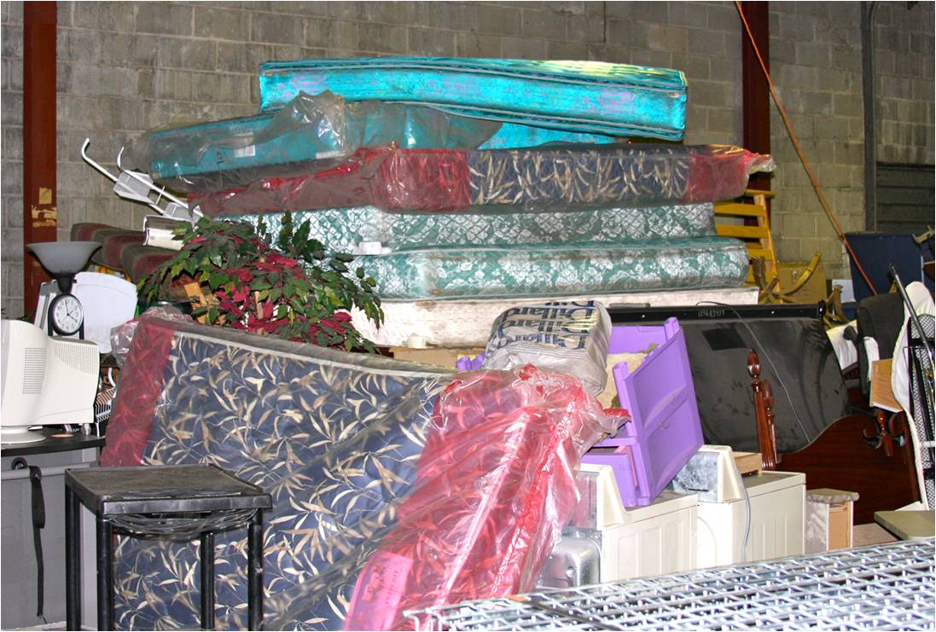
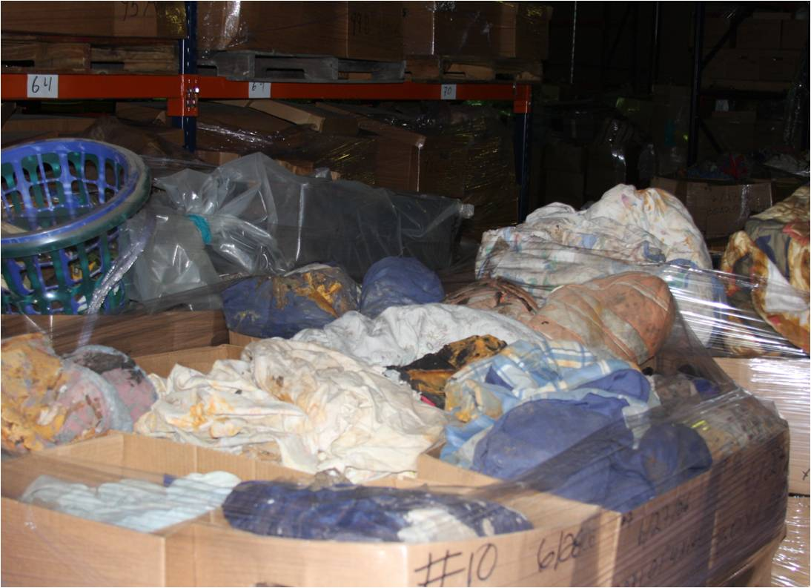
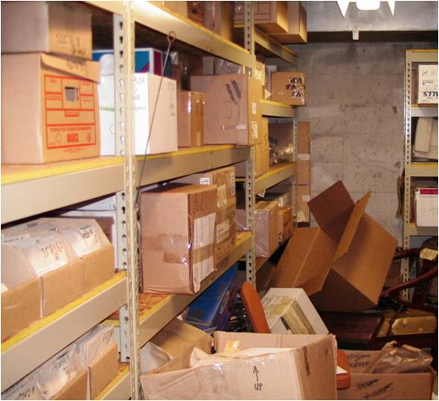
“Bad” Evidence Rooms

Slide 5
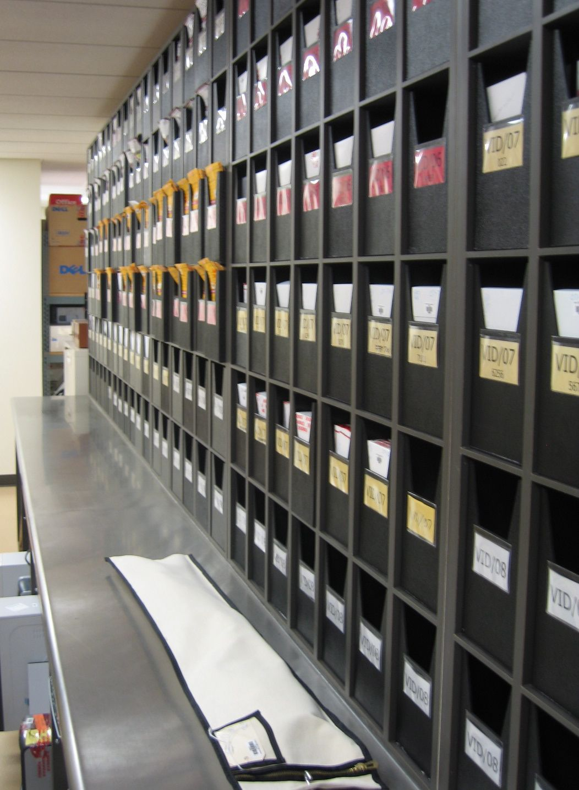
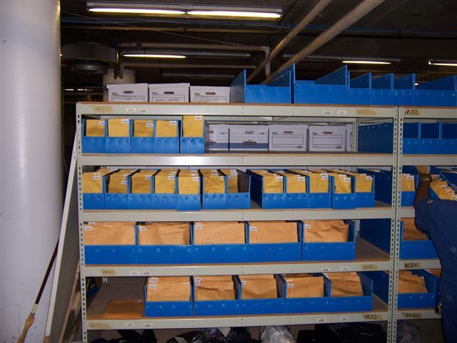
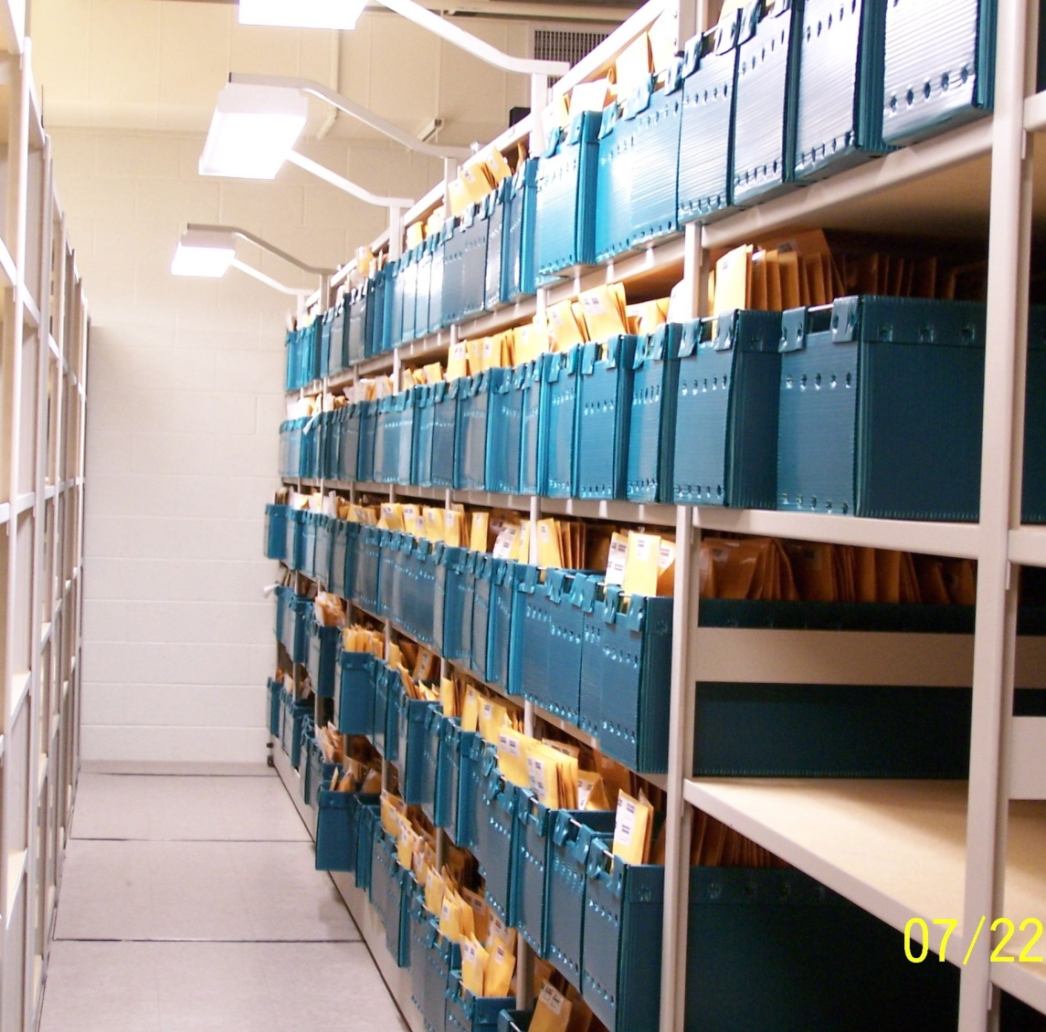
“Good” Evidence Rooms

Slide 6
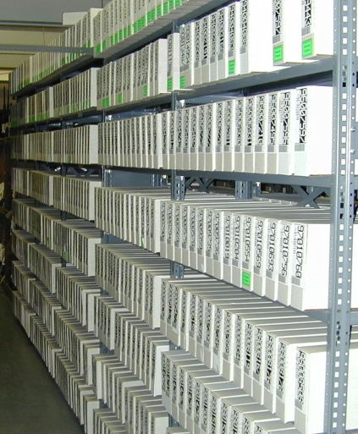
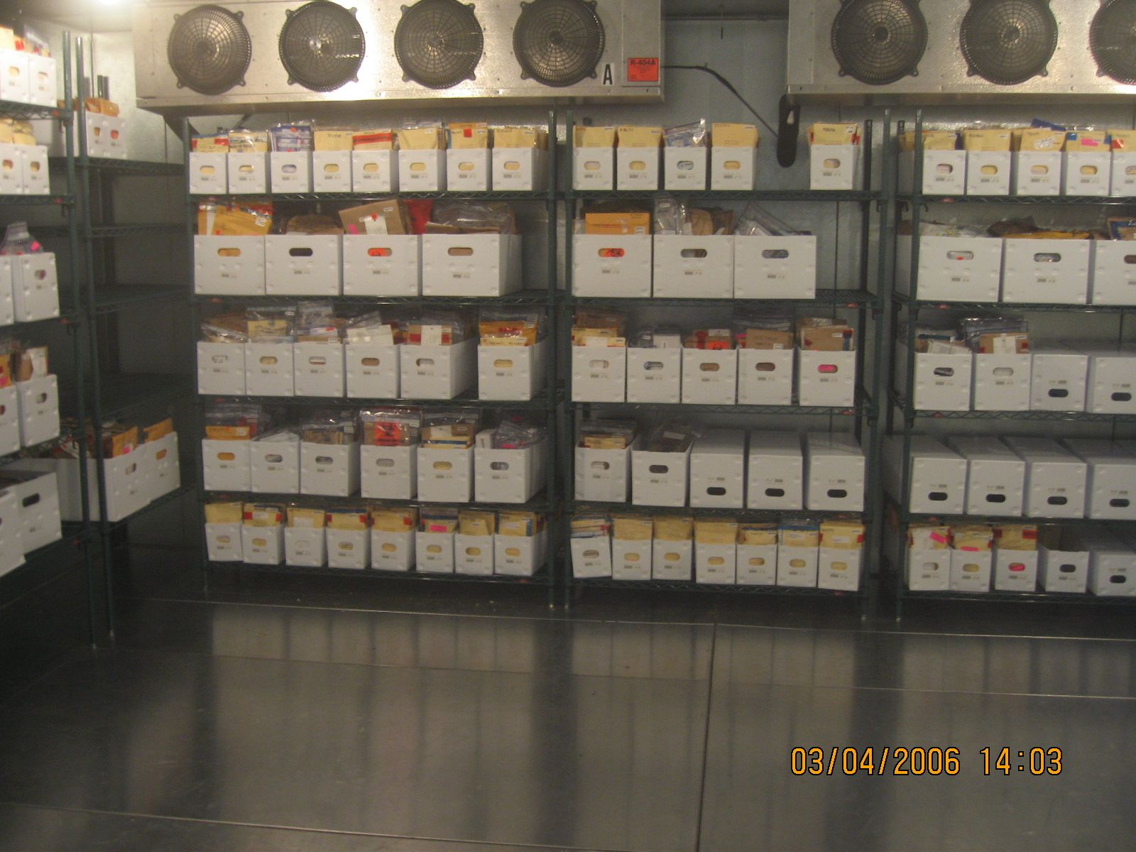
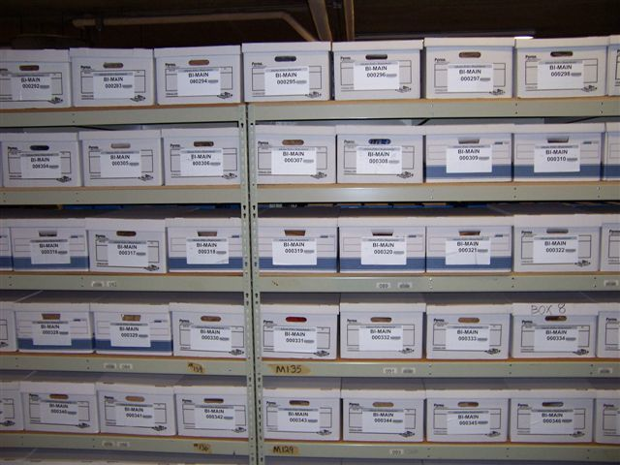
“Good” Evidence Rooms

Slide 7
The State of Biological Evidence Preservation
What does your evidence room look like?

Slide 8
Technical Working Group on Biological Evidence Preservation
TWG was established in partnership with NIJ and NIST
August 2010: Inaugural meeting
Broad goal to “establish proper collection, storage, and preservation techniques throughout the forensic science disciplines.”

Slide 9
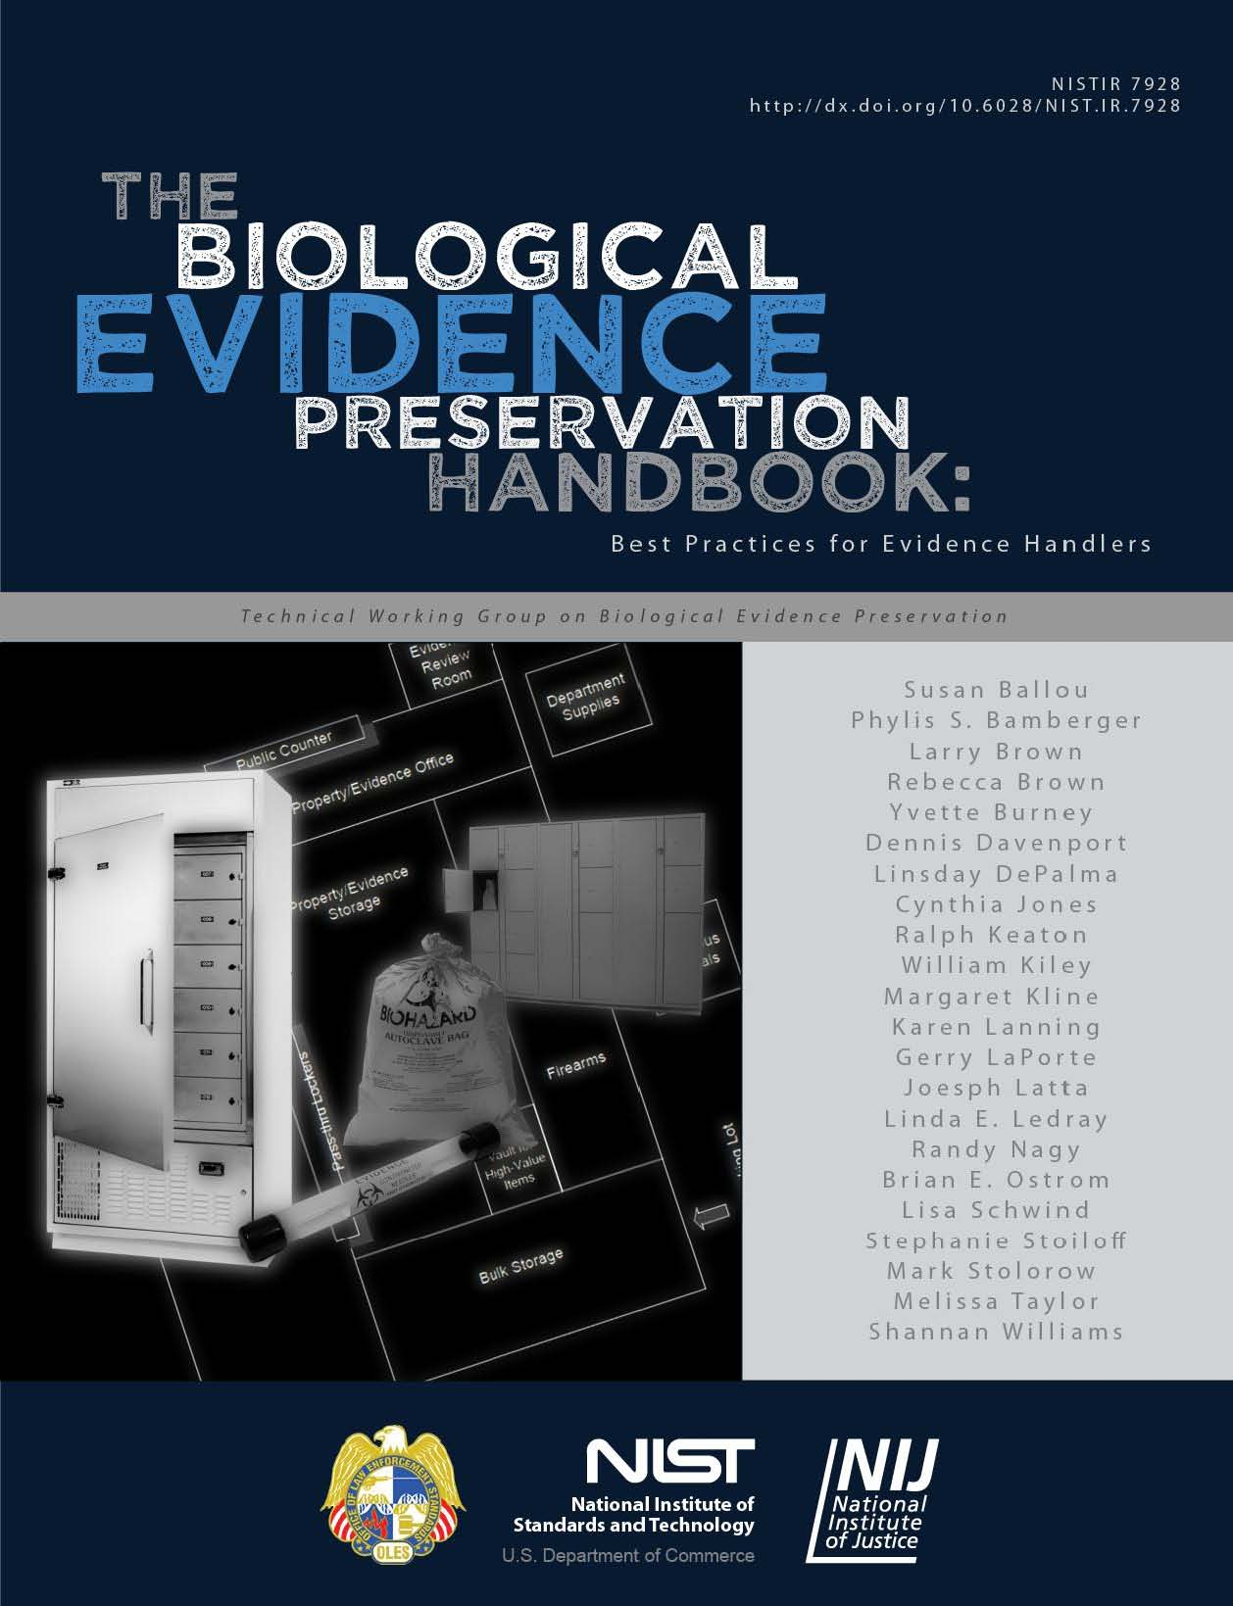

Slide 10
Group Charge
To create best practices and guidance to ensure the integrity, prevent the loss, and reduce the premature destruction of biological evidence --
after collection through post-conviction proceedings.

Slide 11
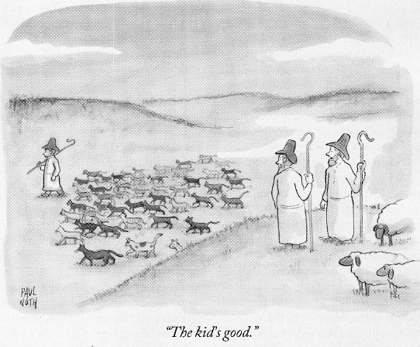
The TWG Group

Slide 12
Handbook on Biological Evidence Preservation
Target Audience:
All handlers of biological evidence (emphasizing
property and evidence custodians)
Sections of Handbook:
Retention
Packaging and Storage
Tracking and Chain of Custody
Disposition

Slide 13
Handbook on Biological Evidence Preservation: Retention Section
Discusses the identification of biological evidence
Provides guidance for length of retention of evidence based on:
crime categories
case status (open, charges filed, adjudicated, unfounded/refused/denied)

Slide 14
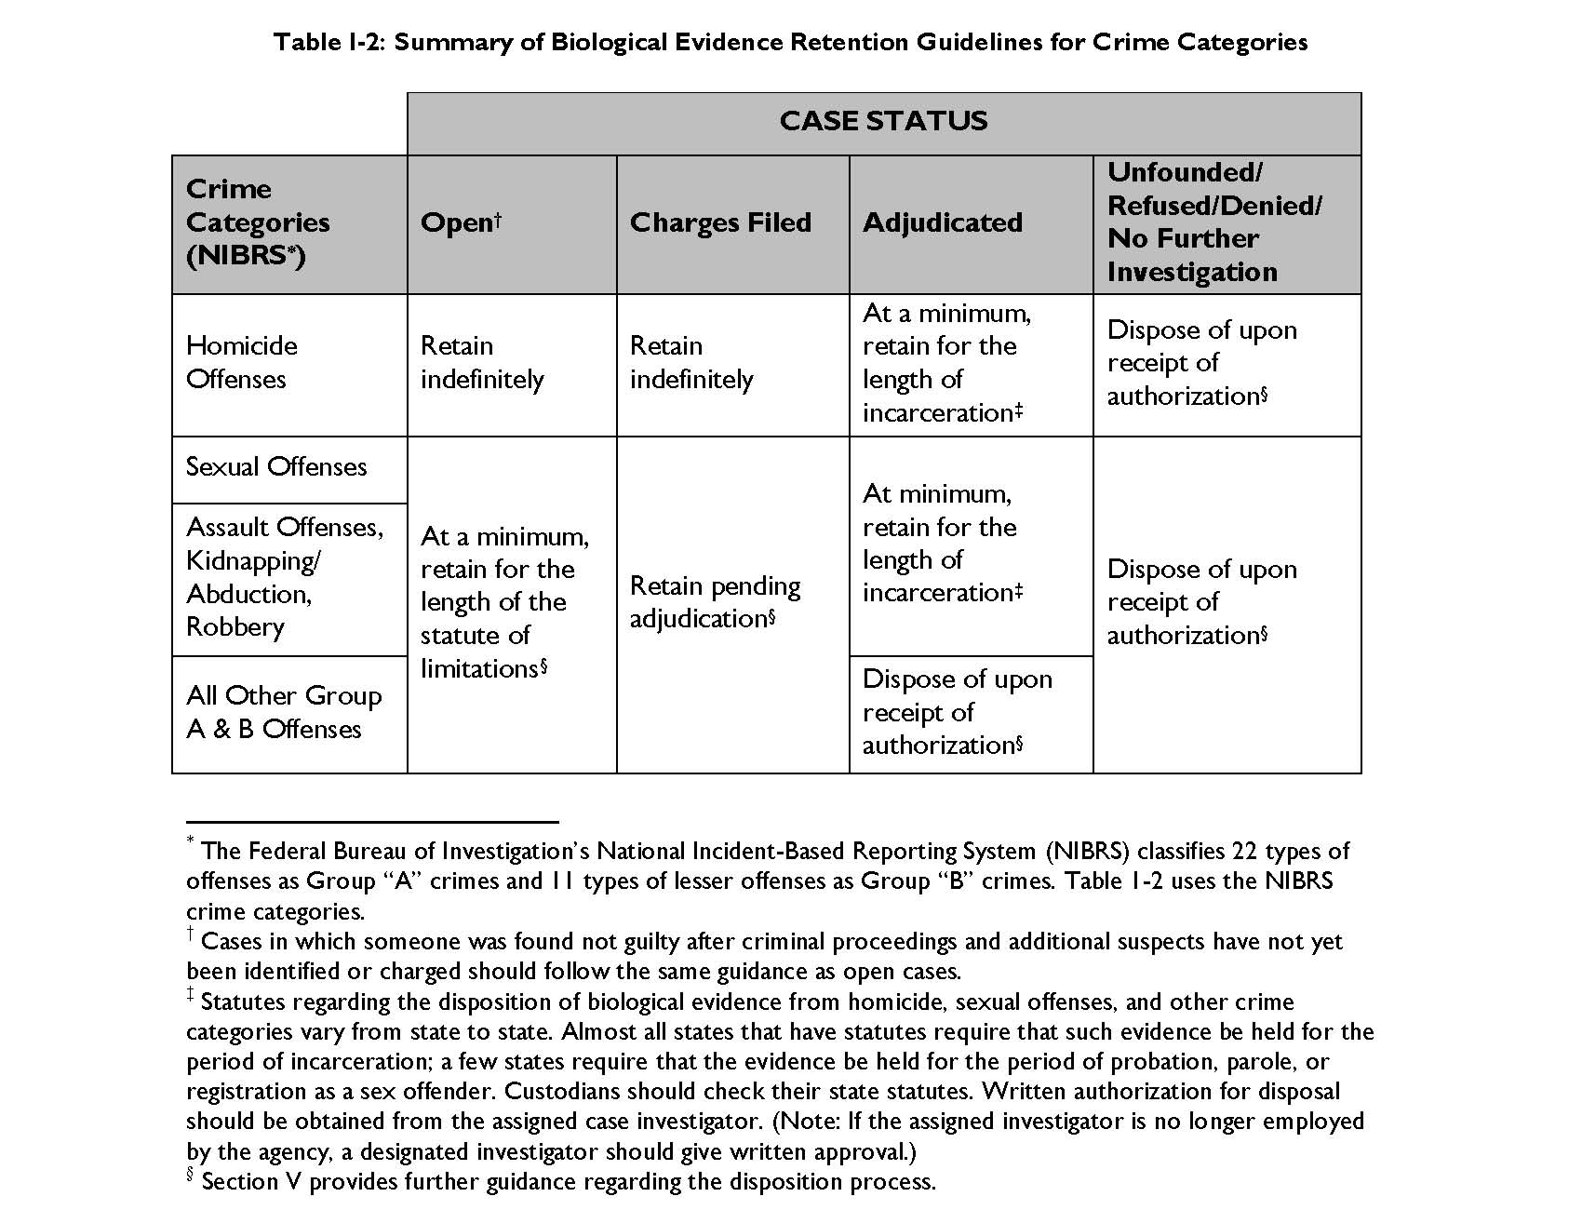

Slide 15
Retaining Biological Evidence: 7 Recommendations
Recommendation I-3: Property and evidence custodians should consult with investigators, laboratory analysts, and, when appropriate, prosecutors to determine whether only representative sample(s) should be retained in situations in which samples are too large or too costly to store. Property and evidence custodians, investigators, laboratory analysts, and prosecutors should discuss situations in which prosecutors should be consulted. These decisions should not be made exclusively by property and evidence custodians.
Recommendation I-4: Biological evidence that is collected in the course of an open investigation should be retained indefinitely for homicides and, at a minimum, for the length of the statute of limitations for all other offenses.
Recommendation I-6: Biological evidence should be preserved through, at a minimum, the period of incarceration in the following crime categories, as defined in NIBRS, regardless of whether or not a plea was obtained: homicides, sexual assault offenses, assaults, kidnapping/abductions, and robberies. For all other Group A and B offenses, biological evidence may be disposed of upon receipt of authorizations.

Slide 16
Handbook on Biological Evidence Preservation: Packaging and Storage Section
Identifies methods and procedures for the proper packaging and storage of biological evidence
Specifies storage conditions for temporary and long term storage of all types of biological evidence (wet, dry, etc.)
Findings are based in scientific studies and collective expertise of the working group

Slide 17
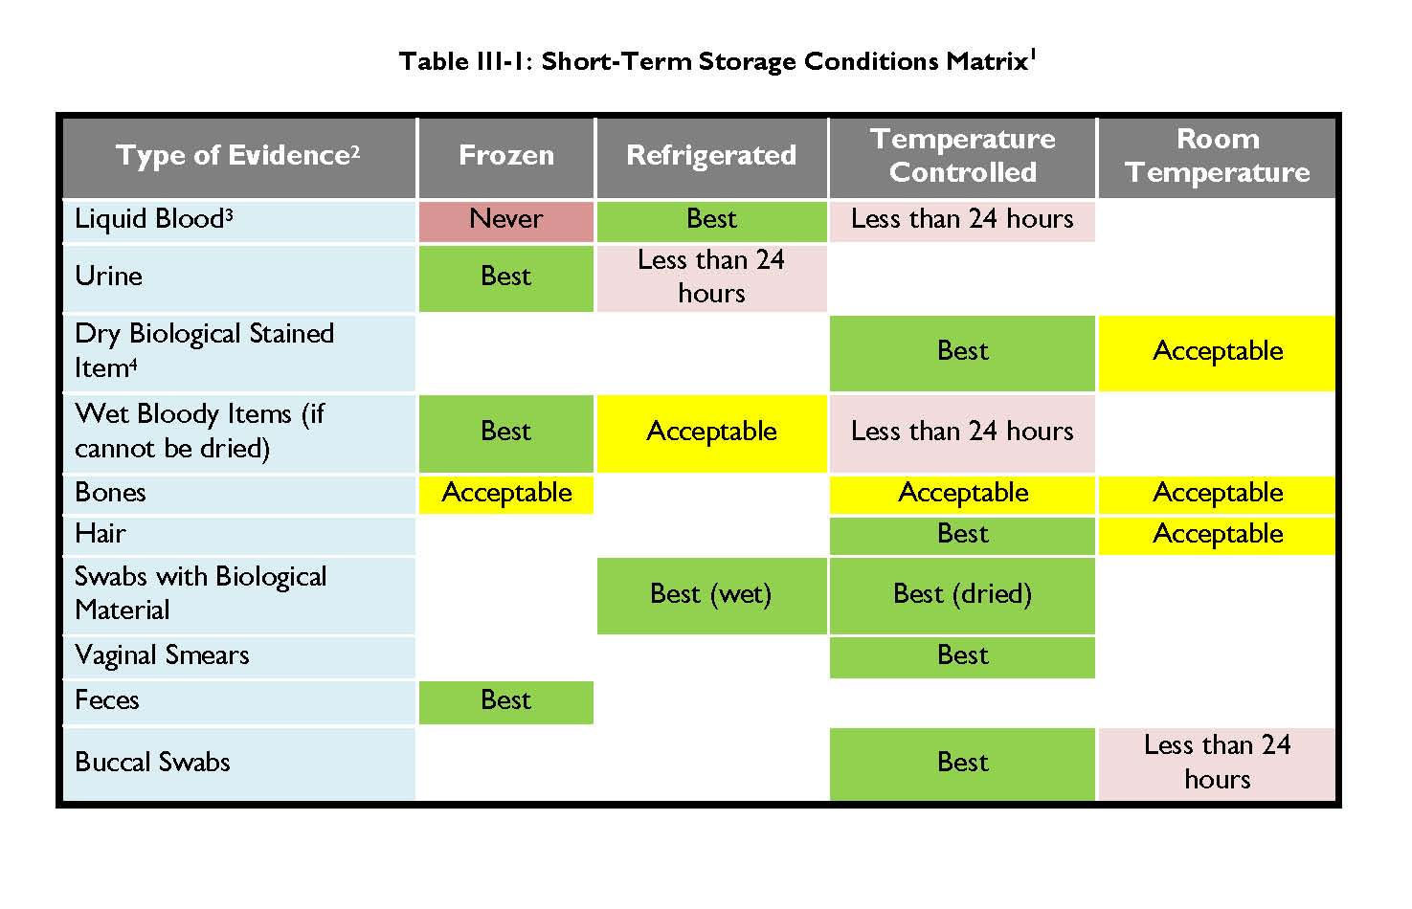

Slide 18
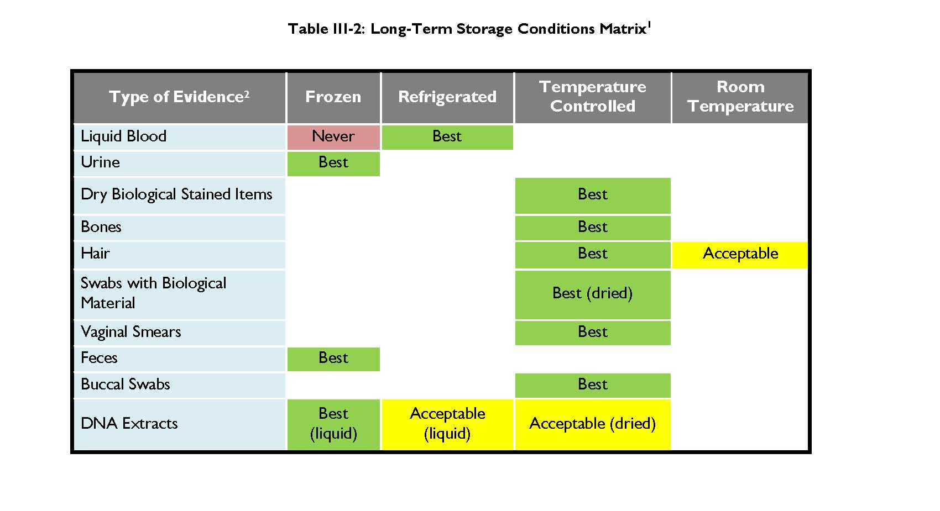

Slide 19
Packaging and Storage: 5 Recommendations
Recommendation III-1: In tandem with state or local legislatures, managers in law enforcement and relevant stakeholders should advocate for additional resources and funding to ensure the integrity of biological evidence through prioritizing the packaging, storage, maintenance, and security of the evidence in their jurisdictions.
Recommendation III-3: Each law enforcement agency should develop a protocol for standardizing evidence packaging materials and customizing shelving to allow for more efficient retrieval of evidence stored in property rooms.
Recommendation III-5: Each law enforcement agency should have a policy and procedure for the storage of biological evidence.

Slide 20
Handbook on Biological Evidence Preservation: Tracking and Chain of Custody Section
Explains the importance of chain of custody
Describes the basic requirements of an effective tracking system

Slide 21
Tracking Biological Evidence and Chain of Custody: 12 Recommendations
Recommendation IV-2: Whatever system an agency uses, it should be able to account for the following:
Chain of custody
date/time/identity of individual who collected evidence
any person(s) in possession of the evidence at scene and during transport
date/time/identity of person who submitted the evidence
date/time/identity of property/evidence custodian who accepted/received the evidence
date/time/identity of any person to whom the evidence was released and who returned it
Unique item identification
description of item
unique number identifier
Location of item in property/evidence storage room or other external location(s), such as court, a crime laboratory, or another investigative agency
location (e.g., shelf number or bin) where evidence is stored
date/time/identity of person who stored the evidence

Slide 22
Tracking Biological Evidence and Chain of Custody: 12 Recommendations
Recommendation IV-6: Overall, it is highly recommended that jurisdictions consider automated identification technologies to enhance chain-of-custody recordkeeping and tracking, to facilitate inventories, and to allow for efficient retrieval of evidence.
Recommendation IV-7: Experienced property and evidence custodian personnel should be included in the procurement of any software and/or hardware that affects the tracking and management of evidence. Agencies need to review existing procedures, to conduct a needs assessment, to develop requirements, and to evaluate technology performance prior to procuring a system. Proper IT support should also be available.

Slide 23
Tracking Biological Evidence and Chain of Custody: 12 Recommendations
Recommendation IV-9: Each entity that can potentially hold biological evidence, including courts, should have (1) written procedures detailing the steps and documentation required when evidence is opened, resealed, and transferred; (2) secure, access-controlled locations to store the evidence; (3) trained and authorized personnel handling the evidence; and (4) written policies outlining chain-of-custody and storage requirements (length of retention, conditions, and disposition requirements) for biological evidence.
Recommendation IV-10: The collection of evidence at the hospital or medical facility establishes the first link in the chain of custody. Biological evidence should be collected by a properly trained medical professional and an inventory of each item should be recorded.
Recommendation IV-11: Jurisdictions should work to assess and improve communications regarding forensic evidence by developing consistent procedures and packaging guidelines and by integrating evidence-tracking systems across locations.

Slide 24
Handbook on Biological Evidence Preservation: Disposition Section
Explains step-by-step guide for evidence disposition
Disposition is the ongoing process of determining what to do with evidence in a case. The process includes retention, destruction, auction, or return to owner.

Slide 25
Biological Evidence Disposition: 4 Recommendations
Recommendation V-3: Timely and proper disposition of evidence is of critical importance in the duties of the property custodian. All property in the care of an agency should be returned to its rightful owner or dispositioned according to law or agency policy.
Recommendation V-4: An evidence disposition process should be part of each agency’s policy and procedures

Slide 27
Handbook on Biological Evidence Preservation
Challenges:
Diverse needs and types of agencies (small vs. large; hi-tech vs. low-tech)
Resources
Backing guidance in science

Slide 28
Other Work Products: Automated Identification Technology (AIT) Assessments
How can AIT be implemented?
Examples of AIT include:
Barcodes
Radio Frequency Identification (RFID)
Barriers to Implementation
Startup Cost
Reliability
Standardization

Slide 29
Other Work Products
Legislative Issues Report: In process
Currently, 32 states (plus DC) have laws requiring the retention of biological evidence for some period of time.
Report plans to address these issues within current legislation such as:
- Length of retention
- Storage Conditions
- Notification Mechanisms
- Sanctions/Remedies
Clearinghouse of Resources
Training
Funding streams

Slide 30
Summary
This handbook is a ‘best practices’ resource for anyone who handles evidence.
The handbook contains a set of recommendations.
The handbook contains a glossary of terms.
This handbook is designed to encourage communication with an agency’s submitting crime laboratory.

Slide 31
Questions?
A copy of the handbook and additional resources can
be found at the Biological Evidence Preservation webpage: http://www.nist.gov/oles/forensics/bioev.cfm.

