Slide 1
One Is Too Many: The Problem of Un-submitted, Unanalyzed Rape Kits Rebecca O’Connor Rape, Abuse & Incest National Network (RAINN)

Slide 2
Organizational Snapshot
Rape, Abuse & Incest National Network (RAINN) was founded in 1994. At the nation’s largest anti-sexual violence organization, we do three main things:
Help Victims.
National Sexual Assault Hotline – 1.800.656.HOPE
National Sexual Assault Online Hotline
Department of Defense Safe Helpline & Safe HelpRoom & Mobile App
Educate the Public.
Media outreach
Events like RAINN Day on America’s College Campuses
Partnerships with the Entertainment Industry
Reaching over 120 million Americans each year.
Improve Public Policy.
Spearhead legislative campaigns (Debbie Smith Act Reauthorization, annual appropriations work)
Recognized by bi-partisan Congressional leaders

Slide 3
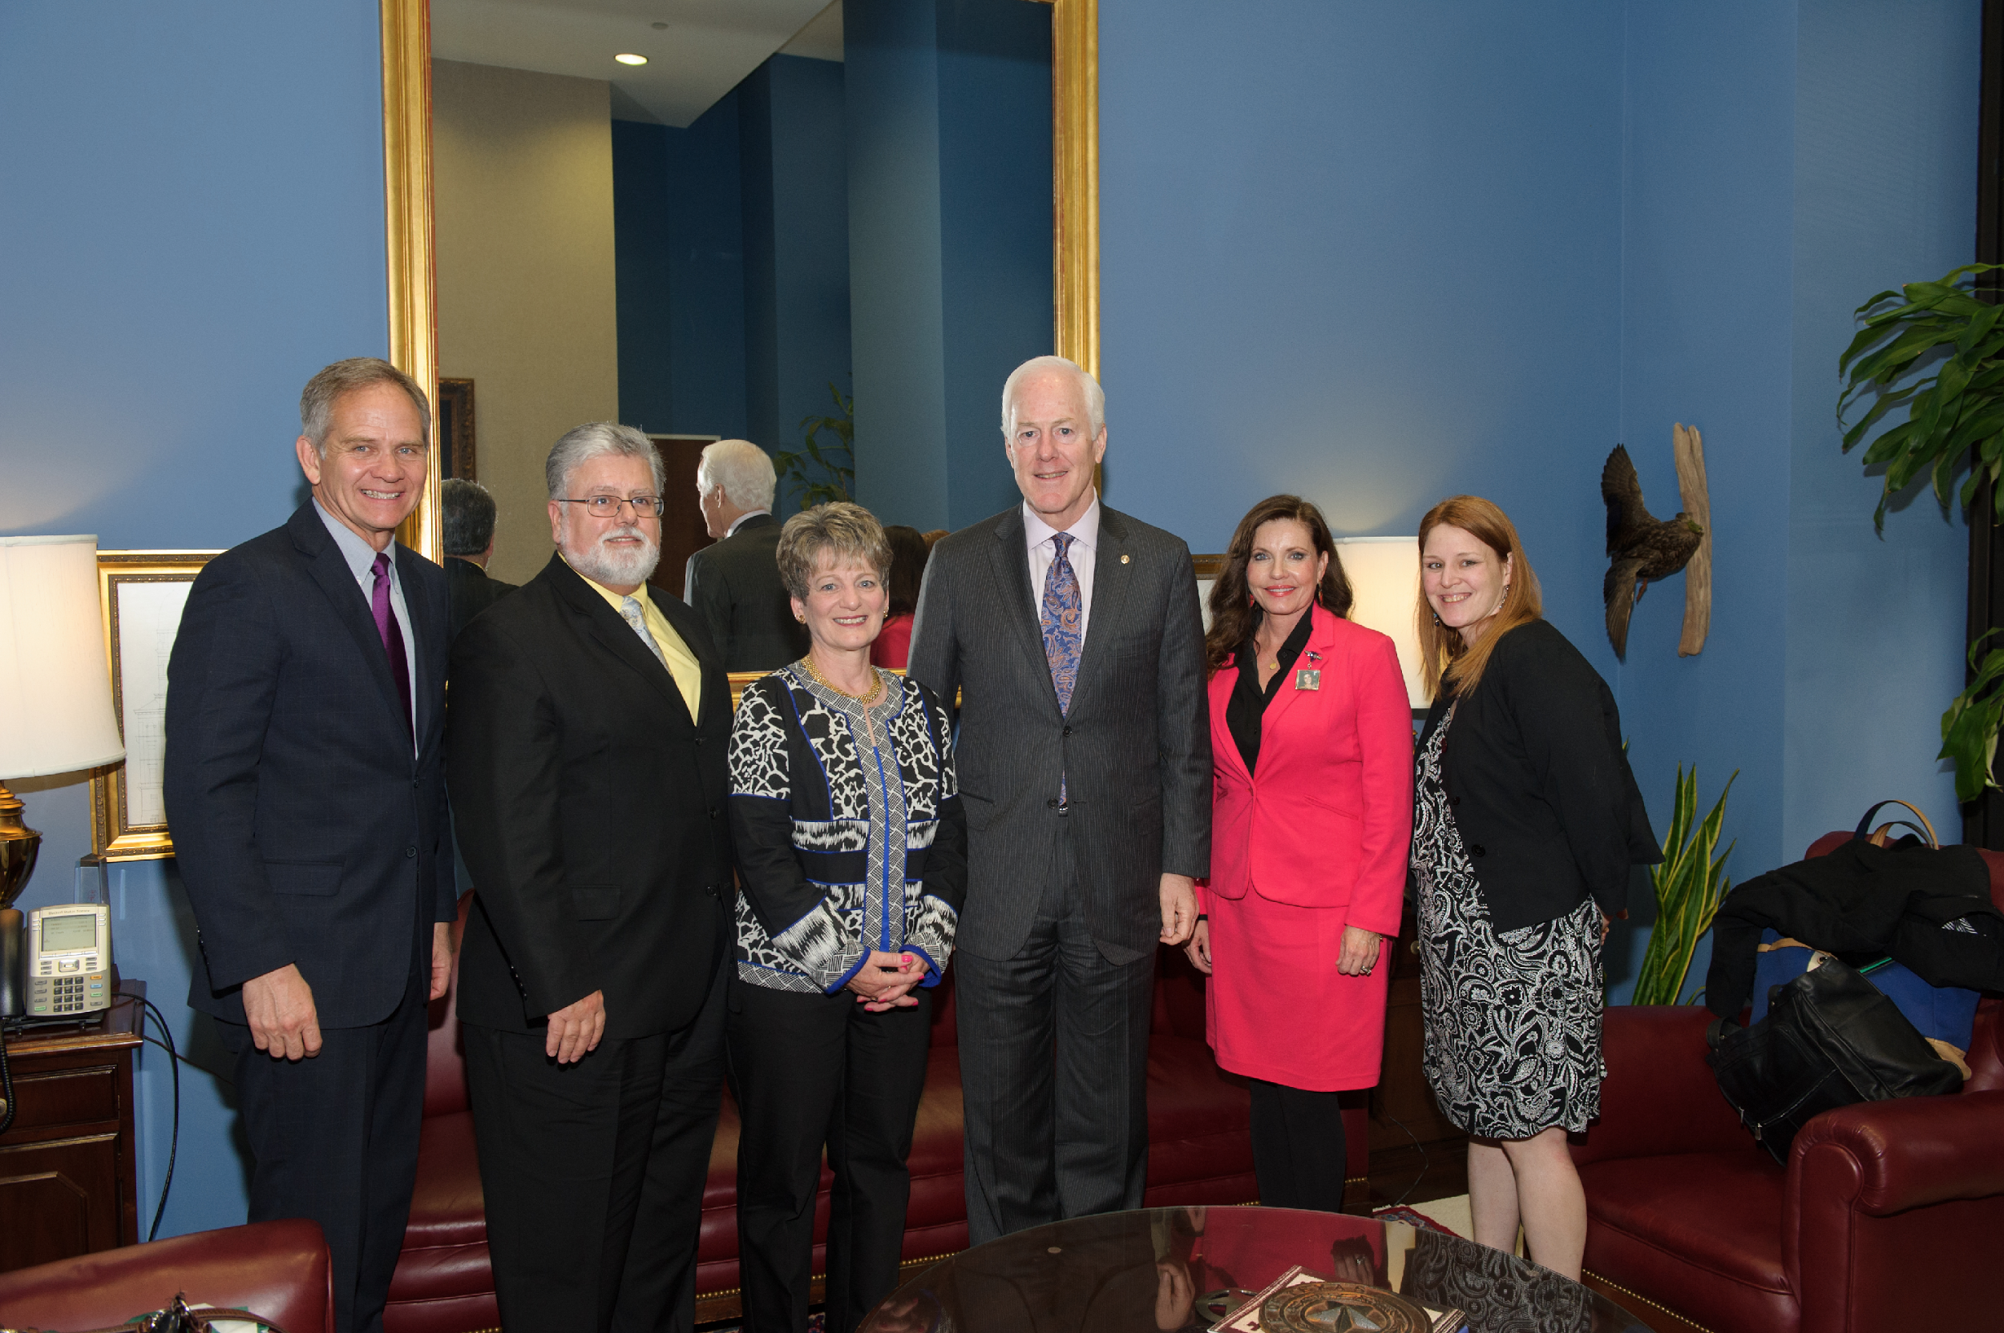
RAINN’S Public Policy Work

Slide 4
Our Partners

Slide 5
Our Partners

Slide 6
Why We Got Into This Space

Slide 7
Why We’re Doing It
Every 107 seconds, another American is sexually assaulted.
68% of sexual assaults go unreported to law enforcement.
Only about 2% of rapists spend a day in jail.
Rapists are serial offenders.
Forensic DNA is one of the most powerful rape prevention tools we have available.
Based on only a handful of public reports, we know that more than 100,000 sexual assault forensic evidence kits (“rape kits”) sit untested and unaccounted for.

Slide 8
Key Terminology/Issues
Un-Submitted Kits (“hidden backlog”)
Unanalyzed Kits (“backlog”)
Downstream impact/prosecutions
Victims’ rights

Slide 9
What We’ve Done: Federal Policy
Justice for All Act
DNA Fingerprinting Act
Justice for All Act(s)
VAWA
The SAFER Act
SAKI Grants

Slide 10
What We’re Doing: State Policy
PUTTING DNA TO WORK FOR JUSTICE AND SAFETY
____________________________________________
GOAL:
Support lawmakers seeking to establish statewide policies regarding the counting and testing of rape kits.

Slide 11
Validation
Participation
“Justice”
Safety
Healing
What’s At Stake for Victims & Public Safety

Slide 12
One Is Too Many

Slide 13
How Many Lost Opportunities for Justice?

Slide 14
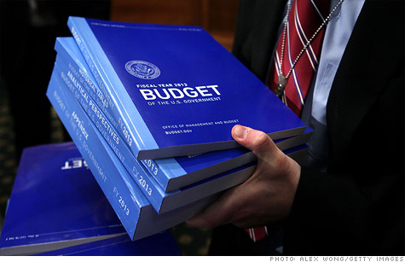
The Road Ahead

Slide 15
Why It Matters.

Slide 16
Contact Information
Rebecca O’Connor
rebeccao@rainn.org
202.544.3059
Rape Kit Action Project (RKAP)
www.everykitcounts.org
everykitcounts@gmail.com

