Slide 1
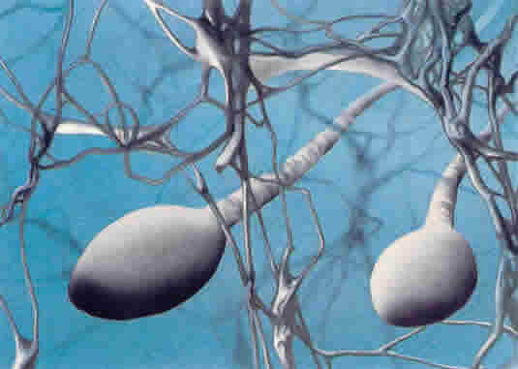
Why Forensic Service Providers Assisting Sexual Assault Investigations should Offer Y Chromosome Testing Services
Jack Ballantyne, Erin Hanson
National Center for Forensic Science, UCF

Slide 2
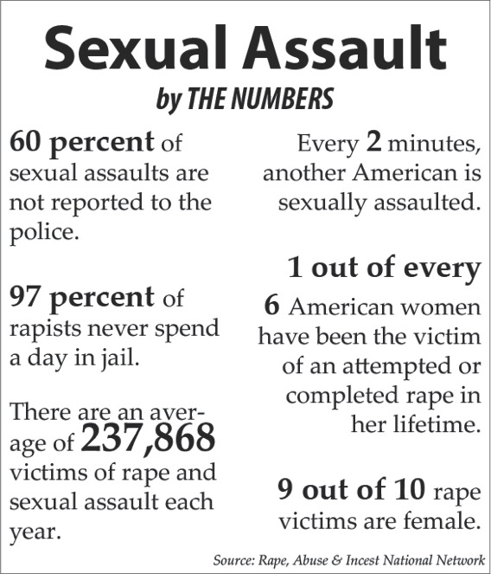
In the US, an estimated 19.3% of women and 1.7% of men have been raped during their lifetimes
-CDC Sept 2014
5
X

Slide 3
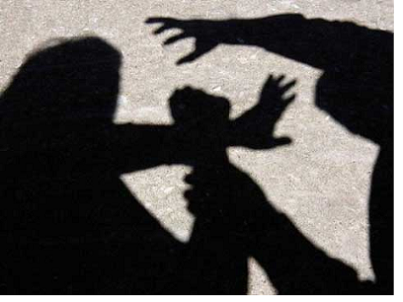
every victim deserves the right to determine the genetic profile of their assailant!

Slide 4
Worse than reported: excuses why some rape evidence is not submitted?
No suspect identified
Analysis not requested by prosecutor
Lab not accepting new evidence due to backlog
Officer uncertain of usefulness
Lab was unable to produce timely results
Incident took place > 72 hours ago

Slide 5
One of the Problems!
some rape victims report the incident > 3 days after the incident
e.g. incapacitation by drink or drugs/ acquaintance rape
in many jurisdictions, no intimate samples collected from rape victims if reported > 3 days

Slide 6
Post Coital Sperm Persistence in the Vaginal Tract
myth or fact? sperm normally only persist in observable numbers in the post-coital vagina up to 3 days after intercourse
standard DNA-STR profiling is not possible in late reported intimate post coital samples
male DNA profile recovery success diminishes rapidly as the post-coital interval is extended: > 24-48h difficult >72 h not normally possible
BUT from the literature sperm (albeit few in number) may be detectable in the vaginal canal 7-10 days after intercourse

Slide 7
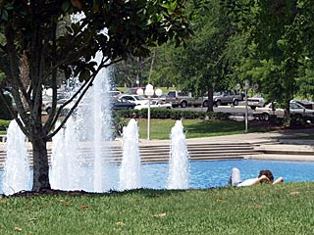
1998: maybe Y chromosome analysis can help resolve rape cases that standard DNA analysis can’t?
??

Slide 8
Why the Y?
Only found in males
Can ‘ignore’ any female DNA from victim
In mixed M/F samples sometimes standard DNA analysis cannot detect the M component
Although discrimination not as good as autosomal DNA-STR testing
Use Y!!!

Slide 9
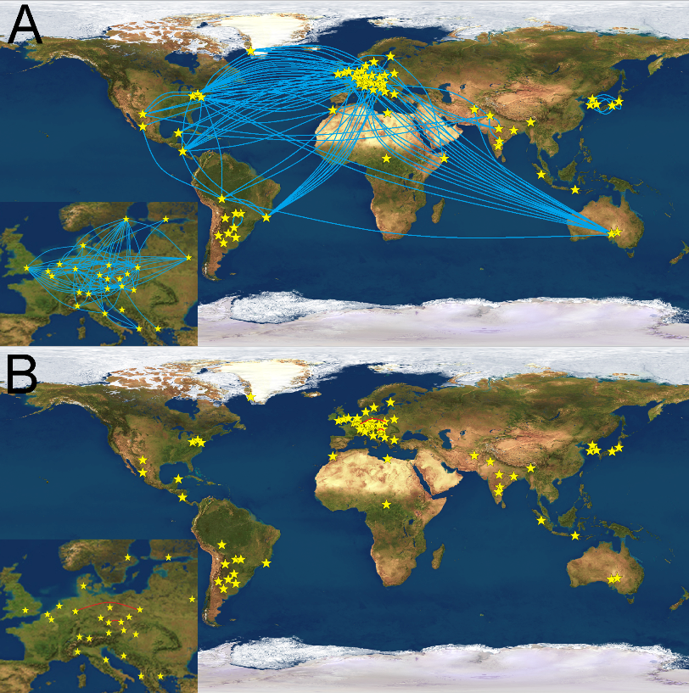
New Y-STR Kits
-more loci
-more discrimination
-better chemistry
-RM loci: higher probability of discriminating patrilineal relatives

Slide 10
New(ish) DNA Quant Kits facilitate standard STR versus Y-STR workflow
Autosomal/total human
Male/Y specific
F/M Ratio
Total Human Quant
Also
Quality (Degradation) Index
Male DNA Quant
Autosomal STR analysis
(low ratio?)
or
Y-STR analysis
(high ratio?)
new YSTR kits
Improved sensitivity?
More robust
Better discrimination

Slide 11
Recognition of current importance of Y-STRs: SWGDAM Y-STR Interpretation Guidelines (2014)
Prescribes the use of Y-STRs in certain case circumstances:
“Y-STR typing is also used in lieu of autosomal typing for the detection of male DNA in mixtures that contain an overabundance of female DNA. Given that under certain conditions a male minor contributor in a mixture of female:male DNA may only be detectable by Y-STR typing, laboratories should pursue Y-STR analysis as the most appropriate means of detecting a male contributor(s) in some forensic samples”.

Slide 12
Extended Interval Post Coital Samples Studies
Use Y-STR analysis
Controlled studies using volunteer couples collect samples at different time points after intercourse
Evidence recovered by cervical brushing
Use enhanced DNA methods

Slide 13
Extended Interval Post Coital Samples Studies
2003 Routine recovery of Y-STR DNA profiles up to 4 days after intercourse
non commercial Y-STRs
enhanced methods
2008 Y-STR DNA profiles up to 5-6 days
commercial Y-STRs
enhanced methods
Y-STR DNA profiles up to 6-9 days
commercial Y-STRs
advanced enhanced methods
Y-STR DNA profiles up to 6-9 days
commercial Y-STRs (new kits)
no need for advanced enhanced methods

Slide 14
More Extensive Longitudinal Studies Collaboration with Pat Speck, UTHSC, Memphis (2010-2014)
66 consenting monogamous couples
Samples collected from cervix and fornix
Baseline; 4, 7 and 9 days after intercourse
Enhanced compared to standard analysis
Advanced enhanced
Next gen commercial Y-STR kits (28 couples)

Slide 15
Significantly improved analysis using enhanced or next gen commercial kit analysis
Probative (at least 10 alleles) Y-STR profiles obtained from ~23% of 9 day samples
Full (highly probative) DNA profiles obtained with commercial next gen kit in ~11% of samples (from 28 couples)
61% partial DNA profiles (1-27 alleles)

Slide 16
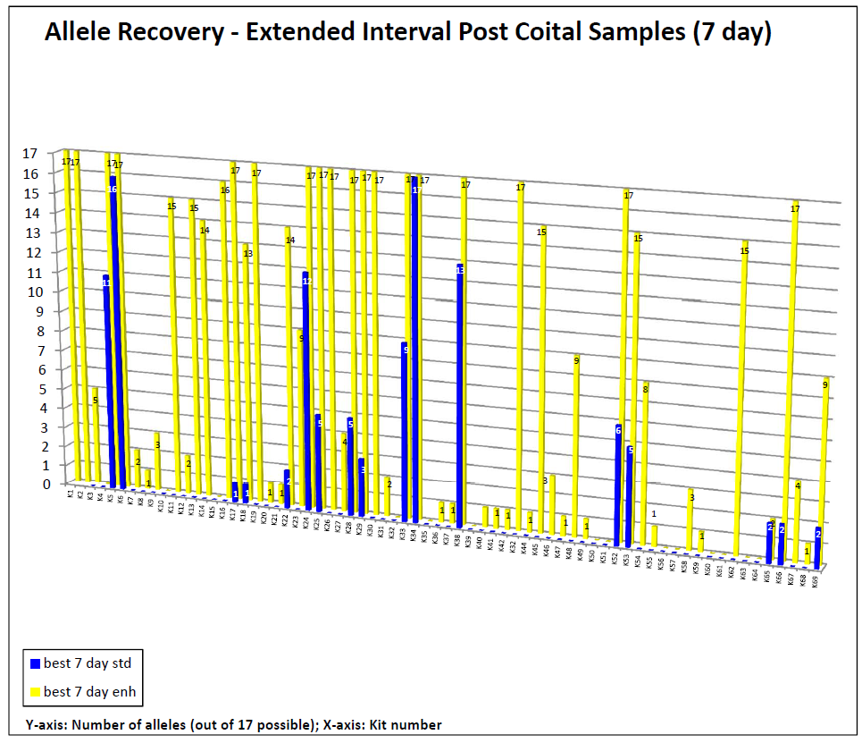

Slide 17
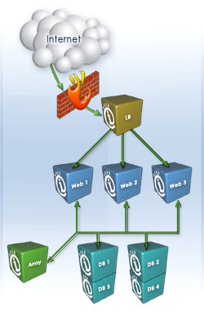
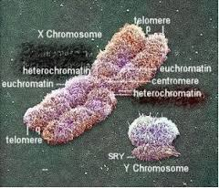
National U.S. Y-STR Database

Slide 18
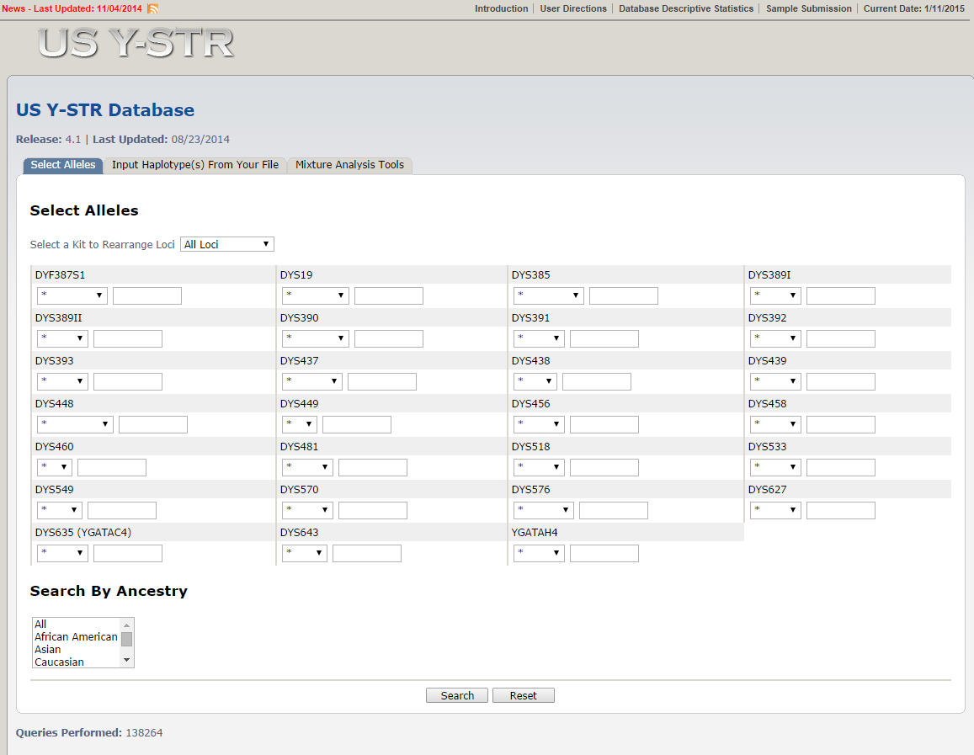
Database Home Page: www.usystrdatabase.org
N = 35,000
African American, Caucasian, Hispanic, Native American, Asian
Notes:
18
18

Slide 19
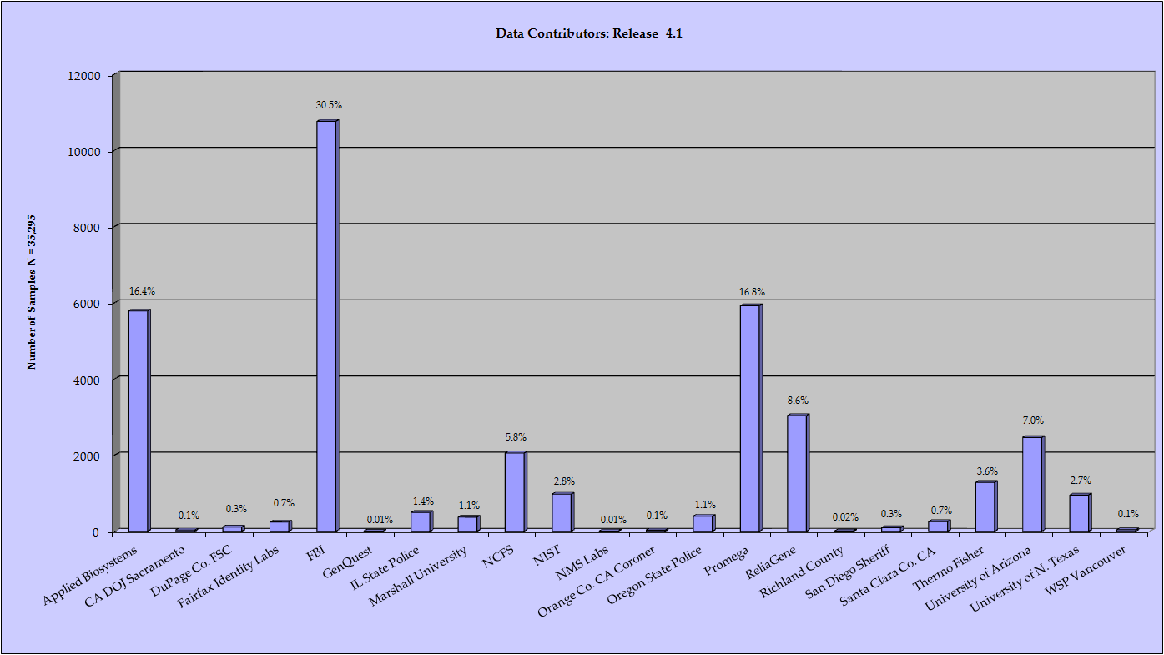
USYSTR is a Community Effort!
Applied Biosystems: 5781 samples
California Department of Justice, Sacramento: 32 samples
DuPage County Forensic Science Center: 112 samples
Fairfax Identity Laboratories: 241 samples
Federal Bureau of Investigation: 10758 samples
GenQuest DNA Analysis Laboratory: 3 samples
Illinois State Police: 494 samples
Marshall University Forensic Science Center: 371 samples
National Center for Forensic Science: 2052 samples
National Institute of Standards and Technology: 974 samples
NMS Labs: 5 samples
Orange County CA Coroner: 30 samples
Oregon State Police: 394 samples
Promega: 5921 samples
ReliaGene: 3036 samples
Richland County Sheriff’s Department: 7 samples
San Diego Sheriff’s Department: 94 samples
Santa Clara County CA Crime Laboratory: 254 samples
Thermo Fisher Scientific: 1283 samples
University of Arizona: 2462 samples
University of North Texas: 951 samples
Washington State Patrol Crime Lab, Vancouver: 40 samples
Notes:
19
19

Slide 20
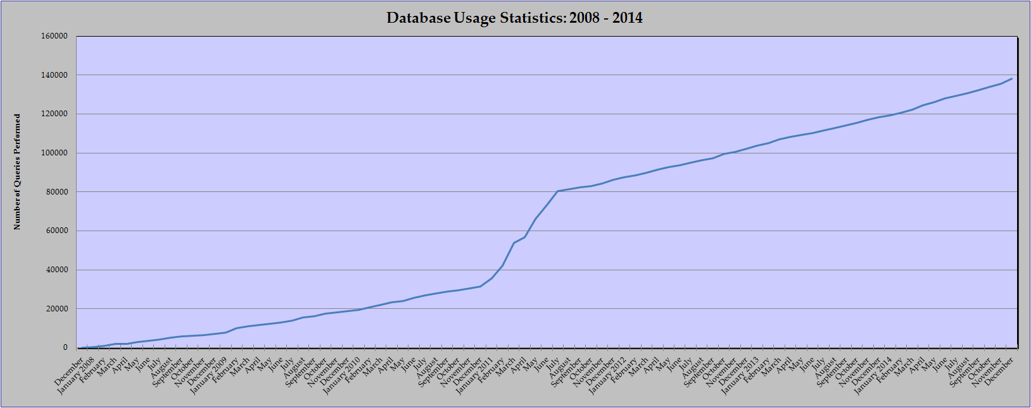
Since January 2008, 140,000 database search queries
Currently 1300 searches per month.
Continue to solicit data from the community (i.e. forensic laboratories)
Continue to incorporate the suggestions and recommendations received from users and SWGDAM
Notes:
20

Slide 21
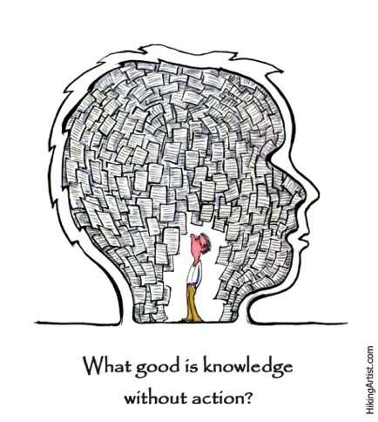
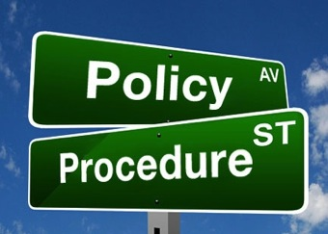

Slide 22
Future Policy and Research
Laboratories should provide or arrange to provide Y-STR typing services in addition to standard DNA analysis
Jurisdictions should collect samples from samples at least up to 10 days after intercourse
What is the limit of recovery of DNA profiles from the semen donor (surely > 9 days)?
Recovery of standard autosomal DNA profile > 4 days?
Other biological and socio-economic factors effecting recovery of male DNA from the cervico-vaginal tract
More loci-NGS- complete male differentiation
Notes:
Your presentations will be live streamed to an online audience and recorded for archival presentation. By presenting, you acknowledge that the presentation content is wholly your own work, or that you have full and explicit permissions to use the presentation content. Please see the release form as part of this package.
Please print and sign the consent and release document shown on the left-hand side of your screen.
You can either email or fax this to the contact information on your screen. This document allows us to release the archived version of your presentation for our On-Demand Training.

Slide 23
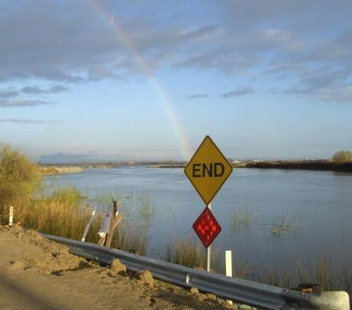
The end crowns all, and that old common arbitrator, Time, will one day end it.
Shakespeare
Thank you for your attention!
Acknowledgements:
Funding: NIJ and FTCOE
Pat Speck (UAB), Tamyra Moretti (FBI)

