Slide 1
How to Produce Courtroom Ready Forensic Scientists
ASCLD Annual Meeting April 29, 2015
Professor Carol Henderson
National Clearinghouse for Science, Technology and the Law
Stetson University College of Law

Slide 2
Incentives for Creating “Courtroom Ready” Forensic Scientists
NAS Report
ASCLD/LAB
NFSC Policy
OSAC Guidelines
Judges’ and Lawyers’ Expectations

Slide 3
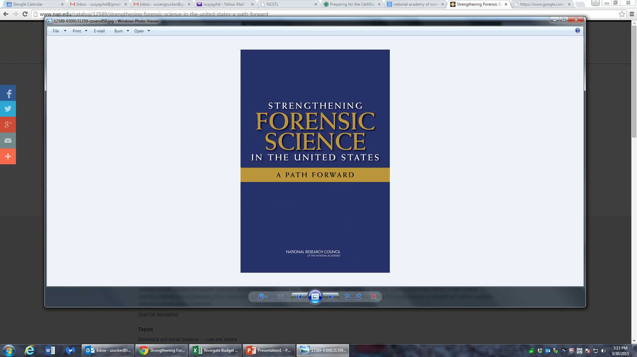
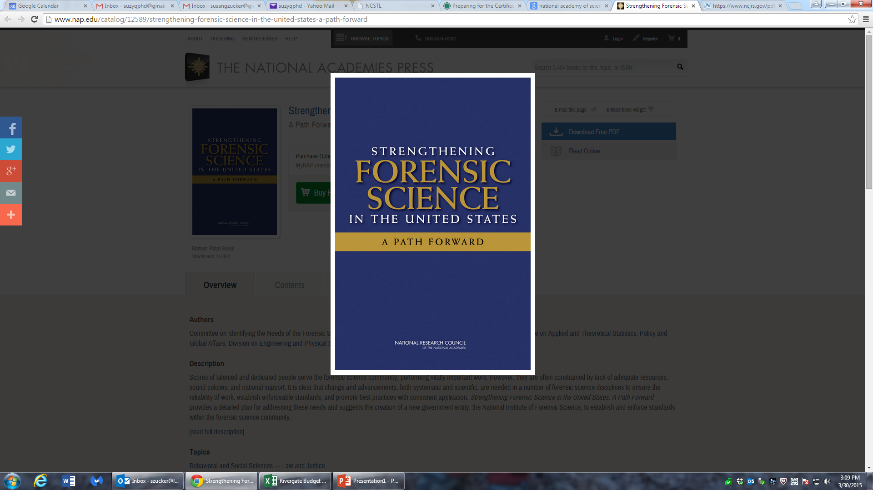
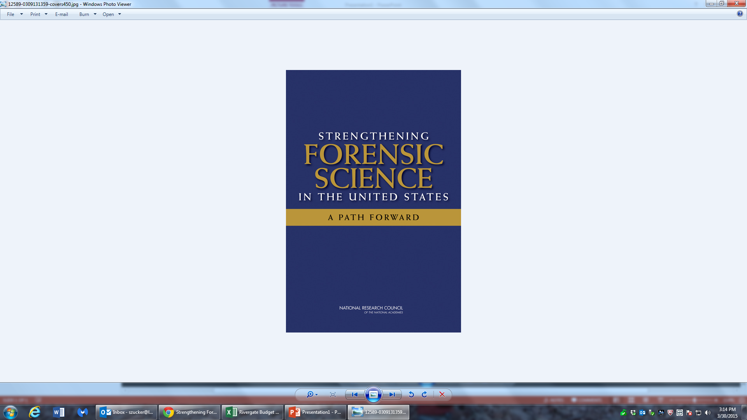

Slide 4
NAS Report
“Everyone in a laboratory needs orientation in…the legal system….effective expert testimony…..” at p. 232
Training can be done in-service or through short courses
Continuing education- core elements include:
Legal – expert testimony, depositions, rules of evidence, criminal and civil law and procedures and evidence authentication. At p. 233

Slide 5
ASCLD/LAB Courtroom Testimony Standards
Training of Analysts:
5.2.1.2 Where applicable, training programs shall also include training in the presentation of evidence in court.
Competency Testing:
5.2.6.2 Competency testing
NOTE Satisfactorily completing a competency test means achieving the intended results. Failure to achieve the intended results would require review or retraining until testing achieves the intended results.

Slide 6
ASCLD/LAB Courtroom Testimony Standards
Competency Testing, cont.
5.2.6.2.2 For any laboratory personnel whose job responsibility includes test report writing, a competency test shall include, at a minimum:
A written test report to demonstrate the individual’s ability to properly convey results and/or conclusions and the significance of those results/conclusions; and
A written or oral examination ( this maybe a question and answer. The laboratory may choose that, or a mock court) to assess the individual’s knowledge of the discipline, category of testing, or task being performed.

Slide 7
ASCLD/LAB Courtroom Testimony Standards
Courtroom Testimony monitoring:
5.9.6 The laboratory shall have and follow a procedure whereby the testimony of all testifying personnel is monitored on an annual basis. Each individual shall be given feedback, both positive and in any area needing improvement, and the monitoring procedure shall prescribe the remedial action that is to be taken should the evaluation be less than satisfactory.

Slide 8
ASCLD/LAB Courtroom Testimony Standards
Courtroom Testimony monitoring, cont.
NOTE 1 (Notes are not requirements) Methods by which testimony monitoring may be carried out include observation of the testimony by a supervisor or a peer; review of transcripts of testimony given; having one or more officers of the court fill out and return a testimony evaluation form (checklist and/or comment sheet) provided by the laboratory; or telephone solicitation by a laboratory director or supervisor to one or more officers of the court for responses to the evaluation form.

Slide 9
ASCLD/LAB Courtroom Testimony Standards
Courtroom Testimony monitoring, cont.
NOTE 2 Areas that should be evaluated include appearance, poise, performance under direct or cross-examination, ability to present information in an understandable manner to a lay jury, and most importantly a determination that the testimony given is consistent with the work documented in the case record. Neither review of transcripts or feedback from the court officials can provide the quality of evaluation that is available through direct observation; therefore, especially for new analysts (however named), supervisory observation in the courtroom is the recommended method.

Slide 10
NCFS & OSAC Differences
NCFS
Federal Advisory Committee that advises the Attorney General
Reports to Attorney General
Develops policy
Limited duration
OSAC
Not a Federal Advisory Committee
Administered by NIST
Develops discipline-specific practice standards and guidelines
Indefinite duration

Slide 11
NFSC and OSAC Committees
NFSC Training on Science and Law Subcommittee
OSAC Legal Resources Committee – responds to and advises FSSB and subcommittees. Future? Standards for testimony in forensic science disciplines

Slide 12
National Commission on Forensic Science
Documents
Work Products
http://www.justice.gov/ncfs/work-products
Meeting Materials
http://www.justice.gov/ncfs/meeting-materials
Governing Documents
http://www.justice.gov/sites/default/files/ncfs/legacy/2014/05/13/
ncfs-charter.pdf
http://www.justice.gov/sites/default/files/ncfs/legacy/2014/07/31/
ncfs-bylaws.pdf

Slide 13
NFSC Draft Documents of Interest
Pretrial Discovery of Forensic Materials
Testimony Using the Term Scientific Certainty
Recommendation on National Code of Ethics and Professional Responsibility for the Forensic Sciences

Slide 14
What Are Probabilistic Testimony Options?
It is more likely than not
It is highly likely
The random match probability is 1 in 387,929.

Slide 15
Is There a Foundational Basis?
What are the data?
What is the examiner’s experiential basis for this conclusion?

Slide 16
Expert Testimony on the discipline
Consider the expert who will testify that a discipline is not yet a science
The expert who will explain “error rates” and cognitive bias

Slide 17
“Nuanced” Gatekeeping by the Court
It’s not only “admit or exclude”
It’s
Admit to show similarities
Admit to establish a lack of exclusion
Admit but without certain verbiage
“science”
“from this gun”
“unique”; “to the exclusion of all others”

Slide 18
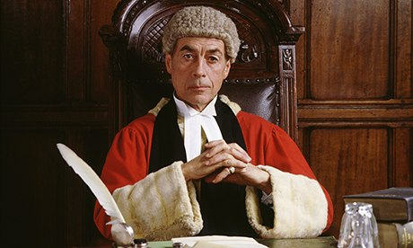
2015 rand survey – is the science valid?

Slide 19
Rand Study Sarah Greathouse, PhD
160 Federal Judges and 160 scientists
View case summary and defense motion to exclude the expert testimony
Will examine the judges’ sensitivity to scientific validity of the expert testimony
Will examine the level of agreement between the scientific experts’ views on scientific validity of the expert testimony with the views of the judges

Slide 20
International Efforts
The Paradigm Shift for UK Forensic Science, Scientific Discussion Meeting, February 2-3 2015, The Royal Society, London – organized by Professors Sue Black and Niamh Nic Daeid, University of Dundee
Speakers included Rt Hon Lord Thomas, Lord Chief Justice of England and Wales and Sir Geoffrey Nice
Satellite Meeting, February 4-5, Chicheley Hall, Five groups each led by a Judge
Chicheley Working Group and Advisory Panel
Report forthcoming this summer

Slide 21
Judicial Education Programs
Center for State Courts
National Judicial College
Federal Judicial Center
ASTAR
AAAS - neuroscience
Independent State Programs, e.g., Arizona, Texas
ABA Judicial Division Forensic Science Committee - April 10 Symposium in Chicago
BJA Grant 2015-4143 Advanced Concepts in Criminal Justice: Judicial Training including forensics

Slide 22
Bibliography of Resources for Courtroom Ready Forensic Scientists
Books on Testimony
Power Points
Training Manuals/Materials
Courses – In Person and On line
Funding Sources – Federal and Private
Recent Case Law citing Melendez-Diaz v. Massachusetts and Bullcoming v. New Mexico

Slide 24
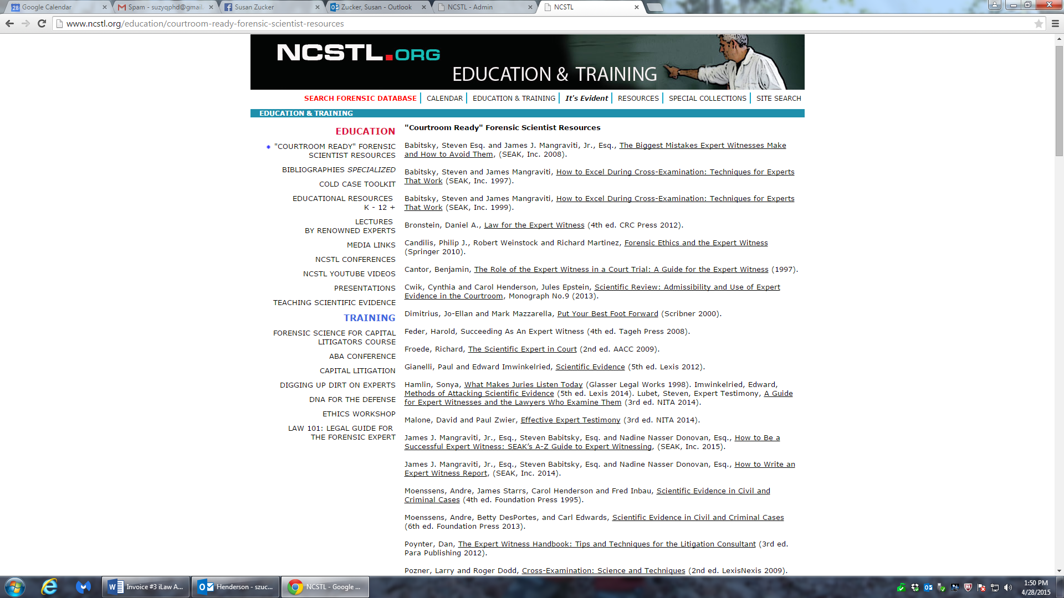

Slide 25
Points to Ponder
Immediate early courtroom training – determine if person can “cut the mustard” in court setting
Use video Q and A sessions
Policy mock trials
Process mock trials
Proficiency mock trials if person not often in court

Slide 26
Centralized Training Resource
Who to Sponsor
Where to House
How to Disseminate
Develop a Pilot Program

Slide 27
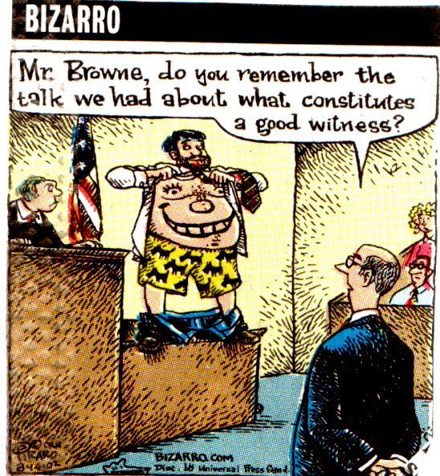

Slide 28
