Slide 1
Organization of Scientific Area Committees (OSAC) for Forensic Science: Status Update
American Society of Crime Lab Directors
Washington DC
April 28, 2015
Mark Stolorow - Director of OSAC Affairs
National Institute of Standards and Technology
Jeremy Triplett – FSSB Chair & Laboratory Supervisor
Kentucky State Police Central Forensic Laboratory

Slide 2
Agenda
OSAC Quality Infrastructure
OSAC Objective & Architecture
OSAC Members & Affiliates
OSAC Support from NIST & Crime Laboratories
OSAC Priorities & Public Comment Opportunity
OSAC Moving Forward

Slide 3
OSAC Outputs: A Framework for a Quality Infrastructure
OSAC Forensic Science
Code of Practice
OSAC Registries
Mandatory
Registry of Approved Standards
SETS HIGH LEVEL CRITERIA FOR:
OSAC Registries
Laboratory Accreditation
Personnel Competencies
Non-Mandatory
Registry of Approved Guidelines
Catalog of Forensic Standards and Guidelines
Existing standards and guidelines including SWG documents
Forensic Science Laboratories and Accreditors

Slide 4
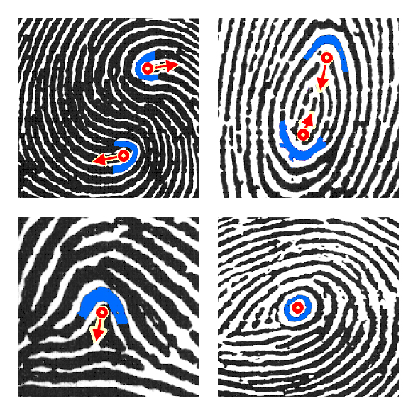
OSAC Catalog of Forensic Standards and Guidelines: 700+ References
The catalog is intended to contain any standard, guideline, best practice, protocol or policy created in collaboration with a body of stakeholders that is applicable to forensic science.
OSAC members can potentially select standards and guidelines from this listing to submit for addition to OSAC Registries or to form a basis for new standards and guidelines to be created.
http://www.nist.gov/forensics/osac/standards-guidelines-catalog.cfm

Slide 5
OSAC Catalog of Standards and Guidelines (Snapshot)
http://www.nist.gov/forensics/osac/standards-guidelines-catalog.cfm

Slide 6
OSAC Registries of Approved Standards and Guidelines
Documentary standards and guidelines that have demonstrated:
1. Technical merit
Detailed Scope
Examination of fitness for purpose
Consideration of uncertainty measurement and potential bias
Method validation, as appropriate
2. Reasonable standards development process
Due Process
Consensus
Openness
Transparency
Freedom from undue influence
Balance of interests
Registry Sources:
An existing standard developed using approved processes
Catalyzed with an existing SDOs
Developed by OSAC using canvass method

Slide 7
OSAC: Standards vs. Guidelines
trans-parency
balance
technical merit
due process
openness
consensus
OSAC Registry of Approved Standards
OSAC Registry of Approved Guidelines
Standard
Specifies uniform methods, actions, practices, or processes, protocols
Compliance recommended to be mandatory and modified only under unusual circumstances: (shall)
Approved by FSSB
Guideline
Suggested methods, actions, practices, or processes to consider in absence of applicable standards
Best practices that are strongly recommended but not required (should)
Approved by SAC

Slide 8
Agenda
OSAC Quality Infrastructure
OSAC Objective & Architecture
OSAC Members & Affiliates
OSAC Support from NIST & Crime Laboratories
OSAC Priorities & Public Comment Opportunity
OSAC Moving Forward

Slide 9
OSAC Objective
To create a sustainable organizational infrastructure dedicated to identifying and fostering the development of technically sound, consensus-based documentary standards and guidelines for widespread adoption throughout the forensic science community

Slide 10
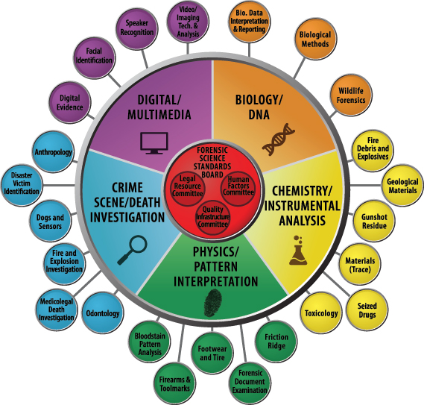
Organization of Scientific
Area Committees
Task Groups at Every Level: 100+
FSSB appointed June 2014
QIC, LRC, HFC – July 2014
SAC – August 2014
Subcommittees – October 2014

Slide 11
Agenda
OSAC Quality Infrastructure
OSAC Objective & Architecture
OSAC Members & Affiliates
OSAC Support from NIST & Crime Laboratories
OSAC Priorities & Public Comment Opportunity
OSAC Moving Forward

Slide 12
OSAC Applicants as of 12 May 2014
Other countries (21 total; 56 individuals)
Australia (10)
Bangladesh (1)
Belarus (1)
Bosnia (1)
Brazil (1)
Canada (17)
China (1)
France (1)
Germany (2)
Israel (2)
Italy (1)
Korea (1)
Malaysia (1)
Nepal (1)
The Netherlands (1)
New Zealand (1)
Peru (1)
Singapore (2)
Switzerland (1)
Taiwan (1)
UK (8)
All 50 states represented
357 state govt
331 local govt
234 federal govt
223 private
154 academic
14 FFRDC
56 non-U.S.
Alaska
Hawaii
Puerto Rico
1313 total

Slide 13
542 OSAC Members Total as of 13 February 2015
49 states represented
94 Academics
147 Federal Govt
8 FFRDC
105 Local Govt
89 Private Sector
99 State Govt
Alaska
Hawaii

Slide 14
OSAC Members Employer Classification (as of 13 February 2015)
542 OSAC Members Total
FFRDC = Federally-funded research and development center

Slide 15
OSAC Members Job Classification (as of 13 February 2015)
542 OSAC Members Total

Slide 16
OSAC Application Status & Affiliates
1813 Total Applications
542 OSAC Members
1271 Applications in Database for Affiliates
All potential Affiliates must fill out an application
OSAC Application: https://www.nist.gov/forensics/osac-application.cfm
Applicant database updated on 1st & 15th each month
Affiliates are selected by OSAC Unit Chairs
Added to Kavi Workspace and receive email

Slide 17
OSAC Positions Held by ASCLD Members (30)
FSSB Chair
Biology SAC Chair
Chemistry SAC Chair & 2 Members
Quality Infrastructure Committee Vice Chair & 4 Members
Biological Methods (DNA 1) Sub Chair & 4 members
Anthropology Sub Chair
SAC Crime Scene Member
SAC Digital Member
3 Seized Drug Sub Members
2 Digital Evidence Sub Members
3 Biological Interpretation/Reporting (DNA 2) Sub Members
1 Fire Debris and Explosives Sub Member
1 Fire Investigation and Explosives Sub Member
2 Friction Ridge Sub Members

Slide 18
Agenda
OSAC Quality Infrastructure
OSAC Objective & Architecture
OSAC Members & Affiliates
OSAC Support from NIST & Crime Laboratories
OSAC Priorities & Public Comment Opportunity
OSAC Moving Forward

Slide 19
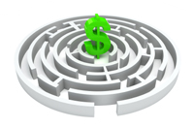
OSAC Support: Provided by NIST
Kavi Workspace: Web-based infrastructure to manage all documents & online balloting/voting
Adobe Connect Licenses: to support virtual meetings – enabling all entities in OSAC to conduct virtual business.
Logistics Support: funding for in-person meetings
Future Contract: Program management support
Spin Out: Spin OSAC out of NIST in 5 years
May initially be with funding from NIST to the outside entity.
Must ensure good science and stability

Slide 20
Your Staff Members Participating in OSAC are:
Interfacing routinely with the leading forensic practitioners and academic researchers
Evaluating the Catalog of Standards for relevant documents to move forward or build from
Determining the standards priorities for each forensic science discipline and noting research gaps
Debating the scientific merit of existing standards
Determining what standards your laboratory may be responsible for following once listed on an OSAC Registry
Shaping the future of the forensic science industry
Thank you for permitting your valuable staff to participate in OSAC activities

Slide 21
Agenda
OSAC Quality Infrastructure
OSAC Objective & Architecture
OSAC Members & Affiliates
OSAC Support from NIST & Crime Laboratories
OSAC Priorities & Public Comment Opportunity
OSAC Moving Forward

Slide 22
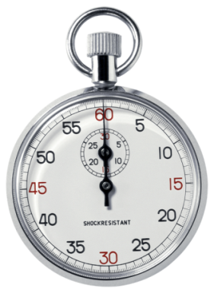
January: OSAC Subcommittee Meetings
Convened 2.5-day in-person OSAC Subcommittee meetings in Norman OK (500+ individuals)
Subcommittee tasked with producing Priority Action Reports for presentation during open SAC Meetings at AAFS
January 13-15, 2015
Chemistry/Instrumental SAC (6 subs)
Crime Scene/Death Investigation SAC (6 subs)
January 20-22, 2015
Biology/DNA SAC (3 subs)
Digital/Multimedia SAC (4 subs)
Physics/Pattern SAC (5 subs)

Slide 23
February: OSAC Public SAC Meetings: Priorities & Public Comment
Monday, February 16, 2015
Digital/Multimedia Scientific Area Committee
Crime Scene/Death Investigation Scientific Area Committee
Biology/DNA Scientific Area
Tuesday, February 17, 2015
Chemistry/Instrumental Analysis Scientific Area Committee
Physics/Pattern Interpretation Scientific Area Committee
Watch Webcast: http://www.nist.gov/forensics/osac/sac-agenda-orlando-2015.cfm

Slide 24
Feb 27th: OSAC Priority Action Plans Posted Online for All 24 Subcommittees
Sample:

Slide 25
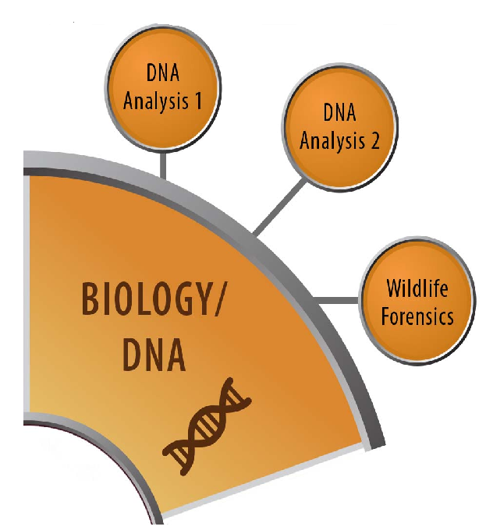
DNA 1: Discipline Description Change
Example Deliverable
The Subcommittee on DNA Analysis 1 will focus on standards and guidelines related to forensic DNA laboratory methodology.
FSSB Approved: the DNA Analysis 1 Subcommittee name and description will change to:
Biological Methods
The Biological Methods Subcommittee will focus on establishing standards and guidelines that support molecular and biochemical methods used to analyze evidence and reference items.

Slide 26
Materials Subcommittee: Standards to move Forward
Example Deliverable
Title | Organization
Standard Test Method for Forensic Comparison of Glass Using Micro X-ray Fluorescence Spectrometry | ASTM E2926
Standard Test Method for Determination of Trace Elements in Soda-Lime Glass Samples Using Laser Ablation Inductively Coupled Plasma Mass Spectrometry for Forensic Comparisons | ASTM E2927
Standard Test Method for Determination of Concentrations of Elements in Glass Samples Using Inductively Coupled Plasma Mass Spectrometry (ICP-MS) for Forensic Comparisons | ASTM E2330
Standard Test Method for the Automated Determination of Refractive Index of Glass Samples Using the Oil Immersion Method and a Phase Contrast Microscope | ASTM E1967

Slide 27
Topic 1: Trace Evidence Interpretation
Example Deliverable
Materials Subcommittee Priority
Priority Level: High
The task group focus will be to provide recommendations to the trace evidence community regarding how to interpret and describe the significance of the overall results of a comparative examination.
Task Group Name: Trace Evidence Interpretation
Task Group Chair Name: Andria Mehltretter
Task Group Chair Contact Information: andria.mehltretter@ic.fbi.gov

Slide 28
Agenda
OSAC Quality Infrastructure
OSAC Objective & Architecture
OSAC Members & Affiliates
OSAC Support from NIST & Crime Laboratories
OSAC Priorities & Public Comment Opportunity
OSAC Moving Forward

Slide 29
OSAC Moving Forward
Outreach – Continue to conduct open OSAC forums and provide presentations to stakeholder organizations
Functional Shift – Transition from infrastructure build-out to operations focusing on standards and guidelines development
OSAC Affiliates – Team up with Members on Task Groups for special projects and serve as pool for new positions and replacements
Become an OSAC Affiliate – apply online https://www.nist.gov/forensics/osac-application.cfm and be appointed to a Task Group to become an OSAC Affiliate

Slide 30
OSAC Moving Forward
May 20-21, 2015 – FSSB Meeting at DEA
July 27-28, 2015 – 3 RCs & 2 SACs at NIST
July 29-30, 2015 – FSSB Meeting at NIST
August 2-5, 2015 – Physics & Digital SACs at IAI
October 14-15, 2015 – Biology SAC at ISHI
December 1st week: ½ of OSAC Meeting?
December 2nd week: ½ of OSAC Meeting?

Slide 31
Future Subcommittees or Task Groups???
Crime Scene
Forensic Art
Polygraph
Forensic Psychiatry
Forensic Engineering
Forensic Entomology
Linguistic Evidence
Forensic Mapping
Fire Modeling
FSSB will design a process to evaluate requests to start new subcommittees $$$

Slide 32
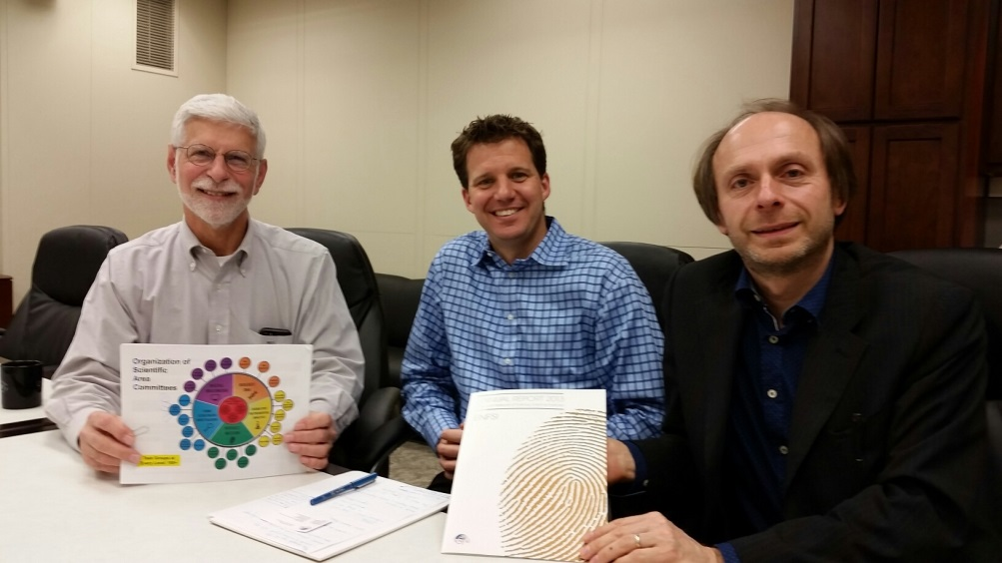
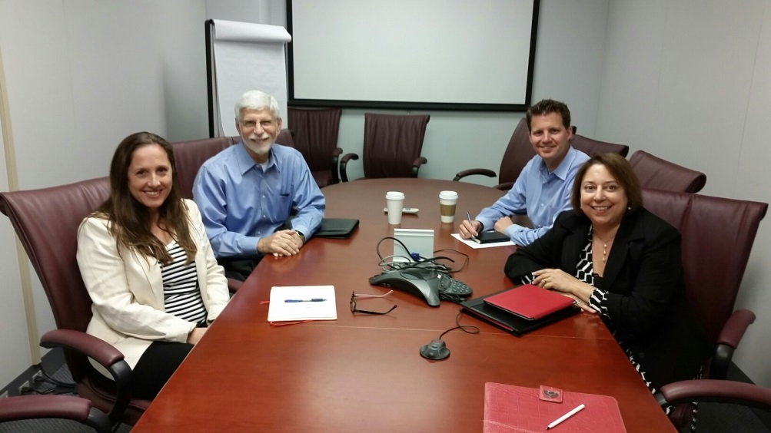
Potential for International Collaborations
OSAC & ENFSI: Jan De Kinder
OSAC & NIFS:
Dr. Linzi Wilson-Wilde
INSERT IFSA Photo Here

Slide 33
OSAC Vision
How OSAC activities COULD affect the courtroom in 5-10 years? *
Forensic Science practitioners embrace change
OSAC Forensic Registries of Standards and Guidelines become implemented in the practice of forensic science across all forensic disciplines in addition to DNA
Prosecutors, defense attorneys and judges begin to use the Registries of Standards and Guidelines in direct and cross examinations of expert witnesses
Judges and Juries routinely hear witnesses testify about how their analysis met current standards and scientific validity and openly describe the limitations of the tests in general and their interpretations in the specific case
Significant forensic science research is finally well organized and well funded with influence from OSAC to define research priorities
Standards enforcement by accrediting bodies finally becomes the rule rather than the exception

Slide 34
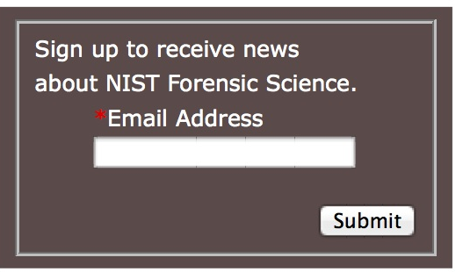
Stay Informed
How can I be notified of latest OSAC announcements or when standards are open for public comment?
www.nist.gov/forensics
Insert your email address
Where are the latest publicly available OSAC materials?
OSAC Homepage: http://www.nist.gov/forensics/osac/index.cfm
OSAC Library: https://workspace.forensicosac.org/kws/public/documents?view=all-documents

Slide 36
Questions?
Mark D. Stolorow
Director for OSAC Affairs
NIST
100 Bureau Drive, Mailstop 8102
Gaithersburg, MD 20899
301-975-2754
mark.stolorow@nist.gov
Jeremy Triplett
FSSB Chair
Kentucky State Police Central Forensic Laboratory
100 Sower Blvd., Suite 102 Frankfort, KY 40601
502-564-5230
jeremy.triplett@ky.gov
www.nist.gov/forensics

Slide 37
What is the Code of Practice?
Documents the minimum requirements for:
Standards and guidelines used in forensic science
Accreditation of laboratories and investigative units supplying forensic science services
Discipline specific requirements to supplement international standards developed in a consensus
Competencies of forensic science practitioners
Implemented in forensic science service organizations’ management systems

