Slide 1
DNA Mixture Interpretation Study: Inter- and Intra-laboratory Variation
Roman Aranda IV¹, Emily Rogers¹, Karl Mereus¹, Phillippa Spencer²,
and Rick Tontarski¹
Office of the Chief Scientist
ASCLD, 28 April 2015
1
2
Notes:
Asterisk(*) presenting authors when appropriate

Slide 3
Mixture Study Structure
Preliminary Results
Variation Illustrated via GIM and AM
Path Forward:
DNA Examiner Assessment Tool (DEAT)

Slide 4
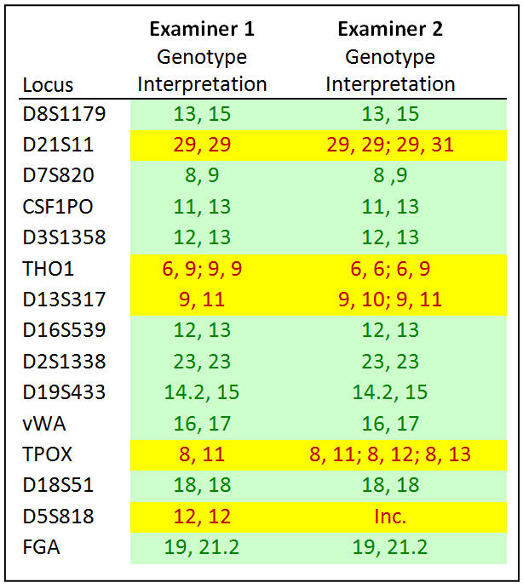
DFSC Mixture Study
Purpose:
To assess the inter- and intra-laboratory variation in DNA examiners’ generated genotype interpretations
To better understand the current state and potential limitations of mixture interpretation in the forensic community

Slide 5
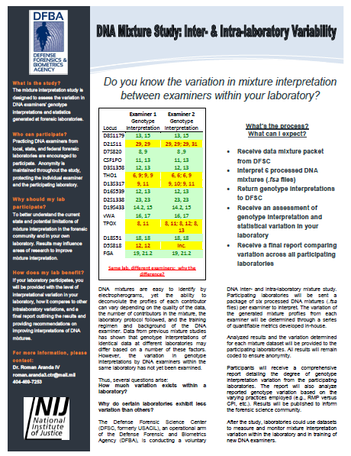
Participation:
Initiated Summer 2014
183 examiners
55 forensic laboratories

Slide 6
Study Datasets:
Examiners asked to interpret 6 mixtures:
All examiners received identical 6 mixtures
Used their laboratory’s SOP
Stochastic and analytical thresholds set by DFSC
Genotypes recorded on Excel-based worksheet provided
User assessment form

Slide 7
Metrics: GIM + AM
Genotype Interpretation Metric: GIM
Allelic Match:
0
0.5
1
Known | Generated | ATM | AFM | Inc
11, 12 | 11, 12 | 2 | 0 | 0
 | 11, Any | 1 | 0 | 0
 | 11, 13 | 1 | 1 | 0
 | 10, 13 | 0 | 2 | 0
 | Inc. | 0 | 0 | 2
Combinations
+ Anys
Inconclusive
Exact Match
How many answers did I provide at each locus?
Did my genotypes include the “correct answer”?

Slide 8
DEAT: DNA Examiner Assessment Tool
Automated program analyzes returned genotypes
Uses worksheet template
Calculates GIM/AM metrics

Slide 9
GIM Box Plots
= Median
= 25–75 Percentile
GIM
= Statistical Max/Min Distribution
= Outliers
Locus, Mixture, etc.

Slide 10
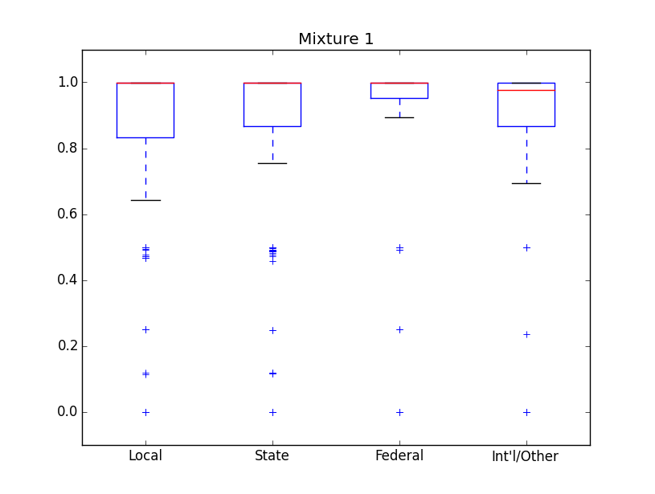
Mixture 1: 3.5:1, 2-person
Major and Minor Combined
GIM
Local State Federal Int’l/Other
Region

Slide 11
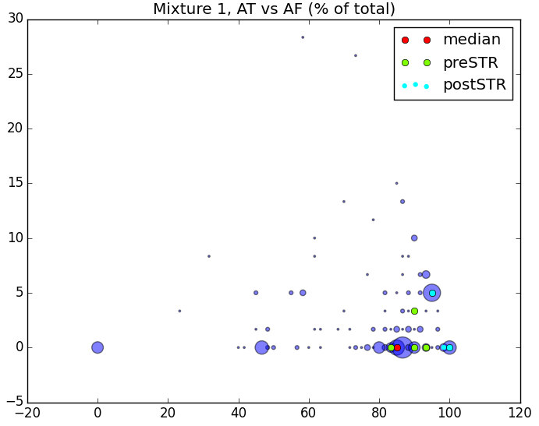
Mixture 1: 2-person, 3.5:1
All Examiners
Plotted Individually
Major and Minor Combined
Median
Method 1
Method 2
AF %
AT %

Slide 12
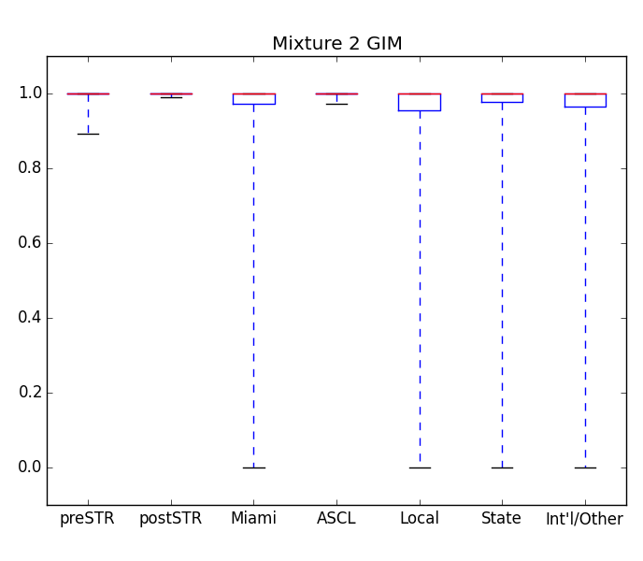
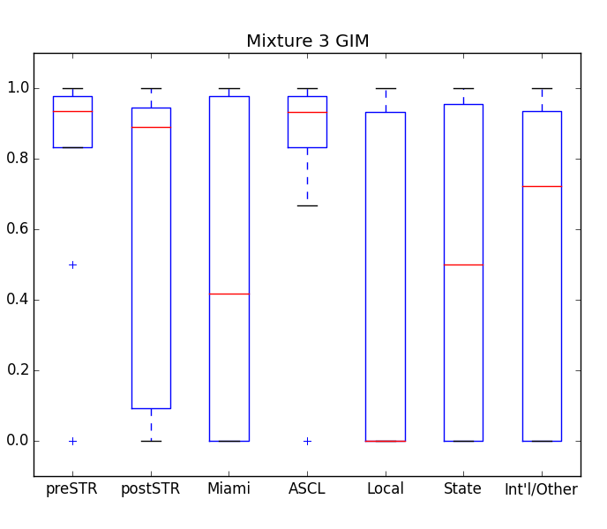
Mixture 2 & 3: 2:1, 2-person
Major and Minor Combined
2:1, w/ Ref
2:1, w/o Ref
GIM
Method 1 2
B C D E F
Method 1 2
B C D E F
Lab A
Lab A

Slide 13
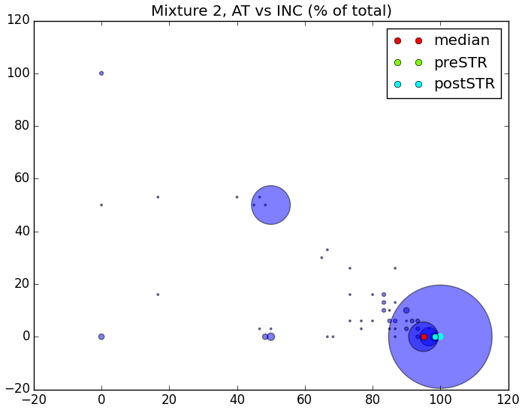
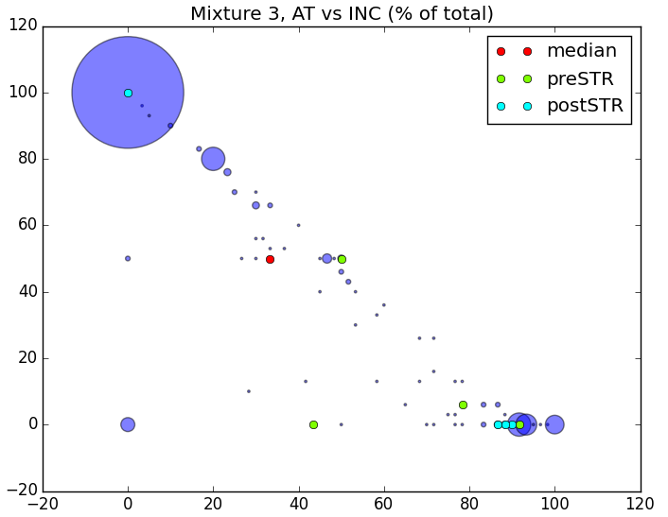
Mixture 2 & 3: 2:1, 2-person
Major and Minor Combined
2:1, w/ Ref
2:1, w/o Ref
Median
Median
Method 1
Method 1
Method 2
Method 2
Inc %
AT %
AT %

Slide 14
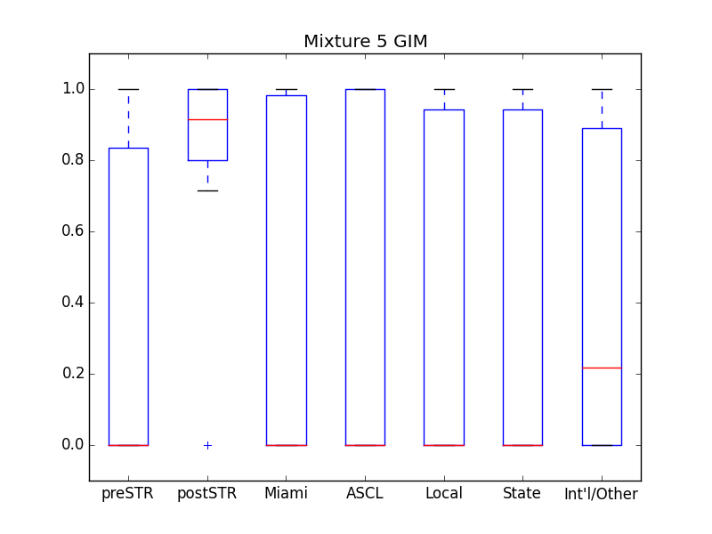
Mixture 5: 3-person, 4:1:1 w/ Ref
GIM
Method 1 Method 2
B C D E F
Lab A

Slide 15
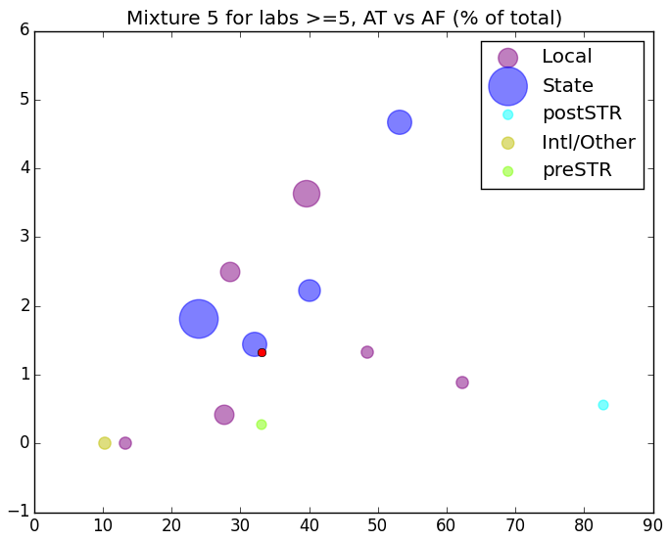
Mixture 5: 4:1:1 w/ ref (Major)
Major and Minors Combined
Method 2
Method 1
AF %
AT %

Slide 16
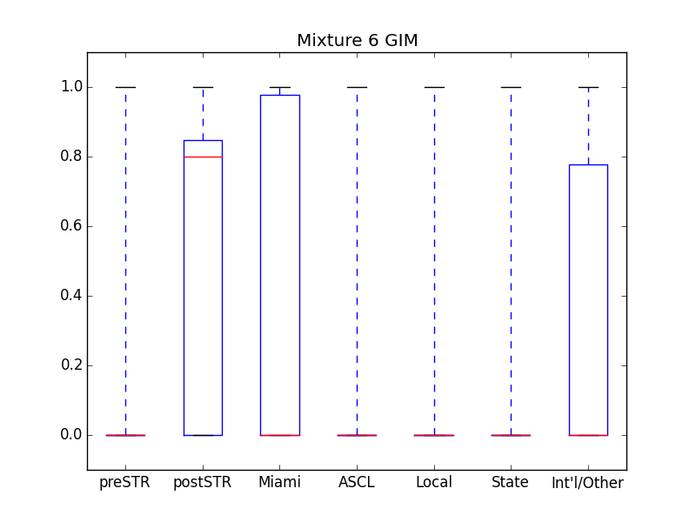
Mixture 6: Box Plot
GIM
Method 1 Method 2
B C D E F
Lab A

Slide 17
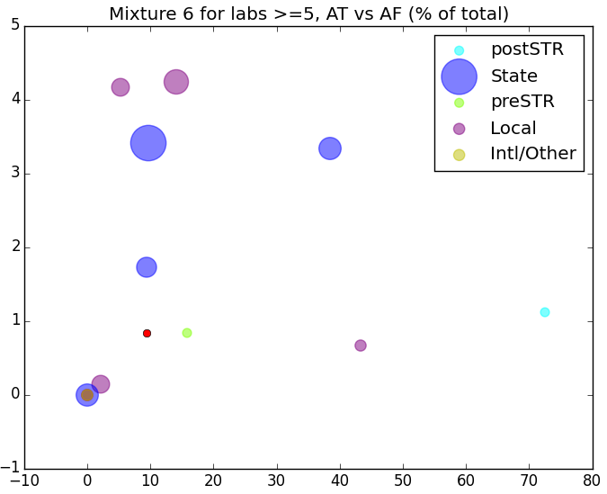
Mixture 6: 3-person, 1:1:1
Major and Minors Combined
Method 2
Method 1
AF %
AT %

Slide 18
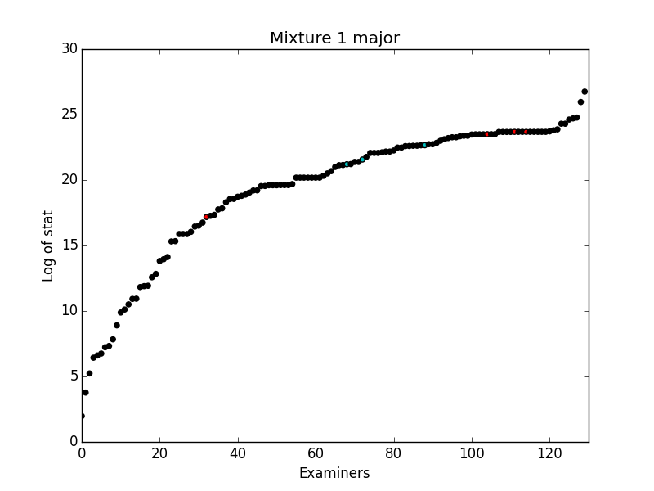
Final Stat: 3.5:1, 2-person, Major
25
~75% of examiners
reported
log (fs)
Lab A
Lab B
5
Examiner

Slide 19
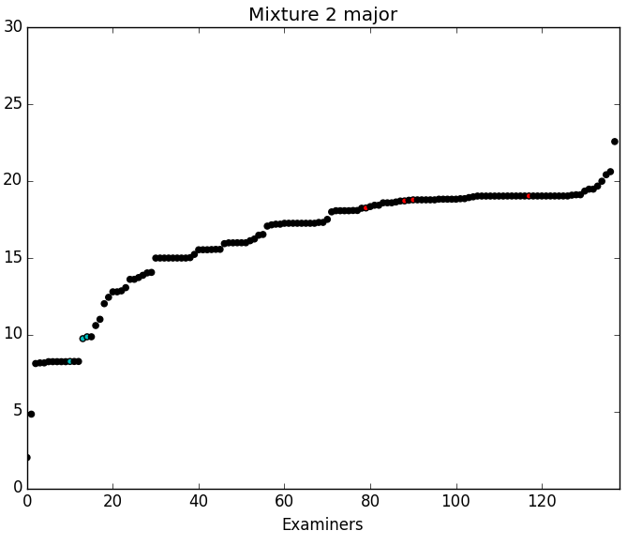
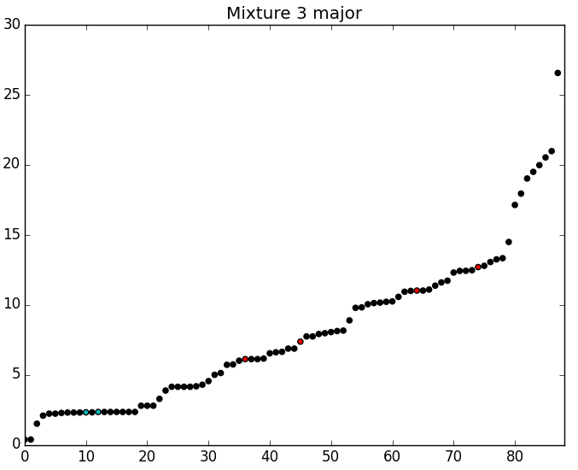
Final Stat: 2:1, 2-person, Major Contributor
w/ Ref
w/o Ref
20
20
log (fs)
Lab A
Lab B
Lab A
Lab B
5
5
Examiner
Examiner
~75% of examiners reported
~50% of examiners reported

Slide 20
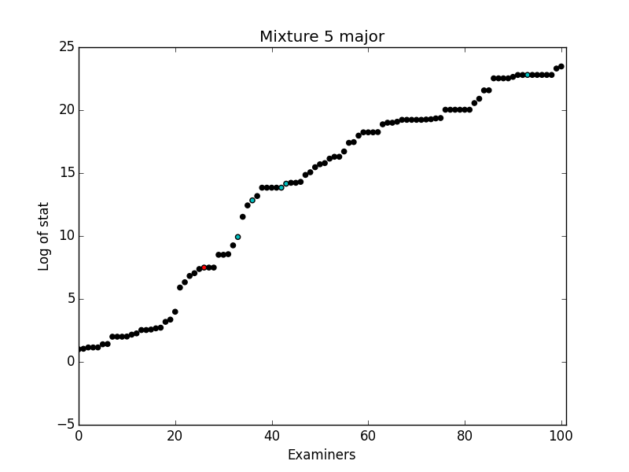
Final Stat: 4:1:1, 3-person w/ Ref, Major
25
~55% of
examiners
reported
log (fs)
Lab A
Lab B
0
Examiner

Slide 21
Laboratory Use of DEAT

Slide 22
Benchmarking
3
Interpretation rate
Variation
Deconvolution
2
GIM
1
Mixture

Slide 23
Examiner Assessment
Training of new and existing DNA examiners:
Within Δ range
Minor Δ: review/retest?
Major Δ: retrain?
1
GIM
2
3
Training/Proficiency Tests

Slide 24
Examiner Assessment
Training of new and existing DNA examiners:
Within Δ range
Minor Δ: review/retest?
Major Δ: retrain?
Simulate whether those errors would still produce a match/hit
3
AF%
2
1
AT% or GIM

Slide 25
Large variation in examiner generated genotypes:
Within and between laboratories
Variation in interpretation methods
Creation of DNA Examiner Assessment Tool: quantify and assess changes via GIM and AM
Potential use of metrics in DNA laboratories
Benchmarking, training, and proficiency tests

Slide 26
Roman Aranda IV
Research Scientist
Office of the Chief Scientist
CTR, A-T Solutions
roman.aranda3.ctr@mail.mil

